Slide 1

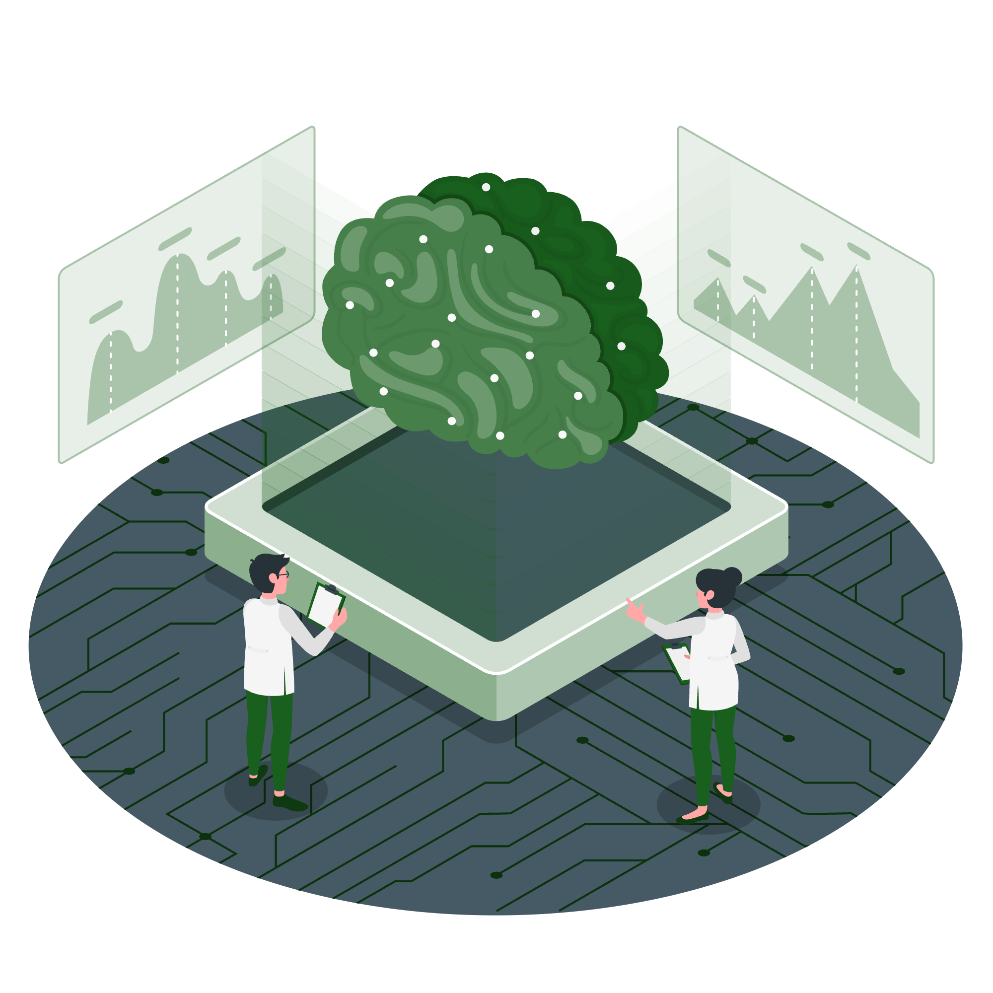

Agentic AI in Research: Community Solutions for Data Challenges
Connie Clare, RDA Global
connie.clare@rda-foundation.org
Trish Radotic, RDA Oceania & East Asia
trish.radotic@rda-foundation.org
Thursday 12 February 2026, 16:00-16:45 UTC
RDA webinar as part of Love Data Week 2026: Where’s the Data?

Slide 2
Housekeeping
🔴 Recording in Progress​
This session is being recorded and presentations will be published online.​
🔇 Keep Your Mic Muted​
Please mute yourself to minimise background noise.​
📸 Cameras On Appreciated​
We'd love to see your face! Please keep your camera on if possible.​
🤝 Respectful Dialogue – RDA's Code of Conduct​
Listen openly and respect all perspectives shared.
❓Q&A at the end
Please write any questions you have in the chat during the session
📝 Questions or comments? Contact hilary.hanahoe@rda-foundation.org​
Notes:
Code of conduct
Mute if your are not speaking
Write your question in the chat - Irina can read them out

Slide 3

Today’s Agenda
About the RDA 🌎
Vision, Mission and Guiding Principles
Membership
Community Groups
Recommendations and Outputs
RDA and Artificial Intelligence 🤖
  Previous Activities
  Agentic AI Consultation
  Key Opportunities and Challenges
  Future Work

Slide 4

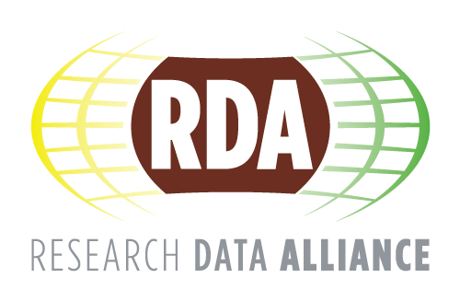




16,000+ members
About the RDA
150+ countries
The RDA is an international member-based organisation focused on the development of infrastructure and community activities that reduce barriers to data sharing and
accelerate data-driven innovation worldwide.
Researchers, scientists,
data professionals
Different disciplines, domains, thematic fields
📊 See More Community Statistics

Slide 5










Guiding Principles
RDA Values
Openness
Vision
Consensus
Researchers and innovators openly share and reuse data across technologies, disciplines, and countries to address the grand challenges of society.
Inclusivity
Harmonisation
Mission
Community-driven
The RDA builds the social and technical bridges that enable open sharing and reuse
of data.
Non-profit &
technology-neutral
How the RDA works

Slide 6



Membership
INDIVIDUALS
16,000+
ORGANISATIONS
90+
REGIONS
35+
  A strategic ‘think tank’ to enhance
  constructive dialogue and
  collaboration on data related
  topics, and to present the latest
  research results in many areas.
  A forum where organisational
  representatives directly
  interact and collaborate to
  develop and implement solutions
  and best practices.
A global perspective to assist in sharing best practices, experiences and common needs to achieve efficiency and reduce duplication of efforts.
Collaborate in groups and generate outputs
Adopt, implement and
customise outputs
Localise (linguistically and culturally) and network
Members Directory
Organisation Directory
Regional Groups

Slide 7






MEMBER BENEFITS
  JOIN FOR
  FREE
The value for members
  Contribute to acceleration of
  data infrastructure
  developments
  Become part of the global
  community and expand your
  professional network
  Create, access and adopt
  RDA Recommendations
  and Outputs
Become a member
  Receive regular updates
  on the work of the
  RDA community
  Gain expertise in data-related
  topics regardless of
  career stage
  Participate in community
  events, including webinars,
  workshops and Plenaries

Slide 8
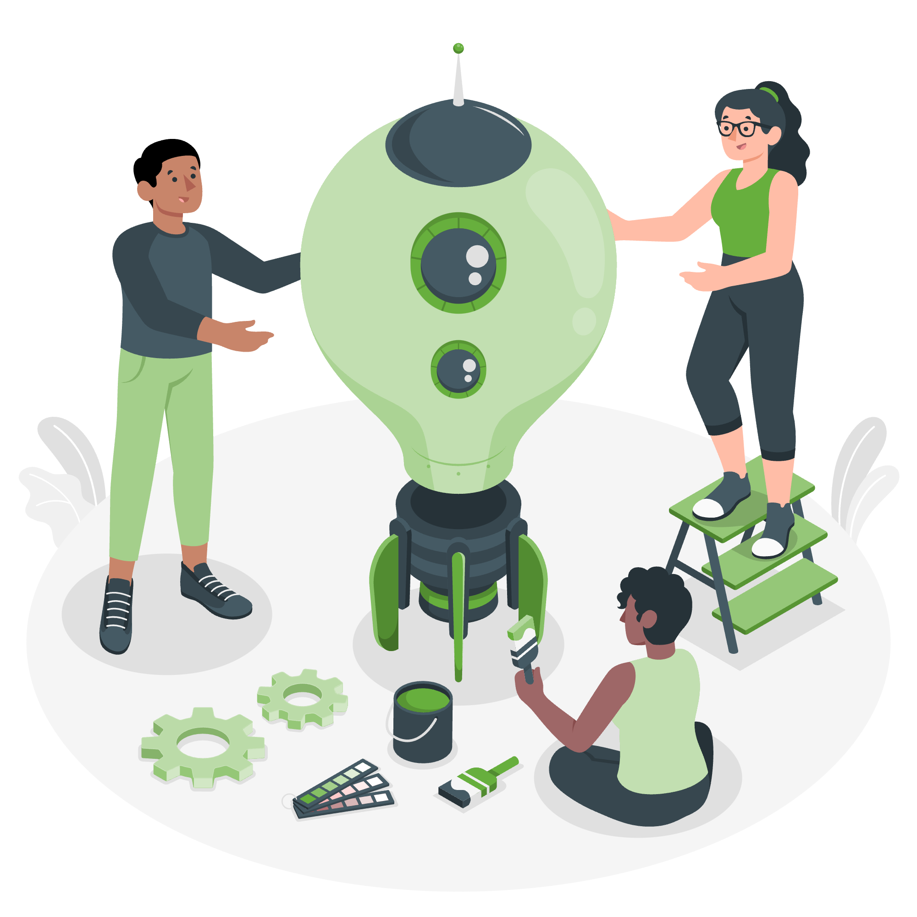


Community Groups
  112
  GROUPS
WORKING GROUPS (WG)
47
INTEREST GROUPS (IG)
63
COMMUNITIES OF PRACTICE (CoP)
2
  Develop tools, policies, practices and products for data that are adopted by projects, organisations and communities. Lifespan: 12-18 months.
  Focus on solving a specific data
  sharing problem and identifying
  what kind of infrastructure needs to
  be built. Lifespan: As long as
  group is active.
‘Umbrella groups’ that focus on a domain / discipline and have a coordination and awareness raising role. Lifespan: As long as CoP is active (review every 18 months).
RECOMMENDATIONS:
Concrete deliverables (e.g., running code, tools, standards)
OUTPUTS:
Best practices, guidelines,
new WGs.
OUTPUTS:
New WGs and IGs, bridge building across the RDA and externally.
All Working Groups
All Interest Groups
All Communities of
Practice

Slide 9
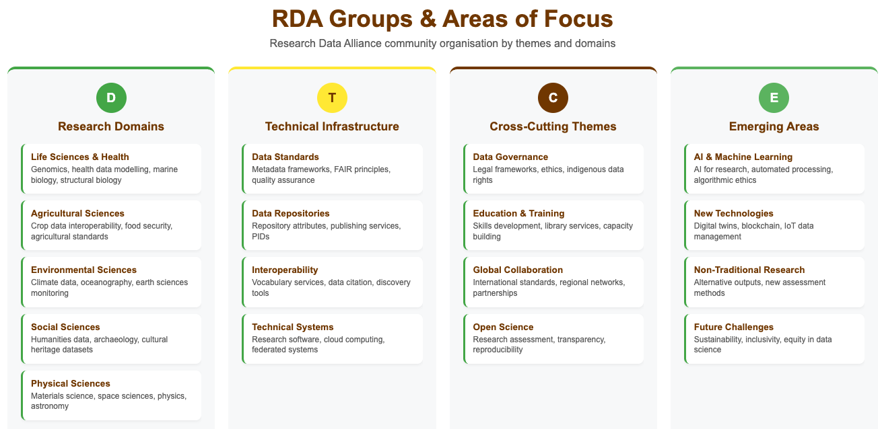
Group Directory
Infographic generated with assistance from Claude.ai (Anthropic)

Slide 10
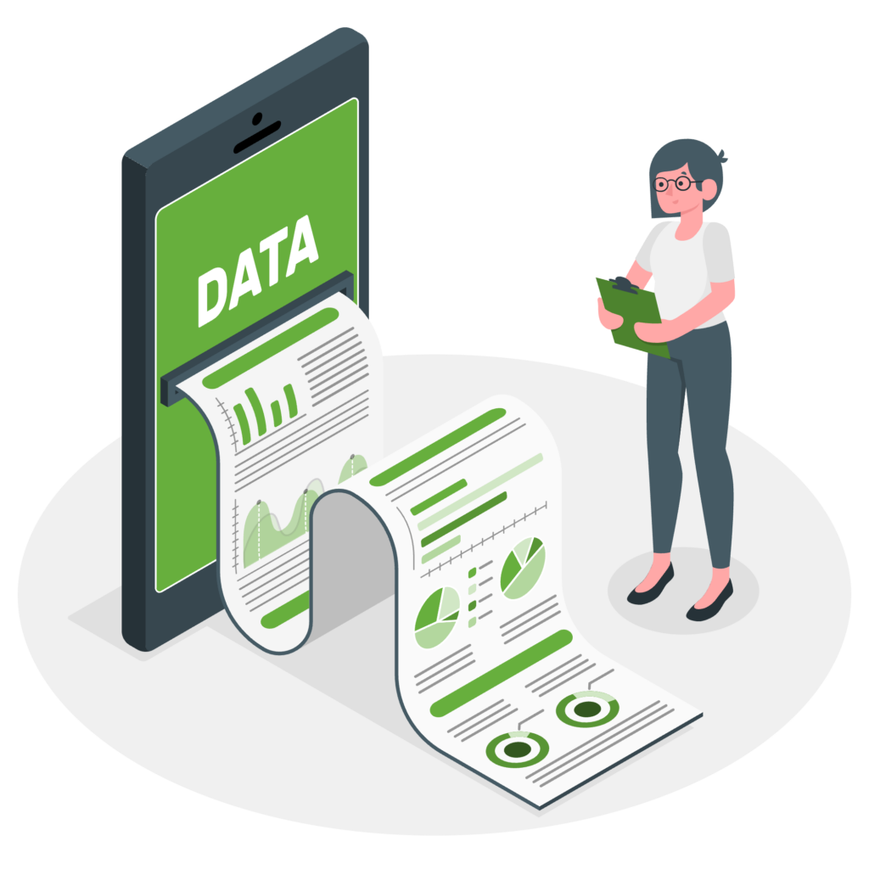


Recommendations and Outputs
RECOMMENDATIONS
43
SUPPORTING OUTPUTS
50
OTHER OUTPUTS
32
  RDA’s flagship outputs and the equivalent of ‘specifications’ or ‘standards'. Recommendations are reviewed by the RDA community, endorsed by Council and adopted by organisations.
  Useful solutions from RDA groups
  that serve to educate and inform,
  but they may not be as clearly
  adoptable by organisations. These
  outputs undergo community review.
Examples include workshop reports, published articles, survey results, etc. produced by RDA groups. Upon request by the groups, these outputs are posted on the RDA website but have no level of endorsement.
All Recommendations
All Supporting Outputs
All Other Outputs
INCLUDING 8 ICT TECHNICAL SPECIFICATIONS

Slide 11
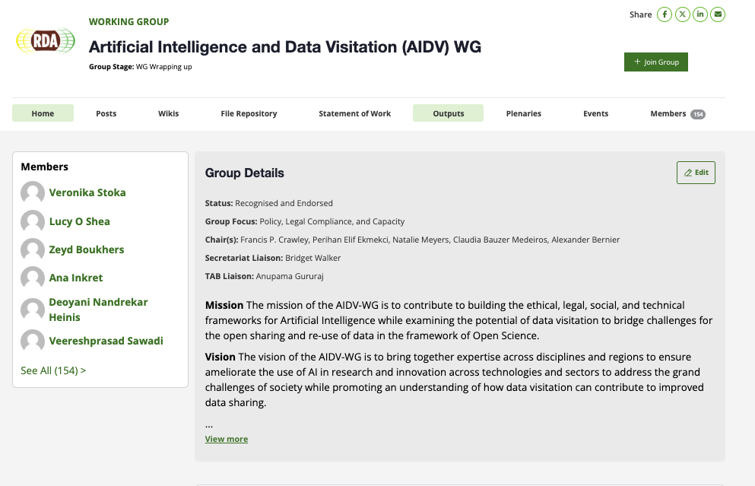
Getting Involved in a Group
https://www.rd-alliance.org/group-directory/

Slide 12
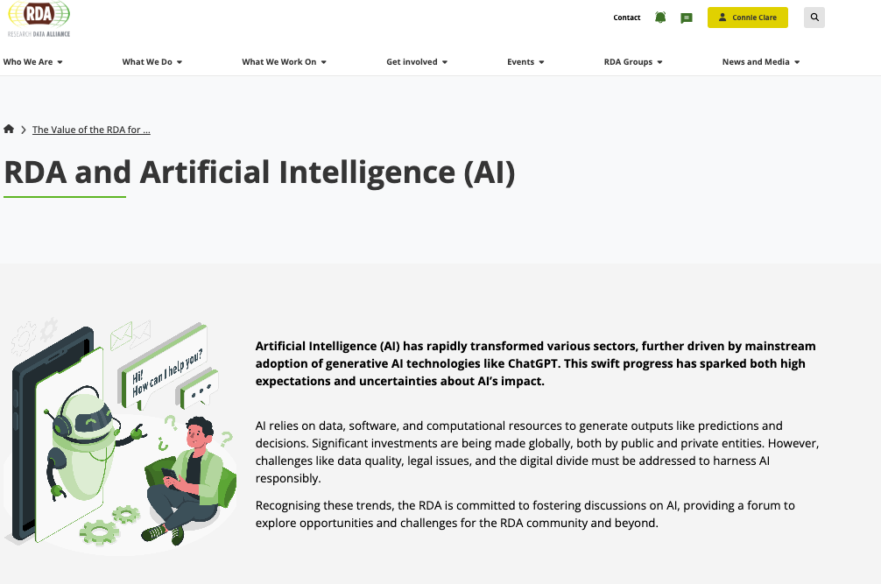
RDA and Artificial Intelligence
🌐 https://www.rd-alliance.org/value_rda/rda-and-artificial-intelligence/
Dedicated webpage
Projects, Activities
Resources
Events
Community Experts
Future Work
RDA Groups
Notes:
Might not need opening slide

Slide 13
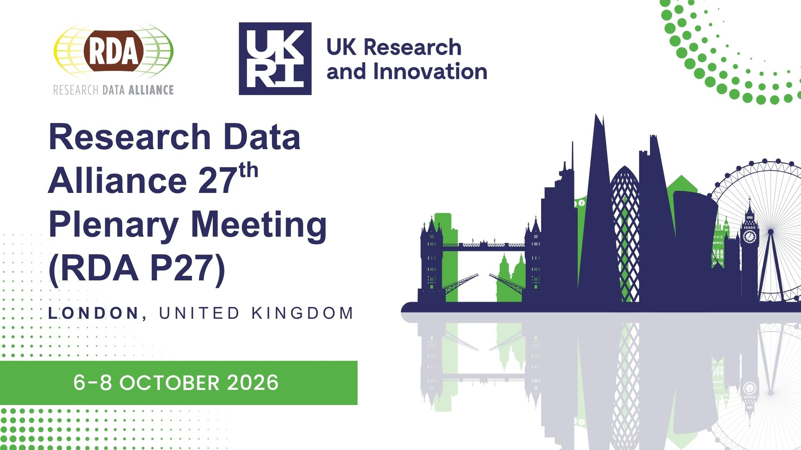
AI-Related RDA
Groups and Activities
Groups
Artificial Intelligence and Data Visitation WG
FAIR Run Time Environments WG
FAIR4ML IG
Computational Modelling of Health Data WG (Not yet endorsed)
BoFs - Newly Emerging Topics of Interest
Is FAIR FAIR? A discussion of the overlaps in the FAIR principles of data management and AI-Readiness
(P19, IDW2022)
Documenting LLM Interactions throughout the Research Data lifecycle (P25, IDW2025)
Autonomous agents at the gate: accelerating data visitation (P26)
🌐 Join VP26 and P27
Notes:
Add the link to the upcoming Plenary - P27 will be in London
Examines ethical, legal, and social challenges of AI and data visitation in Open Science
Computational Modelling of Health Data - Focuses on improving reproducibility, transparency, and accessibility of computational models in health research
FAIR Run Time Environments - Works on making runtime environments findable, accessible, interoperable, and reusable

Slide 14
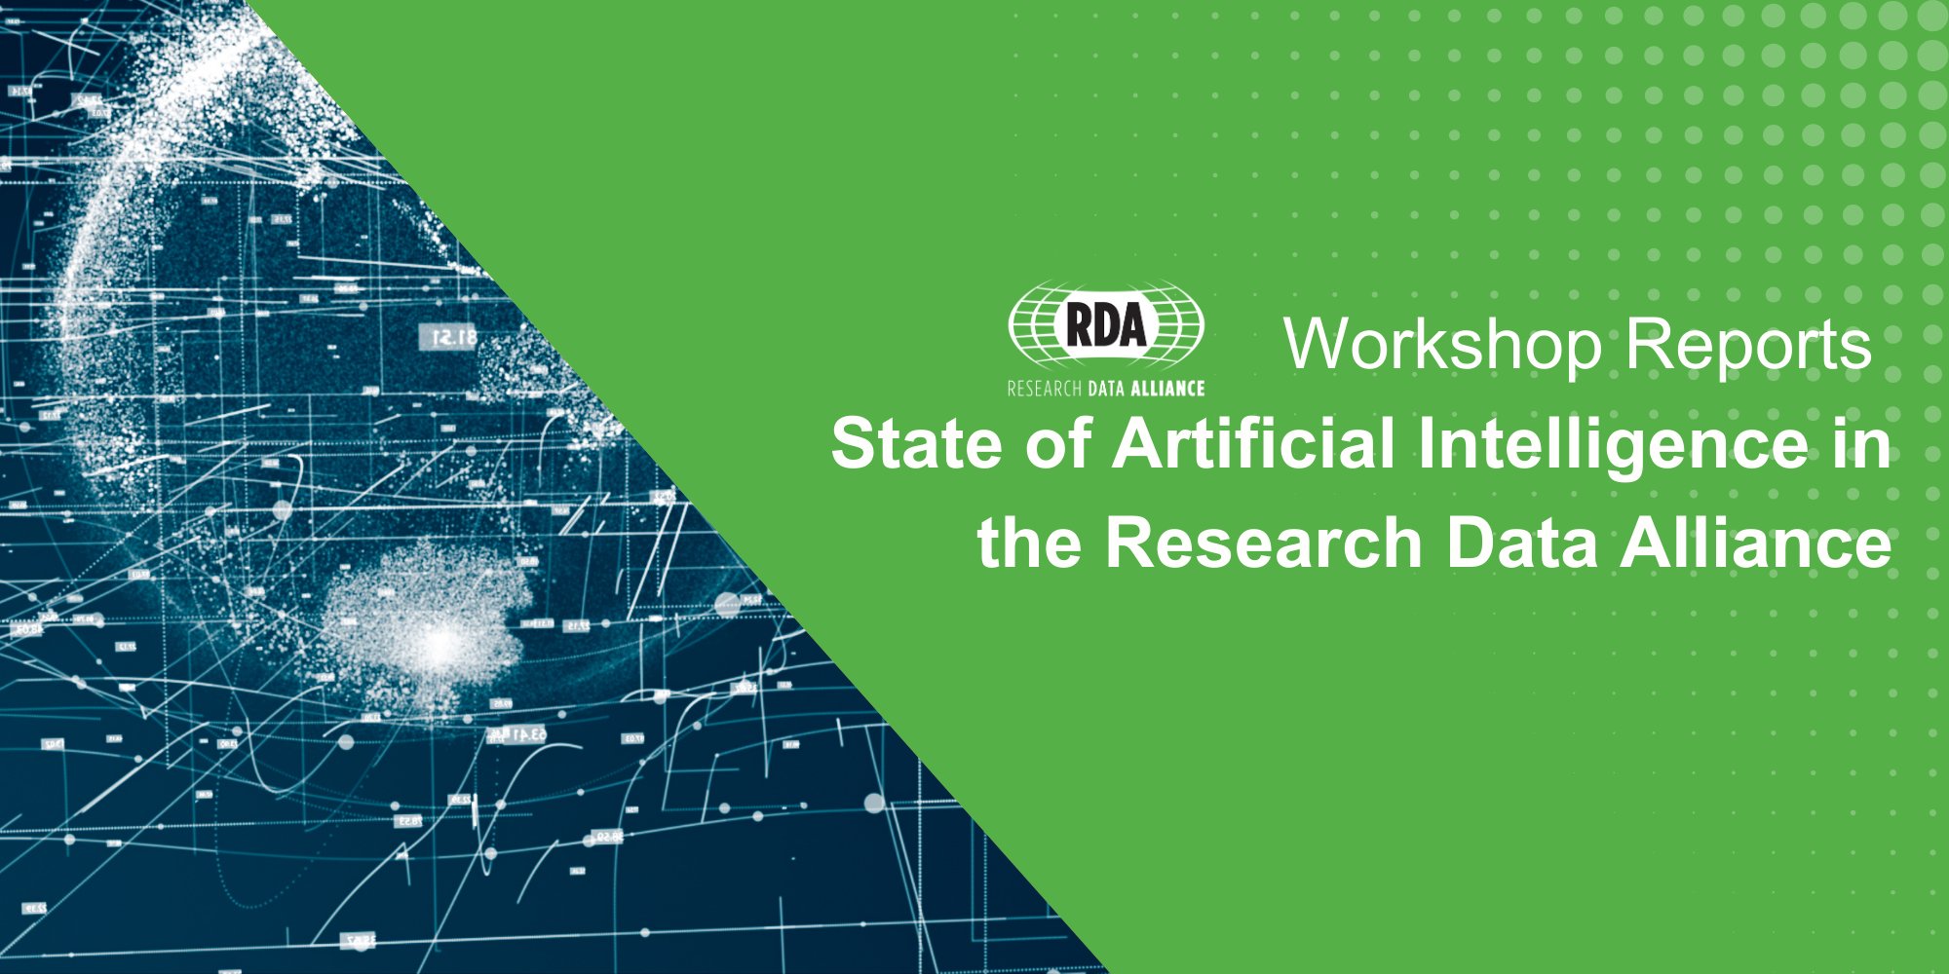
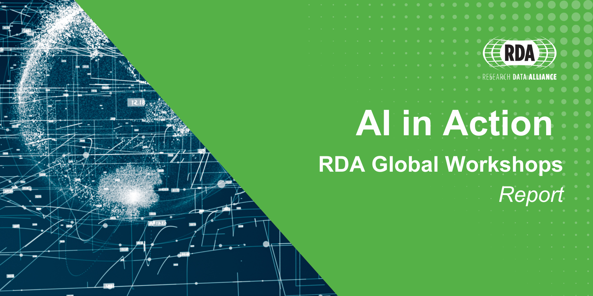
Previous Activities
STATE OF AI
RDA community members shared perspectives on AI's opportunities and challenges, focusing on data, software, and computational needs for responsible innovation.
Report and Summary
SEPTEMBER 2024
AI IN ACTION
Nine speakers across Europe, Asia, Australia demonstrated practical AI implementations, exploring reproducibility challenges.
Outcome: recommendations and plans for future initiatives.
Report
FEBRUARY 2025
Notes:
STATE of AI
AI in Action - examples of talks

Slide 15

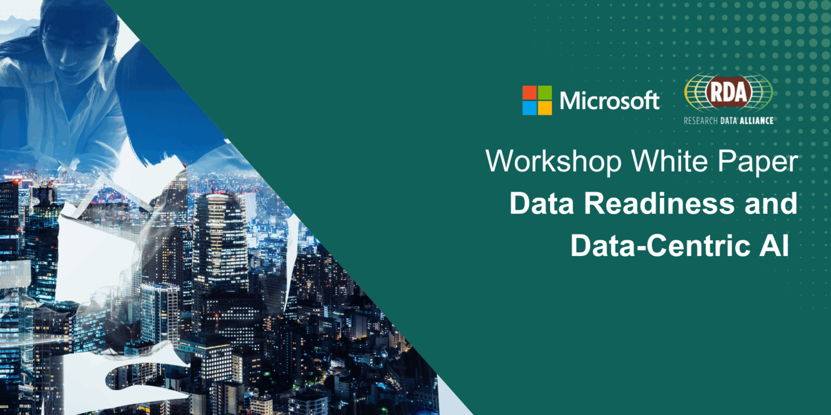

Previous Activities
🌐 In Accordance with the Public-Private Partnership Framework
RDA-MICROSOFT ROUNDTABLE
Determine how researchers prepare data for AI and develop skills for AI-driven research.
White Paper and Summary Slides showcasing community dialogue, practical frameworks and best practices.
MAY 2025
SEPTEMBER 2024
RDA-MICROSOFT ROUNDTABLE
Determine how emerging technologies transform research capabilities.
White Paper and Summary Slides showcasing community dialogue, practical frameworks and best practices.
JUNE 2025
FEBRUARY 2025

Slide 16
Community Need Identified:
RDA-MICROSOFT ROUNDTABLE
Community recommendation to invest in automated data preparation tools, robust metadata standards, and dedicated stewardship roles to enhance data readiness.
Agentic AI emerged as top area of interest and skilling need.
SEPTEMBER 2024
MAY 2025
JUNE 2025
FEBRUARY 2025

Slide 17
Agentic AI in support of Science and Research
How is the research community currently using agentic AI?
What needs and challenges exist?
Where could agentic AI have the greatest impact?
Global community consultation on agentic AI in research
  Autonomously assist with research tasks from data analysis to publication
  Accelerate research, lower costs and democratise access to tools
November 2025: Survey and online information sessions
December 2025: Open report
2026 onwards: Open technology-agnostic blueprint for priority AI agent
🌐 https://www.rd-alliance.org/value_rda/rda-and-artificial-intelligence/global-community-priorities-for-agentic-ai-development/

Slide 18
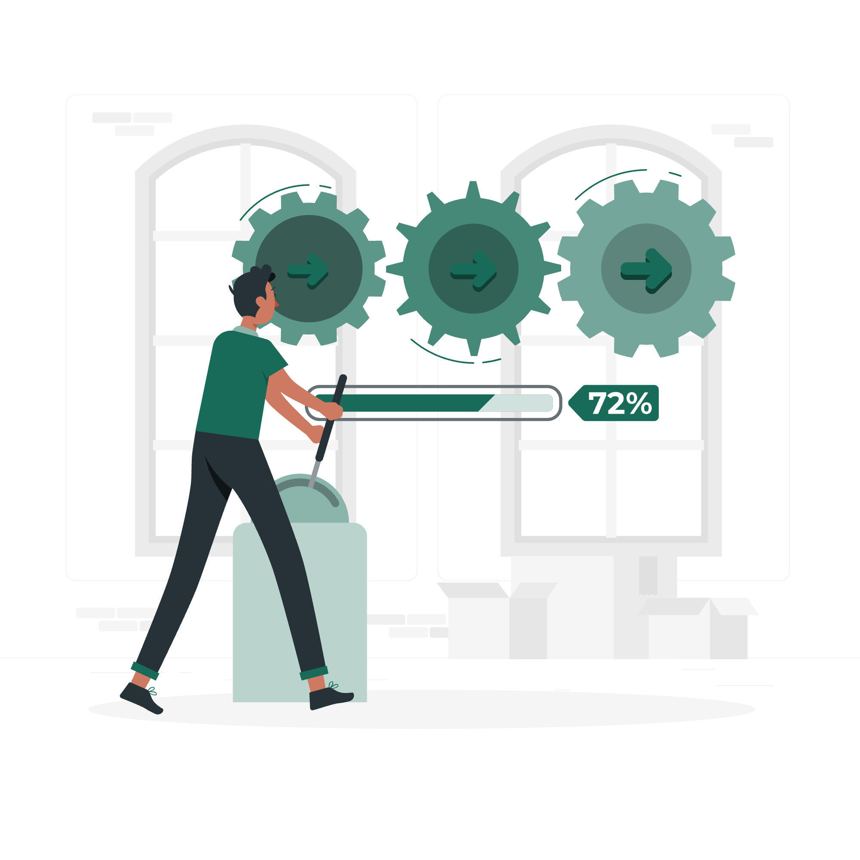
What is Agentic AI*?
Agentic AI refers to artificial intelligence systems that possess autonomy, goal-directed reasoning, and the ability to act independently with minimal human oversight. In contrast, traditional AI typically responds to direct prompts.
*This definition is used for the purposes of the global community consultation on Agentic AI in Research. We recognise that the broader community may hold different definitions, perceptions, and understandings of Agentic AI.

Slide 19
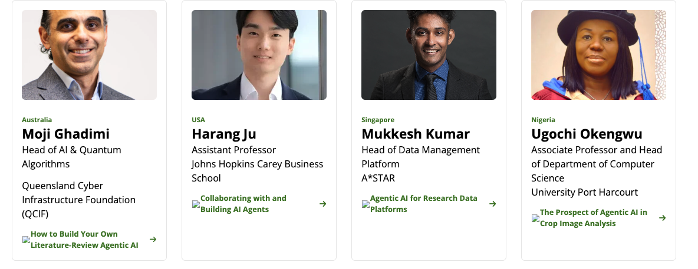

Information Sessions
Four 45-minute online information sessions across different time zones
190 registrants, 70 participants, 33 countries and 6 continents
Open to all research stakeholders regardless of AI expertise
Live polling (Mentimeter) captured real-time feedback on needs, concerns and priorities
Featured 5 expert speakers: AI agents, literature review tools, crop analysis, research data platforms
United Kingdom
Ryan Payton
Research Technology Strategist
Higher Education team
Microsoft UK
Agentic AI in the
Research Lifecycle
📹 Slides and recordings
Notes:
Watch the recordings link to the page

Slide 20
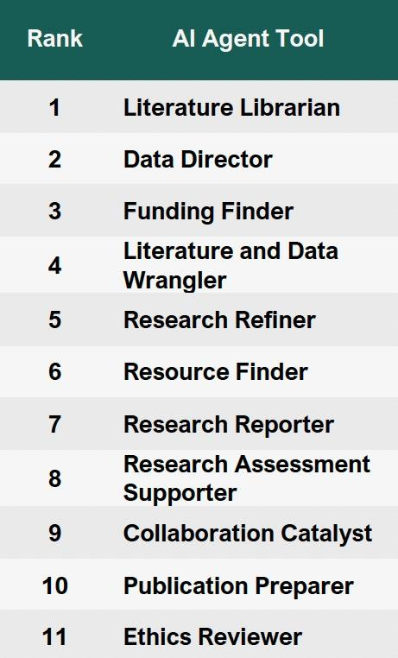
Community Survey
TOP 3 PRIORITY
15-minute anonymous survey open throughout November
83 complete responses from 25 countries
~60% RDA members, ~40% non-members
Largest group: Researchers & Scientists (~40%)
~90% had used AI/ML tools
55% had not used agentic AI systems specifically
🎯 Evaluated 11 proposed agentic AI tools
across research lifecycle stages*
*Extended Microsoft’s previous engagement with over 50 research institutions (United Kingdom) that identified eleven potential agentic AI tools of use throughout the research lifecycle.

Slide 21
The Research Lifecycle
📑 Report
Literature Librarian
Natural language literature searching
Integration with library subscriptions to access articles both open access and behind paywalls
3
Funding Finder
Scan funding databases to match calls with your ideas
Provides the template for your application and ensures you meet the guidelines
Improvements/critiquing based on prior successful applications from the university
1
Literature and Data Wrangler
Scan the literature for gaps in knowledge/research
Identify overlap of ideas with the literature to avoid repetition/encourage reuse of existing data
Identify internal datasets which could be relevant and useful for a new project
New research idea
Ethics Reviewer
Offers potential ethical issues for project proposals
Provides guidance on meeting ethics requirements based on guidelines and prior ethics board decisions
Formulating new research questions
Planning research and applying for funding
Resource Finder
Takes a researcher’s goals and surfaces university services available to help
Linked to lab facilities, IT infrastructure, RSEs, seminar groups, internal funding, etc…
Research Assessment Supporter
Researchers: taking information and preparing it into an appropriate format template
Institution: collecting information from researchers and preparing it to a template
2
Reporting on research output and impact
Conducting research activities
Data Director
Automatic metadata creation, ensuring FAIR and FAIR2 principles are followed
DOI minting
Provides guidance on where the data should be stored to be compliant
Collaboration Catalyst
Suggests internal colleagues to work with on specific challenges based on their profiles
Surfaces dataset and facility owners who could collaborate on a project idea
Research Reporter
Population of Researchfish/new solution based on provided information
Research Refiner
Critical discussion of data presentation to improve communication quality
Translation of research literature and figures for a specified audience – domain researcher, broad researcher or public
Presenting research
Publishing research
Publication Preparer
Identifies appropriate journals and special collections for your work
Ensures your work is in scope, reducing rejection rate
Provides appropriate journal templates and rewrites content to meet guidelines
Generate evidenced novelty statements for editors
Notes:
https://www.rd-alliance.org/news/global-community-priorities-for-agentic-ai-in-research-consultation-results-available/

Slide 22

Key Opportunities of Agentic AI
Automation and efficiency - Augments human capability, accelerates research processes, reduces time and cost
Reduces administrative burden - Addresses pain points in metadata creation, compliance checking, literature searching, proposal formatting
Democratises access to support - Valuable for smaller organisations without adequate support services
Navigates complex ecosystems - Helps researchers find funding opportunities, literature, and appropriate data repositories
Improves standardisation and quality - Reduces human error, enhances consistency in metadata and data management (FAIR principles)
Notes:
Automation and efficiency gains - AI as supportive team member augmenting human capability, accelerating research processes and reducing time spent on administrative tasks across the research lifecycle
Reducing administrative burden - Address pain points researchers find valuable but prefer not to spend time on (metadata creation, compliance checking, literature searching, proposal formatting)
Democratising access to support - Particularly valuable for researchers at smaller organisations without adequate support services, providing capabilities previously available only to well-resourced institutions
Navigating complex ecosystems - Help researchers navigate scattered funding opportunities, vast literature databases, and data repository requirements more effectively
Standardisation and quality improvement - Reduce human error, improve consistency in metadata creation, compliance checking, and data management following FAIR principles

Slide 23

Key Challenges of Agentic AI
Accuracy and trust deficits - AI hallucinations, errors requiring constant verification, inability to handle nuance
Transparency and explainability gaps - Understanding how models work, defending processes; potential to misrepresent data or stifle innovation
Loss of research skills and critical judgement - Reduced hands-on interaction may diminish abilities to justify conclusions and maintain research competencies
Human oversight imperative - Human-in-the-loop crucial for responsible oversight, especially ethics and sensitive data; error propagation risks
Infrastructure and equity barriers - Institutional policies, library contracts, IT protocols; unequal access, vendor lock-in, sustainability concerns
Notes:
Accuracy and trust deficits - AI hallucinations, errors requiring constant verification, lack of reliability, and inability to handle nuance raise fundamental questions about verifying results and establishing trust
Transparency and explainability gaps - Understanding how models work and defending research processes; potential for AI to misrepresent data or enforce 'buzzwords' that stifle innovation
Loss of research skills and critical judgment - Reduced hands-on interaction with data may diminish researchers' abilities to justify conclusions, develop critical thinking, and maintain essential research competencies
Human oversight imperative - Human-in-the-loop crucial for responsible oversight, particularly for ethics and governance with sensitive data; error propagation through automated lifecycle poses serious risks
Infrastructure and equity barriers - Questions about institutional policies, library contracts, campus IT protocols; unequal access, vendor lock-in, sustainability concerns, and whether agentic AI is necessary vs. simpler solutions

Slide 24
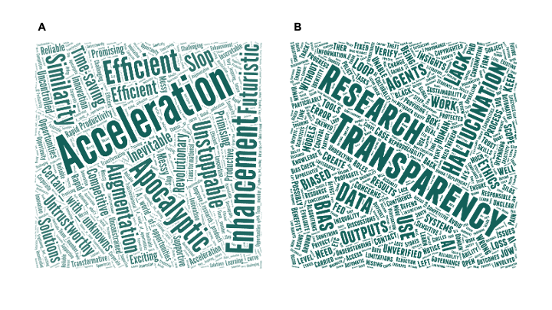
Future Work
The valuable insights from this consultation will guide the next phase of work in 2026
Collaborative community development of an open, technology-agnostic blueprint for a priority agentic AI tool.
This work will be executed with the framework of the RDA and adhere to the RDA Guiding principles.
Get Involved – 📩 Connie Clare (connie.clare@rda-foundation.org)

Slide 25
Hilary Hanahoe
Secretary General
hilary.hanahoe@rda-foundation.org
Connie Clare
Community Development Manager
connie.clare@rda-foundation.org
Irina Hope
Global Events Manager
irina.hope@rda-foundation.org
Trish Radotic
Community Development Manager Oceania & East Asia
trish.radotic@rda-foundation.org
Bridget Walker
Operations and Accounts Manager
bridget.walker@rda-foundation.org
Contact us
The Secretariat staff are employed by the RDA Foundation and some members are made available through in-kind support from Regional partners.
The Secretary General leads the Secretariat and is CEO of the RDA Foundation.

Slide 26

THANK YOU FOR
YOUR ATTENTION.
ANY QUESTIONS?

Slide 27
In Collaboration with…
RDA’s Public-Private
Partnership Framework
Facilitated RDA Working Groups to develop solutions to research data challenges
High-impact community activities on mutual topics of interest
Bridges industry innovation with research infrastructure needs
Organisations collaborate with data experts, gain global visibility and shape open standards
Brings professional facilitation support, accelerated timelines, real-world implementation perspectives
Adheres to RDA Guiding Principles and processes
🌐 http://bit.ly/valueforprivatesector

