Slide 1
Digital Object Management for ENES: Challenges and Opportunities
GEDE workshop,
Brussels, 2018-09-26

Slide 2


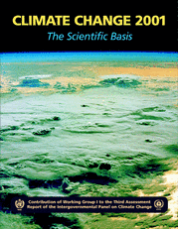
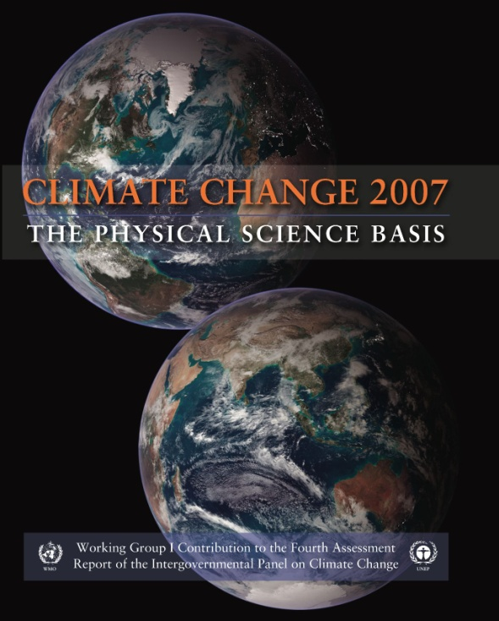
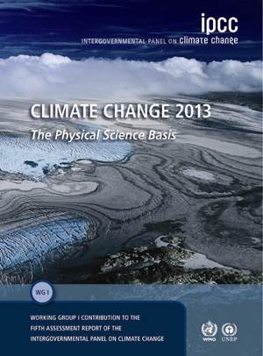
Scientific Driver: International Climate Model Intercomparsion Projects
Intergovernmental Panel on Climate Change (IPCC): CMIP data history
“This evidence for human influence has grown since AR4. It is extremely likely that human influence has been the dominant cause of the observed warming since the mid-20th century.”
(3.5 PB of data)
“Most of the observed increase in globally averaged temperatures since the mid-20th century is very likely* due to the observed increase in anthropogenic greenhouse gas concentrations”
(35 TB of data)
Courtesy of Dean Williams
“There is new and stronger evidence that most of the warming observed over the last 50 years is attributable to human activities”
(500 GB of data)
CMIP6: (300 PB to 3 EB ?)
“The balance of evidence suggests a discernible human influence on global climate”
(1 GB of data)
Bytes
CMIP3: (35 TB of data)
CMIP1: (1 GB of data)
CMIP 2: (500 GB of data)
CMIP5: (3.5 PB of data)

Slide 3
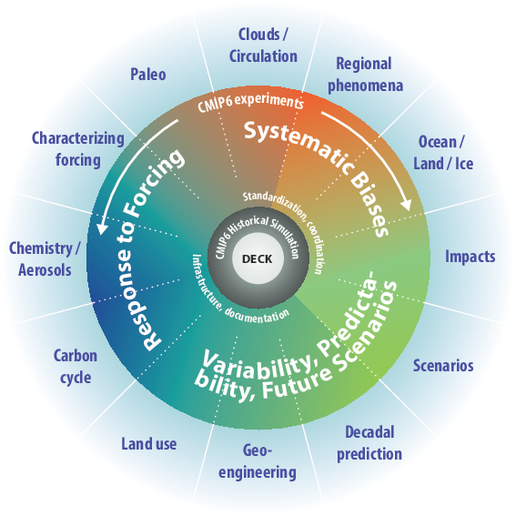
CMIP6 experiment design
Eyring, Bony, Meehl, Senior, Stevens et al., Overview of the Coupled Model Intercomparison Project Phase 6 (CMIP6) excperimental design and organization. Geosci. Model Dev., EGU, 2016. doi:10.5194/gmd-9-1937-2016

Slide 4

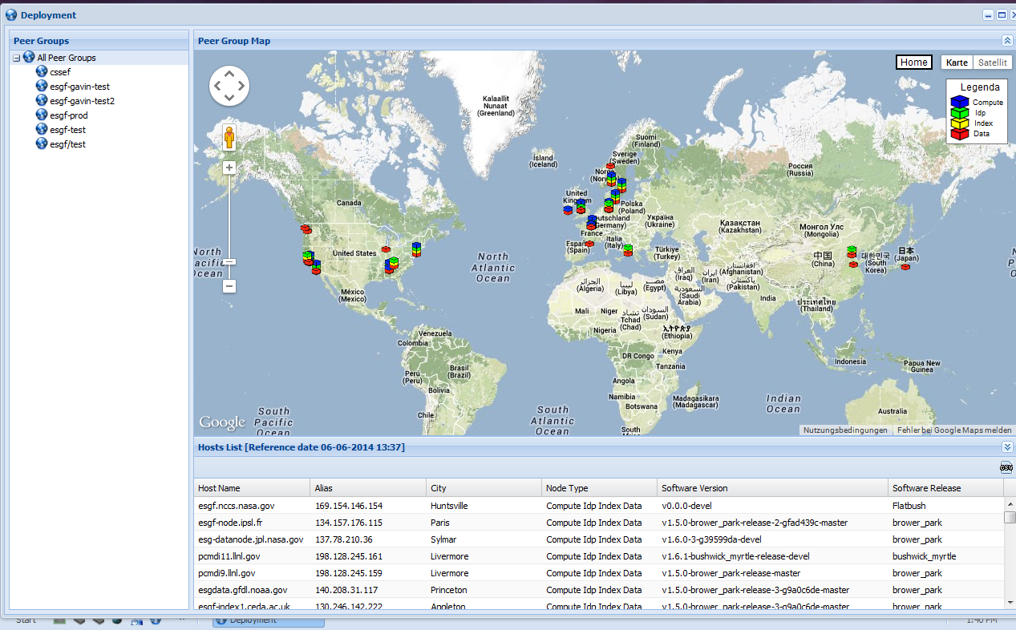

























The Earth System Grid Federation (ESGF)
ESGF is a coordinated multiagency, international collaboration of institutions that continually develop, deploy, and maintain software needed to facilitate and empower the study of climate
IS-ENES: European ESGF federation part
. . .
Courtesy of Dean Williams

Slide 5
Challenges and opportunities
Automated digital object management
Workflow support and provenance aggregation
Support for work at higher levels of abstraction
Services to new user communities
Sustainable funding and business models

Slide 6
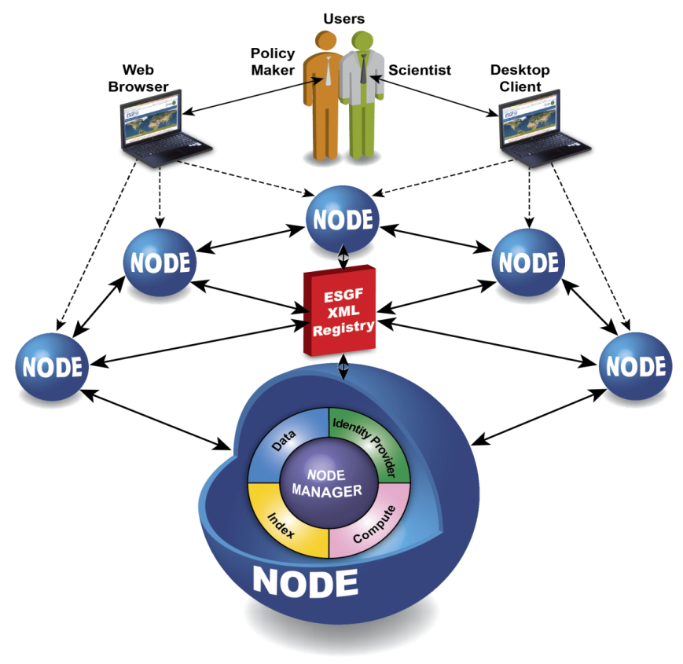
ESGF publication and versioning
raw data (model data, obs data)
Pre-processing
Iterate on new versions
„ESGF publishable“ files
ESGF (re-) publication
Queueing system
Handle
System
Agreed processes;
Kernel Information schema;
Governance

Slide 7
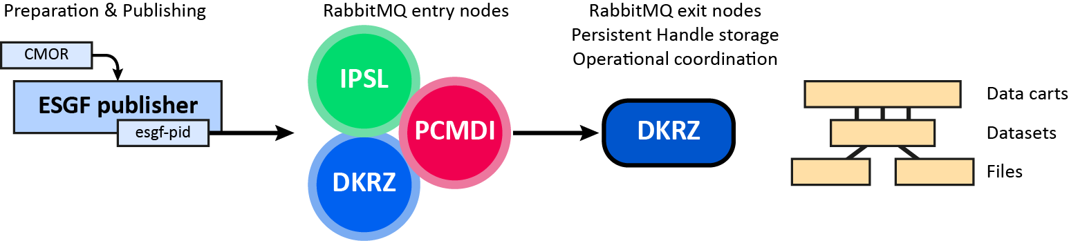
ESGF PID services
Scalability, reliability, governance
Future option: Replication support
  package – replicate – verify
Will require clear interfaces such as the DOIP

Slide 8
Automated DO management & Workflow support
Example: Replication support
Example: HPC workflow support
  Models should be able to record who they are and what they did
Example: Workflow brokering, matching, data transformations
  We discussed this in the frame of T-TAP in the past

Slide 9



Type-Triggered Automated Processing (T-TAP):
Status for climate data
Data distribution service
ESGF search
B2FIND
User
Processing controller
Search service
Agent / Climate processing controller
Structured resource market
ECAS
birdhouse
ESGF PID KI
Schema registry
PID registry
Type Registry
CMIP6 (ESGF)
ePIC DTR
Collection management
Collection builder (cross-discipl.)
obs4MIPs (ESGF)
Computing
resources
CORDEX (ESGF)
Copernicus
Broker
(various environments)
FAIR repositories
DTR-aware Broker
Generic interfaces
red: operational / ready
orange: under construction (e.g. via confirmed projects), but likely to become operational
yellow: more work to be done

Slide 10
Support for work at higher levels of abstraction
DOs as primary citizen in ENES
But: Abstraction not limited to DO concept
Users should concentrate on analysis problems, not data wrangling
Example: Data I/O layer for Jupyter environments
Example: Machine Learning support VRE

Slide 11
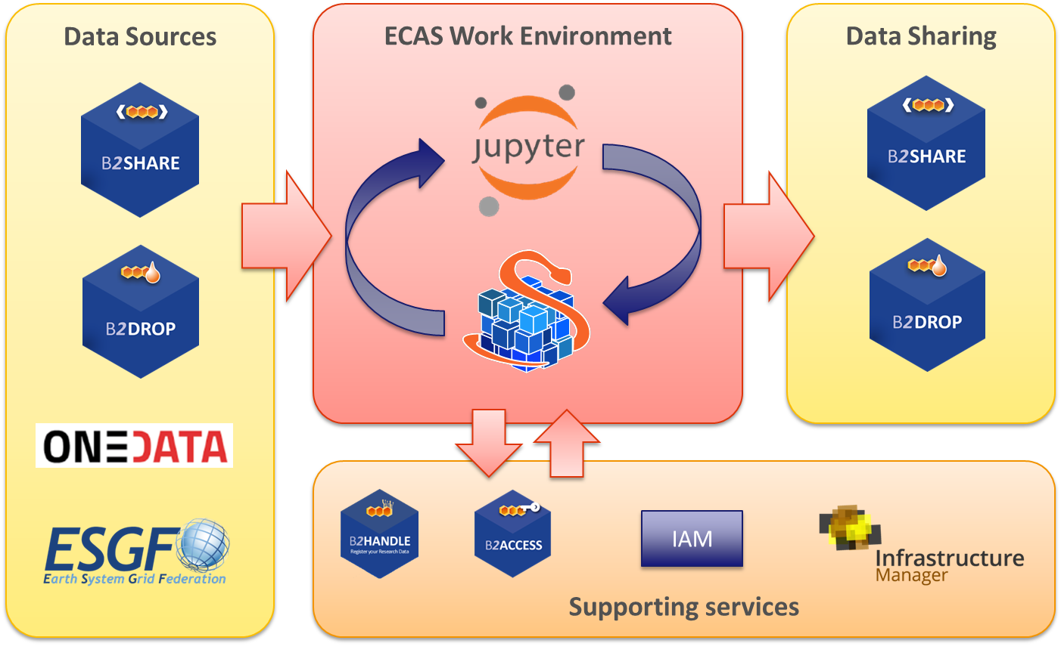
Bridging one gap: Processing services (ECAS)
Opportunity to put Kernel Information in place
Envisaged development for mid 2019

Slide 12
Support for new user communities
Knowledge of limitations and assumptions not obvious to non-ENES users
  social sciences, public administration, policy making
DO angle: Abstraction & Research Object approach

Slide 13
Thank you for your attention!
weigel@dkrz.de

