Slide 1
GORC-WG Speaker series
NII Research Data Cloud
Kazu YAMAJI
National Institute of Informatics, JAPAN

Slide 2


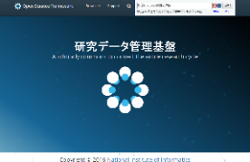




NII Research Data Cloud
2017 Start Development ⇒ 2021: Start Operation
Access Control
Direct Connect
● High Speed Access using SINET5
● Data Sharing Func. using
Virtual NW and ID Federation
● Effective Data Storage Switcher
Experimental
Equipment
Computation
RDM Platform
Hot
Storage
Hot
Storage
Hot
Storage
Hot
Storage
Cold
Storage
Cold
Storage
Cold
Storage
Cold
Storage
International
Data
Repository
管理・保存
Subject
Repository
Storage Area for Long-term Preservation
by
Metadata Aggregation
Build Knowledge-Base
Paper
Suppl. Data
検索・利用
公開・蓄積
Institutional RDM
Discovery Platform
Publication Platform
● Linking Func. between Article and Data
● Researcher and Research Project
Identification and Management Func.
● Data Exchange with International
Discovery Service
● Data oriented Self-Archiving Func.
● Versioning and auto-Packaging Func.
● User Dependent Personal Data
Pseudonym Func.
ORCID
DOI
ISNI
ID Registration Services

Slide 3
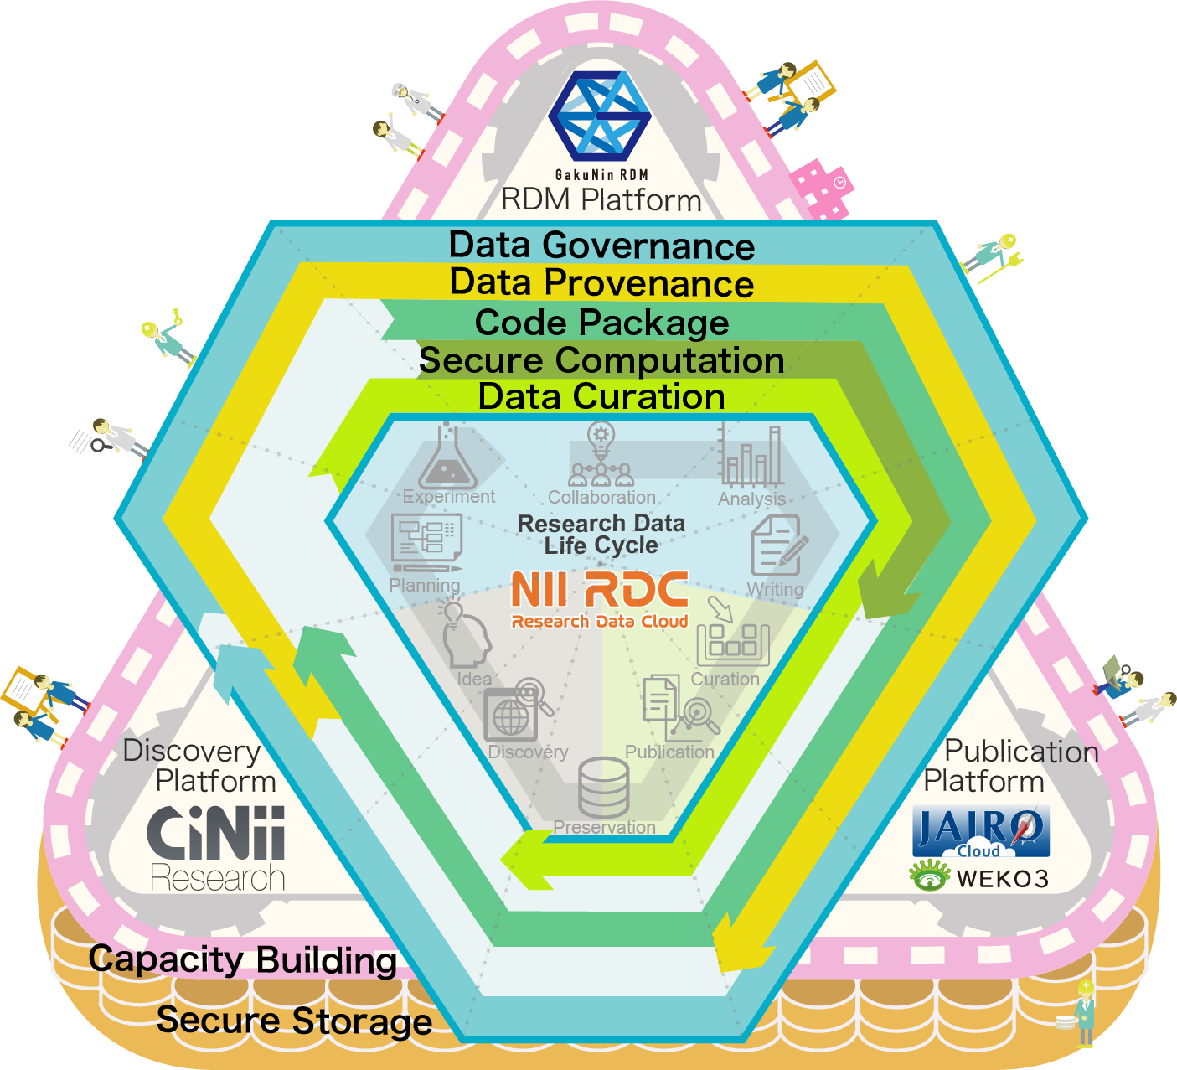












New NII Research Data Cloud
Data Governance
Data Provenance
Code Package
Secure Computation
Data Curation
Secure Storage
Capacity Building
Private
Public
①
②
③
④
⑤
⑥
⑦
Planning
Experiment
Collaboration
Analysis
Writing
Curation
Publication
Preservation
Discovery
Idea
RDM
Publication
Discovery

Slide 4
1. Do you feel like your organization/platform fits into the definition of a commons?
Commons: A global trusted ecosystem that provides seamless access to high quality interoperable research outputs and services.
How to trust and what?
Infrastructure (Service)
Research Output
Confidentiality
  AAI, Access Control
Integrity
  Back-up, Time-stamping
Availability
  SLA
Confidentiality
  Restricted Access Function
Integrity
  Time-stamping Proof
Availability
  Reusable Package (to be)
  Metadata Curation (to be)

Slide 5
2.What are the roles/missions of your Commons?
March 2015 | Cabinet Office, "Promoting Open Science in Japan" ⇒ Follow-up discussions have been take place since 2015
January 2016 | "The 5th Science and Technology Basic Plan" (In Japanese) ⇒ Open Science has been promoted in order to reinforce the intellectual infrastructure
July 2016 | Science Council of Japan (SCJ), "Recommendations Concerning an Approach to Open Science that Will Contributes to Open Innovation"
June 2017 | Cabinet Office, "Comprehensive Strategy for Scientific and Technological Innovation 2017" (In Japanese)
June 2018 | Cabinet Office, "Integrated Innovation Strategy" (In Japanese)
June 2018 | Cabinet Office, "Guideline for Establishing Data Policy at National Research and Development Agencies" (In Japanese)
March 2019 | Cabinet Office, "Guidelines for the Development and Operation of Research Data Repositories" (In Japanese)
June 2019 | Cabinet Office, "Integrated Innovation Strategy" (In Japanese)
December 2019 | Cabinet Office, "Report on the Strategy for Research Data Infrastructure Development and International Expansion" (In Japanese)
November 2019 | Science Council of Japan (SCJ), "Proposal for the Development of a Sustainable Data Infrastructure for Life Sciences" (In Japanese)
May 2020 | Science Council of Japan (SCJ), "Proposal for Toward Deepening and Promoting Open Science" (In Japanese)
May 2021 | Cabinet Office, "6th Basic Plan for Science, Technology and Innovation" (In Japanese)
April 2021 | Council for Integrated Innovation Strategy, "Fundamentals of the Management and Use of Research Data using Public Funds" (In Japanese)

Slide 6
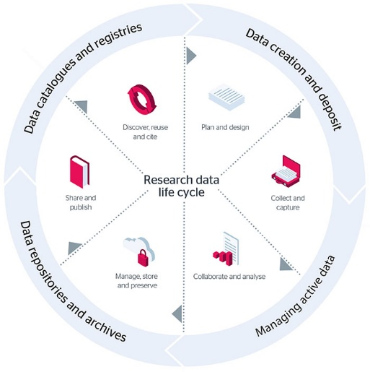
2. What are the roles/missions of your Commons?
Discovery Platform
RDM Platform
Project Start (Application)
Member Management
Initial Setting
Aggregation
Experiment
Data Acquisition
Publication Platform
Institutional or
Domain
Repository
Data Management
Data Analysis
Paper writing
Deposit with Supplemental Data
RDM Platform

Slide 7
2. What are the roles/missions of your Commons?
How NII RDC add value? (example)
RDM Platform
  Researcher can provide appropriate metadata to research data.
  Researcher can proof integrity of research output.
  Researcher can operate RDM properly along with DMP (to be).
Publication Platform
  Library assign DOI
  Library or researcher can describe relationship between research output
  Library provide access statistics to researcher
  Researcher can get curation support from library (to be).
Discovery Platform
  Solve name ambiguity and develop better KB
  Provide opportunity for data reuse and interdisciplinary research.

Slide 8







3. Is your research commons an example of an individual service or platform, or is it an aggregation of multiple disparate organizations/commons?
Japanese Institutional Repository Network
Access
System
Domestic
IRs in Japan
Metadata
National Diet Library (NDL)
Doctoral Thesis Collection System
JAIRO Cloud
D Univ.
NII
IRDB
A Univ.
D Univ.
B Univ.
Japan Link Center (JaLC)
DOI Registration System
C Univ.
E Univ.
NII CiNii Articles
Discovery Service
664 IRs
167 IRs
3.5 M Records
Community
International
OpenAIRE
BASE

Slide 9

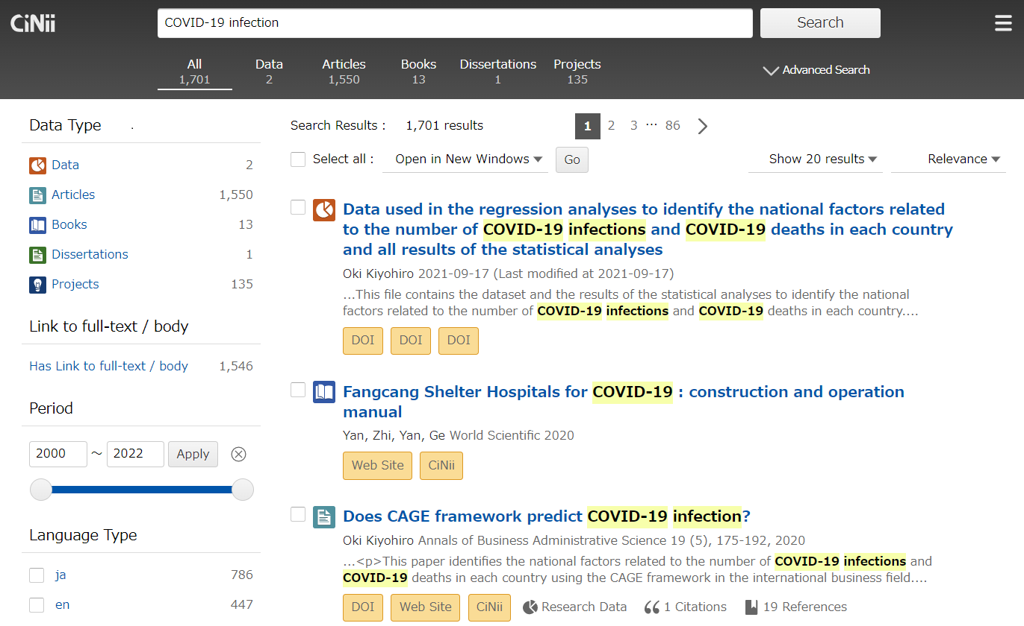
3. Is your research commons an example of an individual service or platform, or is it an aggregation of multiple disparate organizations/commons?
Number of entries
Data sources | Research outputs | Researchers | Projects
CIB | 12,568,735 | 7,974,182 | 0
CID | 681,870 | 710,824 | 0
CROSSREF | 9,067,279 | 18,602,809 | 0
DATACITE | 2 | 0 | 0
DBPEDIA | 29 | 0 | 0
ERAD | 0 | 173,968 | 0
IDR | 1,257 | 4,063 | 0
IRDB | 1,877,880 | 3,288,228 | 0
JALC | 5,522,668 | 13,340,287 | 0
KAKEN | 2,279,147 | 528,265 | 974,563
NINJAL | 508 | 1,132 | 0
RUDA | 61 | 62 | 0
SSJDA | 2,171 | 1,883 | 0
Research resources
books
datasets
Relationship pattern
・citation
・parent-child
・same as
・time / location
articles
dissertations
projects
Collecting more sources.

Slide 10
3. Is your research commons an example of an individual service or platform, or is it an aggregation of multiple disparate organizations/commons?
Microservice Architecture of GakuNin RDM
Wiki
File Previewer
Front-end UI
Sharejs
MFR
Ember_osf_web
Document Store
MongoDB
Authentication
Web Application
RESTful API
Administrator Tools
CAS
Worker
Web
API
Admin
WB_worker
Postgresql
Elasticsearch
RabbitMQ
WaterButler
RDBMS
Search engine
Queuing
Storage Connector

Slide 11
3. Is your research commons an example of an individual service or platform, or is it an aggregation of multiple disparate organizations/commons?
Microservice Architecture of WEKO3
Web Server
<ngnix>
Shibboleth
SP
Shibboleth
IdP
Application server <uwsgi＋flask>
Module
Web API
Module
WEB UI
API
WEB API
UI
CLI
Preview API
Index API
Deposit API
Workflow API
Model
Utility
task
File API
Record API
CNRI
Handle
Database
<PostgreSQL>
Search engine
<Elasticsearch>
Message
queue
<RabbitMQ>
Storage
<Local>
<S3互換>
Cache
<Redis>
Distributed task queue
<Celery>
WEKO3 consists of a combination of Web UI and multiple Web APIs. These Web APIs are provided as standalone Web APIs(microservices).

Slide 12
3. Is your research commons an example of an individual service or platform, or is it an aggregation of multiple disparate organizations/commons?
SAML: Federated access management.
OAuth2: Service integration at RDM service.
Time Stamping Protocol: Proof of data existence at RDM service.
DMP Common Standard: DMP based service composer.
OAI-ORE: Contents packaging at curation service.
SWORD: Contents deposit from the RDM service to a repository.
Open Graph Protocol: Page summary generation at third party service.
ResourceSync: Data providing from the repository to the discovery.
OAI-PMH: Data aggregation from the repository to the discovery.

Slide 13


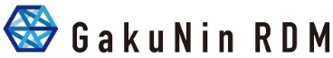



6. Are there any interfaces between your commons and other commons out in the world, or conversations at your commons about connecting with other groups or resources?
Common Discover Service
Domain Centric Services
Each Domain
using NII RDC
Common Services and Tools
Cloud Computing / HPC
Virtual Organization Platform
Identity and Access Federation
Network

Slide 14
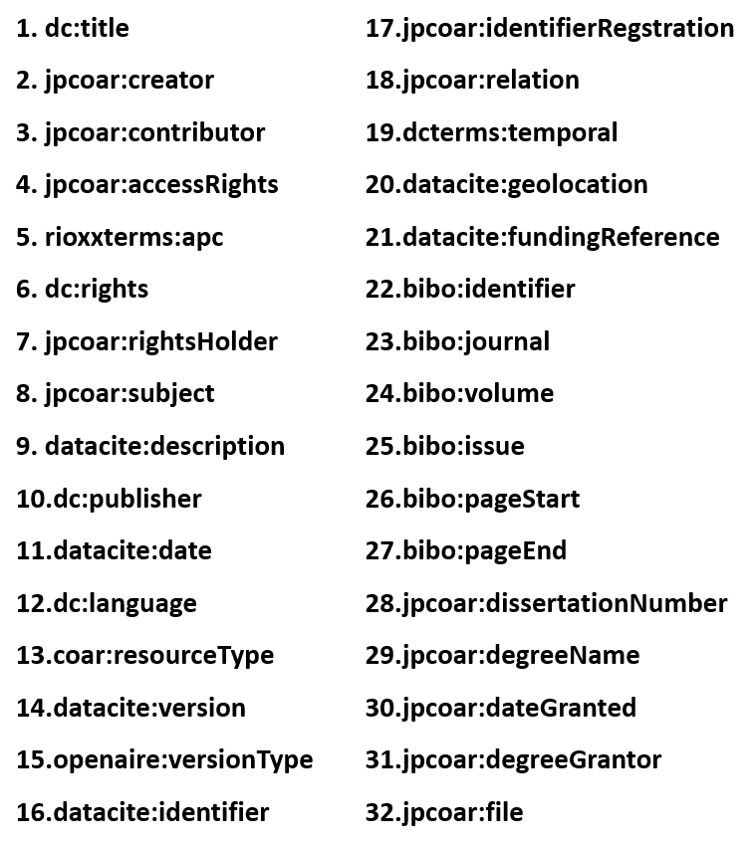
6. Are there any interfaces between your commons and other commons out in the world, or conversations at your commons about connecting with other groups or resources?
JPCOAR Schema Properties
BIBO
RIOXX
COAR
Junii2-> JPCOAR
OpenAIRE
Dublin Core
DataCite
Example of hierarchized elements
<jpcoar:creator>
<jpcoar:nameIdentifier nameIdentifierScheme= “ORCID”
schemeURI= “http://orcid.org/0000-0003-2384-2166” >
0000-0003-2384-2166</jpcoar:nameIdentifier>
<jpcoar:creatorName xml:lang= “ja” > 大隅 , 良典
</jpcoar:creatorName>
<jpcoar:creatorName xml:lang= “en” >Ohsumi, Yoshinori
</jpcoar:creatorName>
<jpcoar:affiliation>
<jpcoar:nameIdentifier nameIdentifierScheme= “ISNI”
schemeURI= “http://www.isni.org/0000000121792105” >
0000000121792105</jpcoar:nameIdentifier>
<jpcoar:affiliationName xml:lang= “en” >
Tokyo Institute of Technology
<jpcoar:affliationName>
</jpcoar:affiliation>
<jpcoar:creator>

Slide 15





8. Some questions around social & organisational constructs
Bottom Up
Top Down
  Committee on Open Science at Cabinet Office, Ministry of Education and Research and Science Council of Japan
Network
ID Federation
Cloud
RDM
Repository
IT Center Community
Library Community
(Open Access Repository)
SIG ID Federation
SIG Cloud
SIG Research Data Management
etc
Research Data WG
Contents Working Group
Community Empowerment WG
Training WG

Slide 16

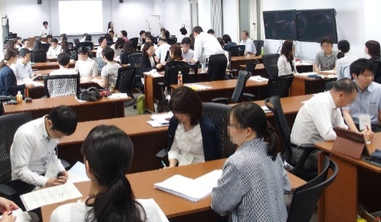
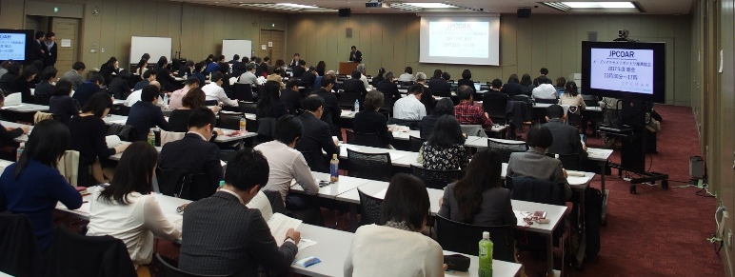
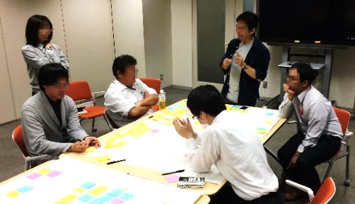
8. Some questions around social & organisational constructs
Joint Operation
Community Support
Survey of Future Development
Test of New Development
Training Course
Accounting
System Development
Service Operation
Reduce total operational costs!
Training Course
JPCOAR Annual GA
Brainstorming with Developer

Slide 17


8. Some questions around social & organisational constructs
Increasing workload for researchers towards research digital transformation
DMP Design
Data
Publication
Research integrity
Metadata
Curation
Research Ethics
Researcher
Data Retention
Information
Security
* In Japan, researchers are required
to retain data for 10 years.
Digital transformation is essential for researchers to turn 'extra work' into 'part of their research'
17

Slide 18




Seven new features of NII Research Data Cloud
- shifting researchers' duties into motivation -
Responsibilities of institution
4-1 Establishing a data policy
4-2 Appending metadata
4-3 Establishing human resources and support systems
4-4 Ensuring security
Responsibilities of researcher
6-1 Determining data to be managed
6-2 Appending Metadata
6-3 Designing a DMP
6-4 Retaining research data
6-5 Publishing and sharing research data
6-6 Post-project handling
DMP Design
Data Publication
Research Integrity
These items have been extracted from the Cabinet Office's "Basic Approach to the Management and Use of Publicly Funded Research Data".
Data governance
Metadata
Curation
Code Package
Data Provenance
Research Ethics
Data Curation
Researcher
Secure Computation
Data
Retention
Information Security
Secure Storage
Capacity Building
Digital transformation is essential for researchers to turn 'extra work' into 'part of their research'
18

Slide 19
New NII Research Data Cloud
Data Governance
Data Provenance
Code Package
Secure Computation
Data Curation
Secure Storage
Capacity Building
Private
Public
①
②
③
④
⑤
⑥
⑦
Planning
Experiment
Collaboration
Analysis
Writing
Curation
Publication
Preservation
Discovery
Idea
RDM
Publication
Discovery
19

Slide 20
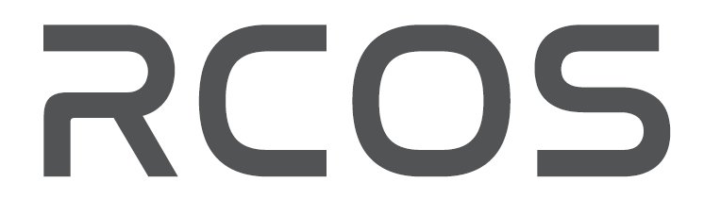
yamaji@nii.ac.jp
Notes:
If you are interested in our activity, please drop an email to me.
Thank you so much.

