Slide 1
RDA/WDS IG Certification of Digital Repositories The new 'Core Trustworthy Data Repository Requirements' hands-on RDA Plenary 9, Barcelona, 05-04-2017

Slide 2
The new 'Core Trustworthy Data Repository Requirements' hands-on
Meeting aim
Hands-on experience with the Core Requirements for TDR certification
https://www.rd-alliance.org/wds-and-dsa-announce-unified-requirements-co...
Meeting agenda
Updates from certification standards communities (10 minutes)
Brief introduction of the requirements (10 minutes)
Evaluation of evidence information and desirable linked evidence in break-out groups (40 minutes)
Round-table discussion (30 minutes)

Slide 3
Core Level Certification
DSA-WDS alignment:
Core requirements published
Common assessment procedure in place
Ad-hoc Board to guide transition towards a new core level standards and certification entity before the end of this year
Activities of the ad-hoc Board:
Governance
Business model
Corporate branding, including name, logo, website, etc.
Applicant and reviewer guidance
Common online tool for assessment and review
Communications
www.datasealofapproval.org/en/news-and-events/news/2017/3/30/new-standards-and-certification-entity-horizon/
www.icsu-wds.org/news/news-archive/new-standards-and-certification-entity-on-the-horizon

Slide 4
A new branding for the Core TDR certification
Represent our values: trustworthiness, baseline requirements
Timeless, simple, distinctive, short, clear, works worldwide…
Branding for:
Certification body
Certified product(s)
Two options are being considered: comments and feedback welcome!
>> CoreTrust <<
>> TrustSeal <<
CoreTrust – Repository (CT-R)
CoreTrust – Software (CT-S)
CoreTrust – Data (CT-D)…
TrustSeal – Repository (TS-R)
TrustSeal – Software (TS-S)
TrustSeal – Data (TS-D)…

Slide 5
Extended certification: nestorSeal
2016
2 positive assessments:
German National Library
Data Archiving and Networked Services (DANS) ( assessment in English)
Based on the experience of these assessments the evaluation process was improved; published as Version 2 of the Explanatory Notes (in German)
Publication of the submission form (in German)
2017
Several assessments are currently being evaluated
Translation of the submission form into English
Translation of the Explanatory Notes in other languages in preparation (Dutch, Czech)
For more information:
http://www.langzeitarchivierung.de/Subsites/nestor/EN/Siegel/siegel_node.html
Contact: nestorsiegel@langzeitarchivierung.de

Slide 6
Formal certification: ISO 16363
ISO 16363 guides auditors in making a judgement about whether or not a repository can be trusted to play its part in preserving digitally encoded information, following OAIS concepts.
There are many metrics (requirements). These are arranged hierarchically to ensure that an auditor is forced to examine all relevant aspects of the repository in the appropriate depth
ISO 16919:2014 specifies requirements for bodies providing ISO 16363 audit and certification – provide detailed competences that auditors need.
16919 specialises ISO 17021, the fundamental standard for audit and certification
Fully integrated into the worldwide ISO audit process on which we all depend – based on ISO 17021:2015.
Auditors need specialised general skills as well as specific knowledge of ISO 16363.

Slide 7
Formal certification: ISO 16363
The first application for accreditation by a National Accreditation Body is underway.
Process includes office assessments and witnessed audits
First accreditation is expected in the next few weeks.
OAIS and 16363 published by ISO in 2012. Update process is underway – see http://review.oais.info.
Updated documents expected to be published in 2019/20.

Slide 8
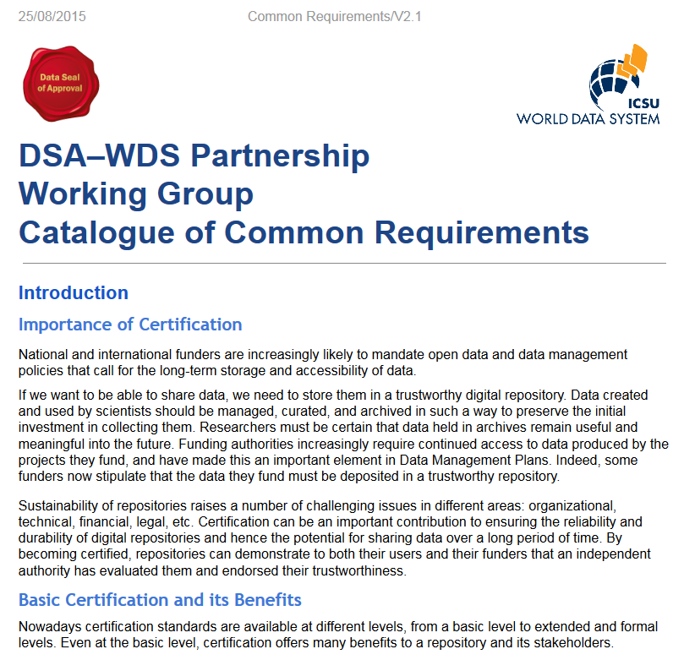
Core TDR requirements
Context (1)
Organizational infrastructure (6)
Digital object management (8)
Technology (2)
Additional information and applicant feedback (1)

Slide 9
Organisational infrastructure
R1. The repository has an explicit mission to provide access to and preserve data in its domain.
R2. The repository maintains all applicable licenses covering data access and use and monitors compliance.
R3. The repository has a continuity plan to ensure ongoing access to and preservation of its holdings.
R4. The repository ensures, to the extent possible, that data are created, curated, accessed, and used in compliance with disciplinary and ethical norms.
R5. The repository has adequate funding and sufficient numbers of qualified staff managed through a clear system of governance to effectively carry out the mission.
R6. The repository adopts mechanism(s) to secure ongoing expert guidance and feedback (either in-house, or external, including scientific guidance, if relevant).

Slide 10
Digital object management (1)
R7. The repository guarantees the integrity and authenticity of the data.
R8. The repository accepts data and metadata based on defined criteria to ensure relevance and understandability for data users.
R9. The repository applies documented processes and procedures in managing archival storage of the data.
R10. The repository assumes responsibility for long-term preservation and manages this function in a planned and documented way.

Slide 11
Digital object management (2)
R11. The repository has appropriate expertise to address technical data and metadata quality and ensures that sufficient information is available for end users to make quality-related evaluations.
R12. Archiving takes place according to defined workflows from ingest to dissemination.
R13. The repository enables users to discover the data and refer to them in a persistent way through proper citation.
R14. The repository enables reuse of the data over time, ensuring that appropriate metadata are available to support the understanding and use of the data.

Slide 12
Technical infrastructure
R15. The repository functions on well-supported operating systems and other core infrastructural software and is using hardware and software technologies appropriate to the services it provides to its Designated Community.
R16. The technical infrastructure of the repository provides for protection of the facility and its data, products, services, and users.

Slide 13
Review procedure
Self assessment in online tool
Guidance text available
Review by two reviewers:
URLs to evidence strongly encouraged
Maturity ratings strongly encouraged
Successful assessments publicly available by default
Renewals every three years

Slide 14
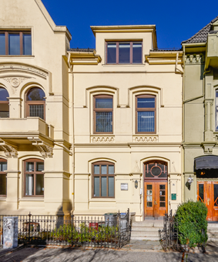
Some results of the CESSDA Trust and Certification
Working Group so far
In particular based on the CESSDA Workshop in Zagreb, 1-2 March 2017

Slide 15
Tasks CESSDA Trust Working group (DANS, GESIS, UKDA, FSD, ADP)
Advisory body on DSA and obligations of the CESSDA Statutes
Monitoring status certifications
Advising the SP’s (continuing Trust workshops)
Role in training
Contact with certification boards

Slide 16
Results in Zagreb: what we did
15 Self-Assessments have been sent in!
Reviewed by the 5 members of the CESSDA Trust Group
Each self-assessment reviewed by two reviewers
Compliance levels given:1-4
Comments made

Slide 17
Main conclusions
Results varying between and in service providers
Both for the “old” and “new” service providers
Providing evidence clearly is the weakest point
Some service providers are simply not yet in a position to become DSA/WDS compliant

Slide 18
Lowest scores
REQUIREMENT
XVI Security
XV Technical infrastructure
III Continuity of access
IX Documented storage procedures
X Preservation plan

Slide 19
Lowest scores
XV. Technical infrastructure
The repository functions on well-supported operating systems and other core infrastructural software and is using hardware and software technologies appropriate to the services it provides to its Designated Community.
XVI. Security
The technical infrastructure of the repository provides for protection of the facility and its data, products, services, and users.
III. Continuity of access
The repository has a continuity plan to ensure ongoing access to and preservation of its holding
IX. Documented storage procedures
The repository applies documented processes and procedures in managing archival storage of the data.
X. Preservation plan
The repository assumes responsibility for long term preservation and manages this function in a planned and documented way.

Slide 20
Highest scores
REQUIREMENT
I Mission / Scope
XIV Data reuse
VI Expert guidance
IV Confidentiality / Ethics

Slide 21
Highest scores
I. Mission/Scope
The repository has an explicit mission to provide access to and preserve data in its domain.
XIV. Data reuse
The repository enables reuse of the data over time, ensuring that appropriate metadata are available to support the understanding and use of the data.
VI. Expert guidance
The repository adopts mechanism(s) to secure ongoing expert guidance and feedback (either in-house, or external, including scientific guidance, if relevant)
IV. Confidentiality/Ethics
The repository ensures, to the extent possible, that data are created, curated, accessed, and used in compliance with disciplinary and ethical norms.

Slide 22
Breakout sessions
Materials:
Requirements
Self assessment GESIS based on the requirements
Questions:
Considering the guidance provided, is the evidence information provided suitable?
What type of evidence can/is best documented in the self-assessment?
What type of evidence can/is best linked to a public document?
Can the guidance be improved?

