Slide 1
DFIG and Workflows Tobias Weigel, Peter Wittenburg, Larry Lannom, Jay Pearlman, Stefano Nativi, Christine Staiger, Reagan Moore, Bridget Almas, Rainer Stotzka, Rapahel Ritz, Ralph Müller-Pfefferkorn, more to come

Slide 2
Work Flow in Data Fabrics
General aspects
Human and type controlled processing
DFIG basics: still fitting?
Required components
RDA groups contributing

Slide 3
The Great Challenge
How to cope with the increasing volume and complexity of scientific and industrial data
Currently
integration of data from different sources is expensive
80% of the data is no longer accessible after a short time
80% of time of data scientists is wasted with data management
And it will get worse
50 Bio Smart devices will create data monsters
(continuous feed, fine granularity)

Slide 4
Expected Developments
And, simultaneously, complexity will increase!!!

Slide 5
Fundamental Changes due to IoT
Cyber
infrastructure
Humans
Physical
Objects
adapted from
Chris Greer, NIST

Slide 6
Fundamental Changes due to IoT
Internet
WWW
etc.
Humans
Actors
Mediators
Physical
Objects
adapted from
Chris Greer, NIST

Slide 7
Fundamental Changes due to IoT
Humans
often
bypassed
Cyber
infrastructure
PO
directly
acting
adapted from
Chris Greer, NIST
Cyber

Slide 8
Brokering & Complexity
Conceptual Object
Object implementation
Object implementation
Object implementation
Abstraction
Brokering
Implementations
Allow different implementations of a common conceptual object
Artifact
Artifact
Artifact
Artifact
Type A
Type B
Mediate among different artifact types

Slide 9
Workflow Abstractions and Implementations
Distinguish between two different types of Workflow specifications/notations
Abstract Workflow
Executable Workflow
Abstract Workflow (Business Process) specification
Generated by Process Experts
Based on abstract and well known object types
Implementation/Technology independent
Executable Workflow
Generated by IT experts –e.g. Web Services experts
Based on accessible object implementations –e.g. Web Services
Technology dependent –e.g. workflow engines and related languages

Slide 10
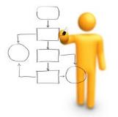
Workflow Abstractions and Implementations
GAP
Abstract Business Process
Executable Workflow(s)
PID and Object typing help fill the gap
Brokering services (e.g. Data services brokering, Processing services brokering) help fill the gap.

Slide 11
Content
General aspects
Human and type controlled processing
DFIG basics: still fitting?
Required components
RDA groups contributing
general aspects
human and type controlled processing
DFIG basics still fitting?

Slide 12
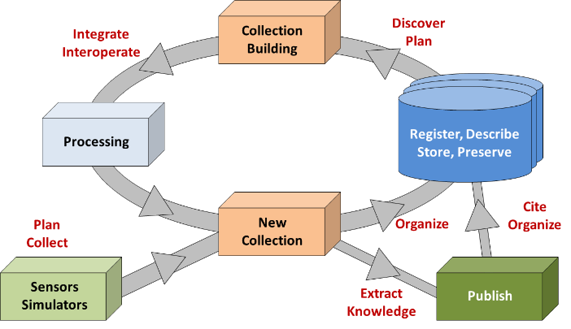
Human Controlled Processing (HCP)
Observations
Experiments
Simulations
etc.
Cycle can be manually controlled or semi-automatically via pre-set pipelines.
Even in case of semi-automatic pipelines humans are close-in "designers“
(diagram is well-known in DFIG)

Slide 13
Type-Triggered Automatic Processing (T-TAP)
Data Events
New feature: cycles run highly autonomously - precise steps depend on the types of data entering the workflow
exposing
new DOs
Structured
Data Markets
adding new data
some kind of profile matching
Researchers are not in direct control
Data Federation
Agents
Data Type Registry
Processing services
Brokering & Mediation
services
result
scripts

Slide 14
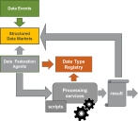
Use Case #1
A neurologist wants to research the causal relation between Alzheimer phenomena and specific genes, proteins, neural activity, etc.
She needs as much data as possible from patients exposing the same phenomena.
Such data is being generated in a variety of hospitals and labs worldwide by different experts.
As this is sensitive data, she works in a federation based on strict usage agreements using certified software.
She engages a federation agent which is provided with profiles of data she can use for her research, specifying the disease and the data types she can use.
Whenever useful data is generated her machine learning based algorithms will run to provide new evidence to improve her theories.

Slide 15
Use Case #2
A linguist is working on theories about „economy of languages“, i.e., finding objective patterns that make languages more or less easy to process and learn.
He needs detailed feature descriptions at different linguistic levels from a wide spectrum of languages which are generated in many labs worldwide by different experts.
Since this data is in general open there is no need of a specific federation.
He engages an agent which is provided with profiles of data he can use for his research, specifying the languages, features, and approach to extracting the features.
Whenever useful data is generated machine learning based algorithms are run to provide evidence to improve his research.

Slide 16
Use Case #3
The data manager of a large data centre has the obligation to check the quality of new data of specific types, transform it according to certain rules/policies and create n replications in a federation.
He decides to work asynchronously and use agents to scan the offers of a variety of repositories in his user federation for new data of the specified types.
The agent scans the offers from the repositories and whenever new data of the specified profiles is found,
quality checks are carried out
transformations are applied and
replicants are generated in the centre‘s federation.

Slide 17
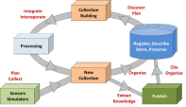
Principle Differences
 | HCP | T-TAP
Human role | procedural | declarative
Aggregation | designed | profile driven
Events | planned | asynchronous
Mapping | designed | brokered – third party services, it becomes a business
Required Metadata | flexible in case of human control detailed in case of WF | detailed
Typing (semantics) | optional | required
PID types | optional | required
DFT model | optional | required

Slide 18
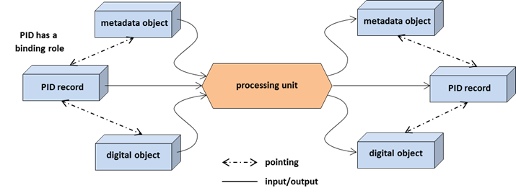
Core "reproducibility machine“ in both cases
Brokering & Mediation services
add-on
source
DO(s)
new
DO(s)
Bit Sequence
Bit Sequence
shown is a suggestion for systematic documentation
(several implementations possible)
assumed is that DOs in a collection will be processed to create new DOs incl. new content, new PIDs and MD extended by new provenance information
interaction pattern see next slide

Slide 19
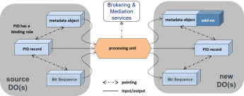
interaction pattern
read new PID from collection DO
get PID record
get metadata (incl. provenance)
get bitstream from trustworthy repository
do the processing on the bit sequence
run brokering & mediation services where useful
create new bit sequence
register new PID
create new metadata (incl. updated provenance)
upload data and metadata to a trustworthy repository
back to 1 if more DOs available in collection
the green marked items can be ready made code snippets!

Slide 20
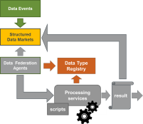
What is structured “Data Market”?
Repository x
Repository y
repositories
expose PIDs
representing
new DOs
ResourceSync
W3C Standard
PIDs
Profiles
Federation Agreements
Agent j
Agent k
not all agents can see all exposed PIDs
at this stage bit sequences are not touched (GDOC)

Slide 21
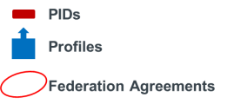
How to relax a Federation agreement
Repository x
Repository y
Agents can make use
of Brokering services to avoid repositories to implement the same metadata model/structure
Brokering & Mediation services
Agent j

Slide 22
What is the market? (I)
Market: Stalls (providers) with offers and customers with needs
Market is a „social“ space that facilitates matchmaking between these
Brokers may also be involved in case the customers delegate the matchmaking
Offers = PIDs (with their embedded/referenced metadata and pointers to the bit sequences)
Required to maintain the market: registry of providers
Requirement: In e.g. medicine, not all offers (PIDs) should be visible
Even the existence of a PID may be sensitive information
therefore federation agreements need to
be established where necessary

Slide 23
What is the market? (II)
Now we can imagine different models:
A: Open data provider/customer market
All providers are visible, but not everyone is allowed to look into all stalls; meaning: even the medicine service endpoints are listed, but access requires specific permissions.
Federation agreements are then simply the organizational format in which permissions are given to a specific customer group
B: Provider group/Customer group federation market
Not all providers are visible, so normal users are not even able to see the medicine service endpoints. In this case, a second (higher-level) market for making federation agreements is required. These agreements are between groups of providers and groups of customers.
The „data market“ is then not flat and open, but more complex: Every market stall is behind a black curtain, and the doorman in front of the curtain will check credentials to even know what is behind the curtain
There can still be stalls without a curtain, following the open market model.

Slide 24
Matching in federation environment
metadata of DO
Repository
bit sequences of DO
PID Resolver
MD
bs
PID record
1
DTR
PID
5
Rights DB
Type Record
3
2
12
rights record
6
4
10
13
Agent
9
8
Y
7
11
Controller
WF
Matcher
14
Broker
14
14
Profiles
Broker
Broker

Slide 25
Requirements and observations
First repositories are active and signalise new DOs using ResourceSync (W3C)
Then agent is the key-active part crawling known offers
The agent makes decisions
The agent can act upon missing replies (time-out) – it controles the flow
When agent found a new DO suitable for the intended processing the controller becomes active
Interfaces/protocols required for every arrow
Some of them are already defined or being addressed in active RDA groups, but some are missing
Example for missing piece: Communication between agent and matcher

Slide 26
Procedure
repository will expose PIDs of new data
agent will scan known ResouceSync offers and get PIDs
agent will ask for PID record
agent will get PID record
agent will get MD record from repository
agent will check whether access rights & licenses are ok
agent will hand over info bundle to Profile Matcher
Matcher will read his profiles and compare
in case of fit agent will give info bundle to controller
controller will look into data type registry and get record incl. actions to be carried out on the type
controller will start and observe processing (workflow, etc.)
bit sequences will be read and processed to new results
new PID, data and metadata will be registered at/via repository
brokering services will be needed to map between different formats, name spaces, etc.

Slide 27
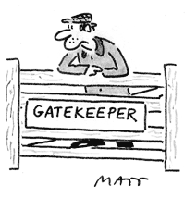
Closed Cycle Solutions
in simulations data is generated by „own“ software – quality control is integrated
no need to leave the domain of registered DOs
however gate keeper for the software
„collection
building“
processing
proper
repository
checked code to be added
(workflows, scripts, etc.)
„new
collection“

Slide 28
About Metadata in WF (pipelines)
in Workflows typing by metadata needs to be fine-graded going beyond the usual metadata such as
system metadata
descriptive metadata
in general additional information is required for the machines
history of software that created the bit sequence
versions of the software
in case that different types of output can be generated the exact parameter set needs to be documented etc.
this information is to be included in provenance records as part of the metadata
detail metadata to be fit for machine use
PID
Metadata
bit sequence
processing
component
PID
Metadata
bit sequence
processing
component
PID
Metadata
bit sequence

Slide 29
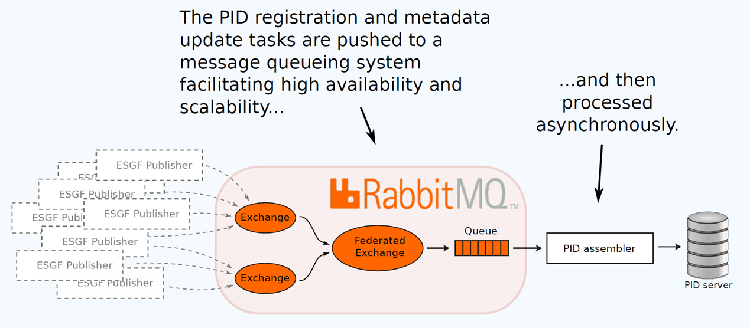
WFs require PID registration strategies
taken from DKRZ/ENES

Slide 30
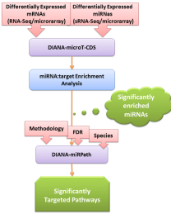
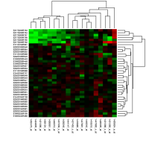
Future: Data and workflow integration
Goal: Make the life easier for scientists who are no experts in programming and handling data
Portals: integrate data and compute workflows
Data
Workflow
Result
Preview:
Set 1
✔
Set 2
✔
Set 3
…
Data: <PID>
Notes:
Workflow diagram: Diana tools – Taverna
Heatmap: wikipedia

Slide 31
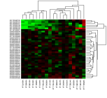
Future: Data and workflow integration
Label data with PID
Label (parts of) workflows with PIDs
#Load data
mRNA = W1(D1)
miRNA = W1(D2)
#Analysis
res1 = W2(mRNA, miRNA)
res = W3(res1)
#PID for result
file = writeToFile(res)
create_PID(file)
#Plot for preview
Plot(res)
PID D1
PID D2
Data
Workflow
Result
PID D3
Preview:
PID W1
Set 1
✔
Set 2
PID W2
✔
Set 3
PID W3
…
PID W4
Data: <PID>
Notes:
Portal builds the script and executes it based on PIDs for data and PIDs for code snippets.

Slide 32
WHY? Data and workflow integration
Why this effort?
Different stakeholders with different expertise:
Scientists are users
Scientific programmers: experts on algorithms
Data managers: care for data curation
How can this work?
PID information types:
Structured PIDs for different objects: data, workflows
Information in PID record helps combining the right objects in the right way
→ PIT model checking with Data Type registry
Notes:
Workflow diagram: Diana tools – Taverna
Heatmap: wikipedia

Slide 33
Controls for Workflows
multiple independent services are used to manipulate/manage digital objects, i.e. automated coordination is required between the services to ensure that assertions remain valid
how to enforce assertions made about a collection when a service is applied to a digital object. Examples of assertions range from:
integrity
access control
authenticity
provenance
chain of custody
arrangement
description

Slide 34
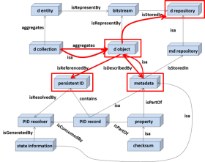
should DO be self-contained?
 | MD included | MD separate
data protection | problem | easy
data volumes | problem | easy
database content | n.a. | easy
dynamic metadata | problem | easy
citation stability | problem | easy
complexity | less | higher
dependency | small | high
many formats have integrated MD
take best of both, i.e. make use of headers, but also extract MD, however,
maintenance complexity
requires DFT model use

Slide 35
Content
general aspects
human and type controlled processing
DFIG basics still fitting?
required components
RDA groups contributing
general aspects
human and type controlled processing
DFIG basics still fitting?

Slide 36
principle of configurations remains
configuration A
configuration B
Common
Components
& Services
Task to solve:
Identify and specify Common Components (CoCo)
Recommend CoCo
Put CoCo in place
Task is not to identify ONE architecture, but to identify CoCos that could cooperate in specific configurations to solve a function (infra, VRE, etc.)
Specific
Components
& Services

Slide 37
seeing PIDs central remains the same
PID Record
PID
PID
CKSM
PID
paths
PID
PID
Metadata
Rights
data copies
Relations
Provenance

Slide 38
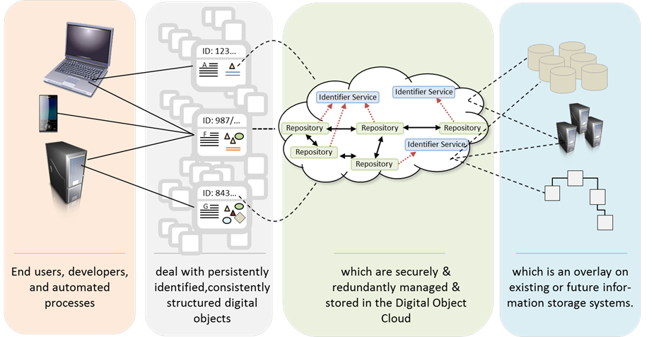
GDOC remains the same

Slide 39
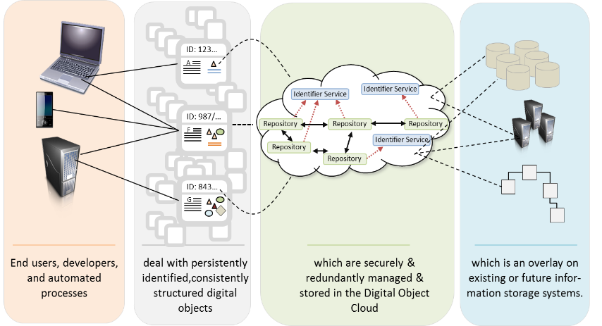
PID Centric Data Management and Access
Brokering & Mediation
services

Slide 40
PID Centric Data Management and Access
PID CDMA
Storage Systems
Users
Consumer
B
Provider
Consumer
B
Provider

Slide 41
Types of Data Fabrics (Reagan)
we can differentiate between
user data fabrics to support discovery and access to published data
collaboration data fabrics that support processing of shared collections
repository data fabrics that are focusing on preserving data
Supported virtualized entities in these DFs are
data collections that include the context of DOs
workflows encapsulating analyses
data flows managing data transport
Essential capabilities are interoperability, federation, interaction control

Slide 42
Nature of Data Fabrics
Obviously Data Fabrics in the above sense are blueprints to create generic infrastructures that support virtualisation of collections, workflows and data flows
Instantiations of Data Fabrics will offer a set of services some of which are core and others are optional
Data Fabrics are NOT instantiations of a specific collection, workflow or data flow.

Slide 43
Content
general aspects
human and type controlled processing
DFIG basics still fitting?
required components
RDA groups contributing

Slide 44
required core components
DO registration | a piece of code that allows to register a DO, i.e. store bit sequence in a trustworthy repository, request a PID and register metadata
DO management | at GDOC level operators such as MOVE, COPY, DELETE need to be provided
PID initiation | a piece of code that requests PIDs and initiates the PID record according to a profile
remote PID change | a secure program that allows authorised entities to modify the PID record within federations
PID provider certification | a set of certification rules to assess the quality of PID service providers
metadata extractor | a piece of code that gets metadata via the PID information type
metadata generator | a piece of code that creates new metadata incl. a new provenance record

Slide 45
required components
collection builder | a software that allows humans and machines to create a collection
data type registry | a registry that allows to associate types with operations
license registry | a registry which contains license agreements from different users to be used in federation access chains
rights & license registry | a registry which contains rights records to be used in federations
repository registry | registry of trusted federation centers
CoCo registry | a registry of core components incl. a quality and security test
schema registry | a registry that contains schema definitions
category registry | a registry that contains vocabularies and individual categories

Slide 46
required components
ResourceSync | a W3C standard to expose offers from repositories
provenance | a standard allowing to write prov records
resource broker | different types of brokers for transformations, mappings, etc.
common metadata model | a clarification of suitable and agreed metadata components
common PID types | a registered set of common PID types

Slide 47
Metadata Structure
How can metadata structure be brought in?
Metadata Components/Packages as discussed by MD IG
Unique Identifier (for later use including citation)
Location (URL)
Description
Keywords (terms)
Temporal coordinates
Spatial coordinates
Originator (organisation(s) / person(s))
Project
Facility / equipment
Quality
Availability (licence, persistence)
Provenance
Citations
Related publications (white or grey)
Related software
Schema
Medium / format

Slide 48
Content
general aspects
human and type controlled processing
DFIG basics still fitting?
required components
RDA groups contributing
general aspects
human and type controlled processing
DFIG basics still fitting?

Slide 49
RDA groups contributing
RDA Group | providing ...
DFT | a basic FAIR compliant model to organise data
PIT | the notion of attribute profiles of PID services
DTR | a mechanism to link data types with operations
Dyn DC | a mechanism to correctly refer to data
PP | a large number of cases for typical operations
MDC | a metadata schema registry
DSA/WDS | a set of rules to assess the quality of repositories
DF | a framework to discuss this document
Publ Data Services | a mechanism to universally link data and literature
Publ Data Workflows | requirements for scientific workflows
Reproducibility | recommendations to make data reproducible
Legal Interop | recommendations about data licences

Slide 50
RDA groups contributing
Brokering Framework | studying the possibilities to apply brokering
Collection | Provides collection builder interface specifications

Slide 51
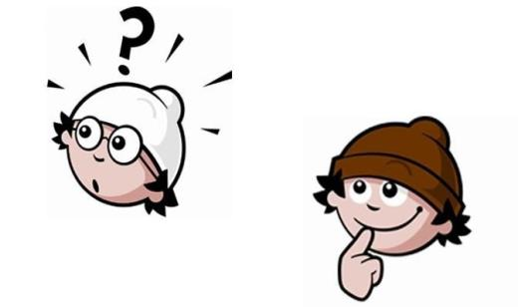
Questions/Comments?

