Slide 1
The Research Data Alliance (RDA)
Plenary Meetings in a Nutshell
(Details of previous plenary meetings and their highlights)
March 2024
rd-alliance.org @resdatall

Slide 2
Vision, Mission & Values
Vision
Researchers and innovators openly share and re-use data across technologies, disciplines, and countries to address the grand challenges of society.
Mission
RDA builds the social and technical bridges that enable open sharing and re-use of data.
RDA Guiding Principles
Openness
Consensus
Inclusive
Harmonization
Community-driven
Non-profit and technology-neutral

Slide 3
What are Plenary Meetings?
Working meetings for the RDA community
Organised around the world every 6 months
Exciting & productive events bringing together a unique community of data science professionals, from multiple disciplines and domains;
Help move the community forward in creating tangible deliverables that improve data sharing across disciplines, technologies, and countries;
Heart of the plenaries are working meetings of RDA Working & Interest groups and new potential groups through Birds of a Feather meetings
Presentation of new Outputs and Adoption cases
See 14th Plenary Meeting Highlights - https://www.youtube.com/watch?v=Xplae800pLM#action=share

Slide 4
RDA Plenary Meetings: benefits of attending
Exchange knowledge, share discoveries, discuss barriers and potential solutions
Learn about new trends, strategies, research developments, directions and policies
Expand your network and meet new committed and passionate data science professionals, working in multiple disciplines
Contribute to acceleration of data infrastructure development

Slide 5
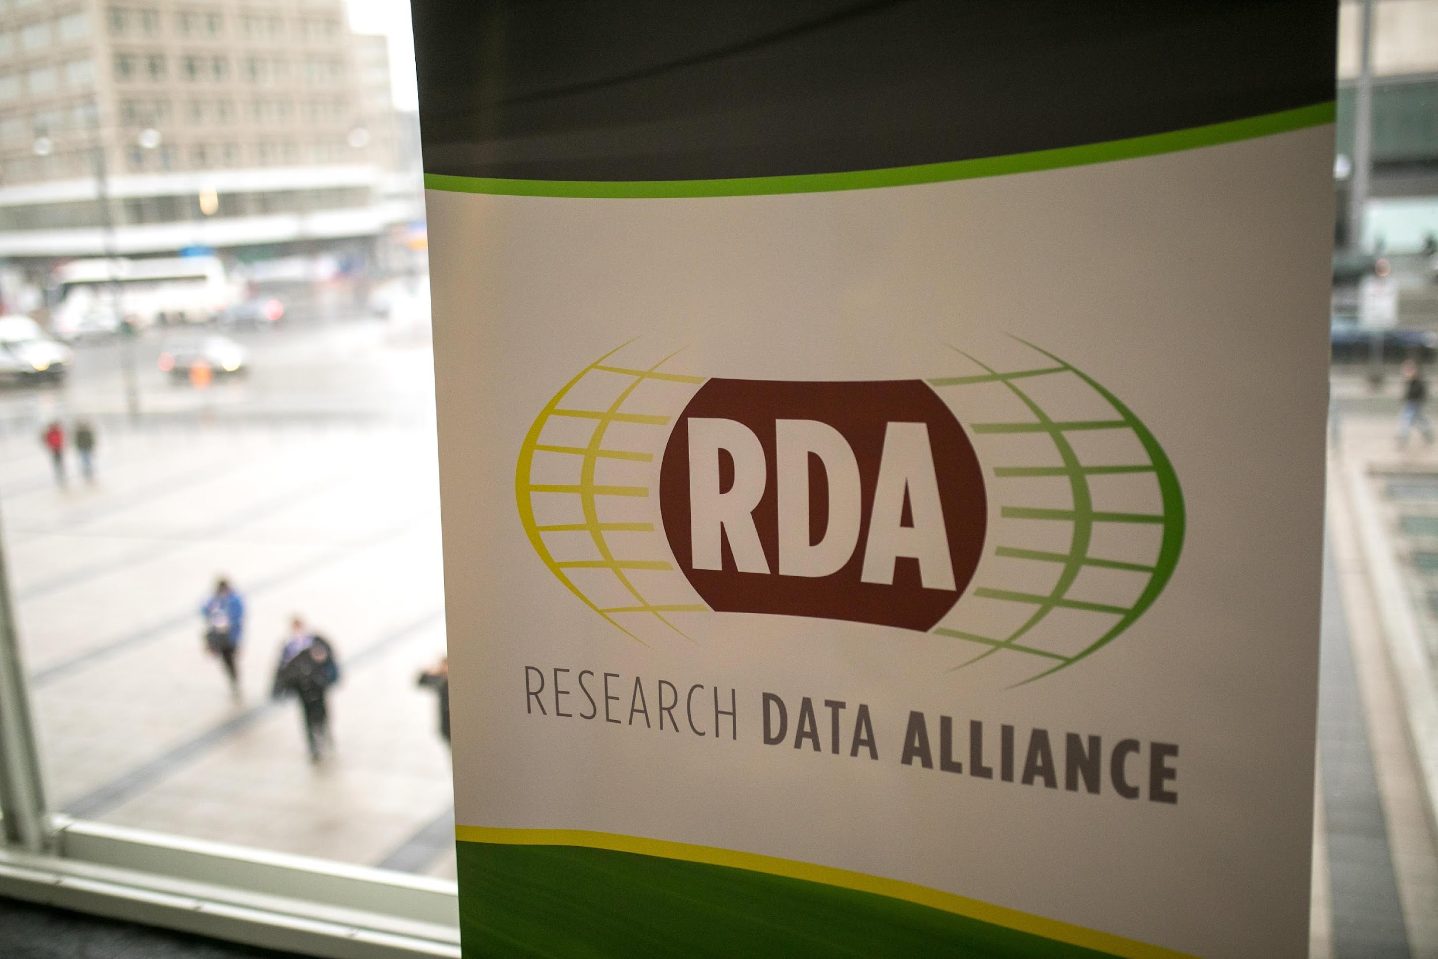
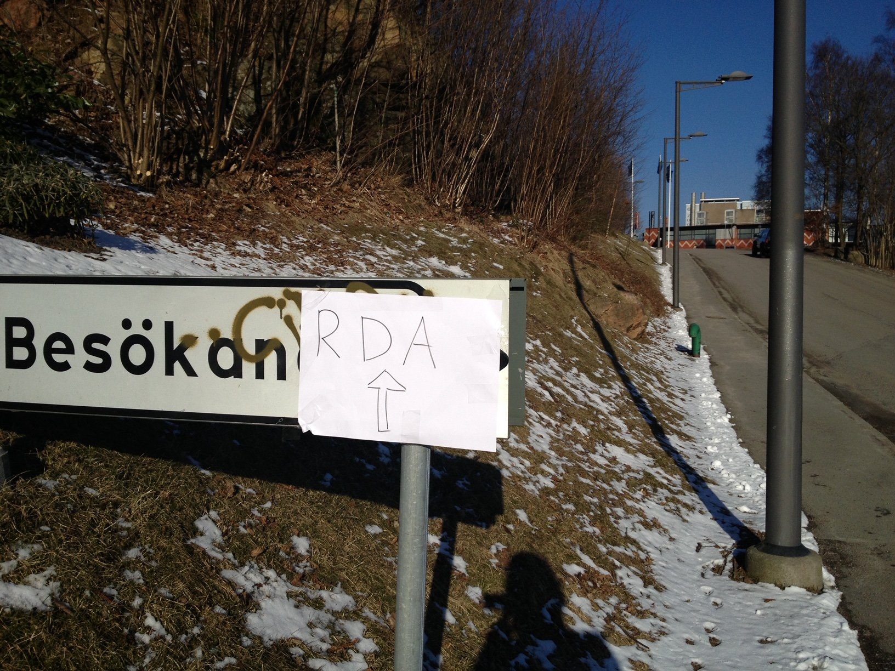
1st RDA Plenary (Goteborg, Sweden)
18-20 March 2013
Theme: “Launching the Research Data Alliance”
300 attendees from 22 countries
Hosted by RDA Europe, Chalmers University Sweden
https://www.rd-alliance.org/plenaries/rda-first-plenary-meeting-gothenburg-sweden

Slide 6
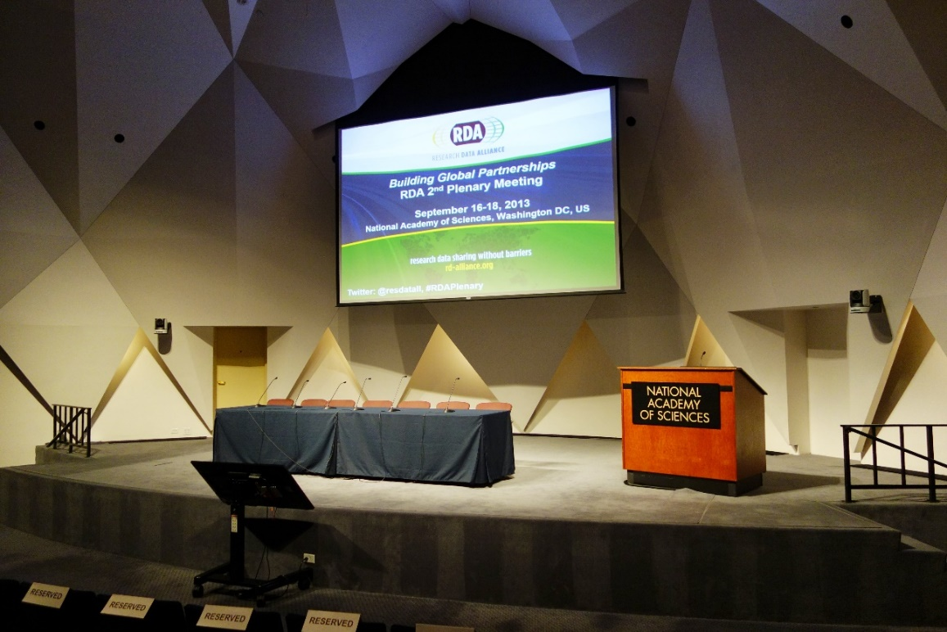
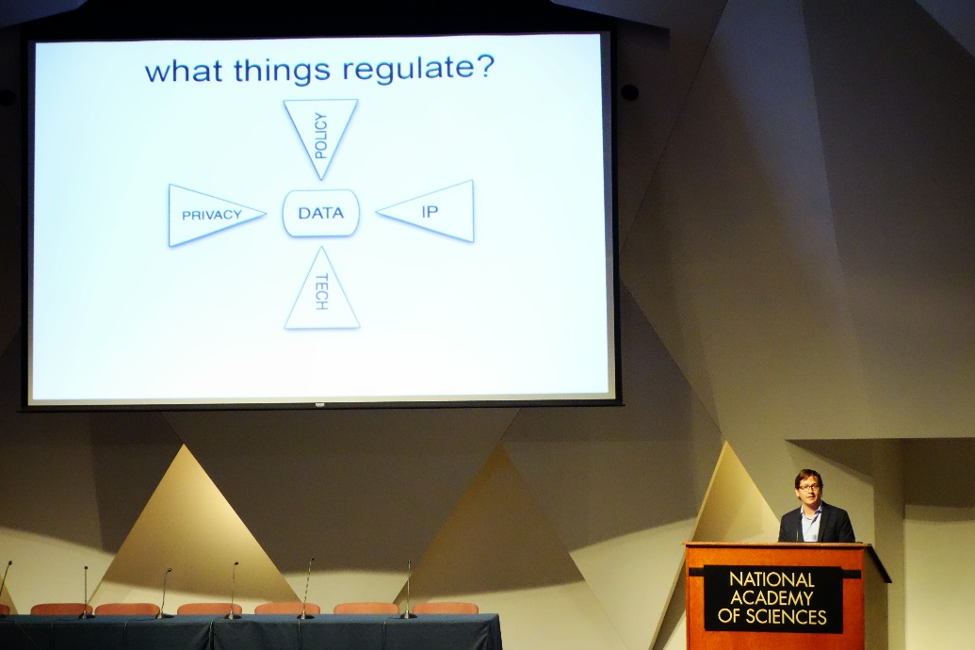
RDA Plenary 2 (Washington DC, USA)
16-18 Sept 2013
Theme : “Building Global Partnerships”
364 attendees from 23 countries
Hosted by RDA US
https://www.rd-alliance.org/plenaries/rda-second-plenary-meeting-washington-dc-us

Slide 7
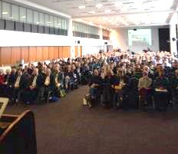
RDA Plenary 3 (Dublin, Ireland) 26-28 March 2014
Theme: “Playing YOUR part”
500 attendees from 35 countries
Hosted by Ireland and Australia
Co-located events:
EUDAT Training
MUMIA Meeting on Verifiable Results in Multi-lingual/Multi-faceted Search: Challenges in Sharing Data, Tools and Results Workshop
SIM4RDM: Building Collaborations to address research data management workshop
APARSEN-EUDAT-SCIDIP-ES Workshop on Data Preservation and Re-use
Focus on emerging professionals :
RDA/EU sponsored 22 European Early Career Researchers and Scientists
RDA/US sponsored 8 Student Interns
https://www.rd-alliance.org/plenaries/rda-third-plenary-meeting-dublin-ireland

Slide 8
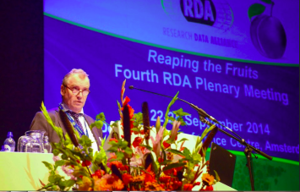
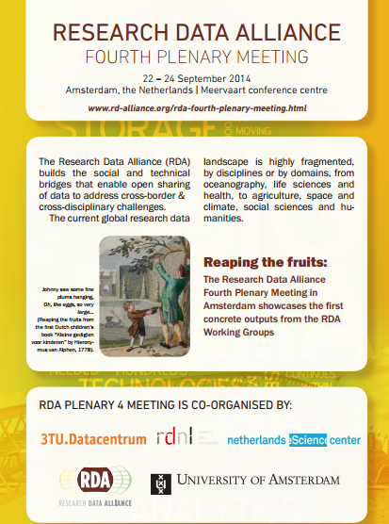
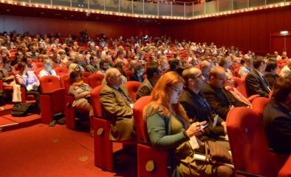
RDA Plenary 4 (Amsterdam) 22-24 September 2014
Co-located conferences:
EUDAT Conference
Crowd Computing 2014
Data Seal of Approval Conference 2014, etc.
1st RDA deliverables presented:
Data Type Registries
PID Information Types
Practical Policy
Data Foundation and Terminology
Focus on emerging professionals :
RDA/EU sponsored 14 European Early Career Researchers and Scientists
RDA/US sponsored 8 Student Interns and 5 Early Career and Student Fellows
Theme: “Reaping the Fruits”
550 attendees from 40+ countries & Co-hosted by DANS, Netherlands
https://www.rd-alliance.org/plenaries/rda-fourth-plenary-meeting-amsterdam-netherlands

Slide 9
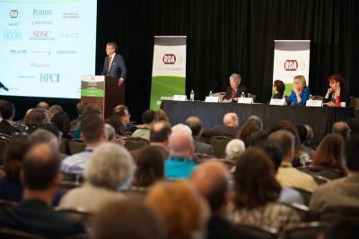
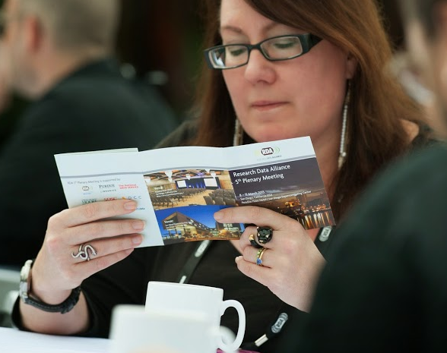
RDA Plenary 5 (San Diego, CA) 8-11 March 2015
1st Adoption Day & Large scale data projects meeting
2nd Set of RDA deliverables presented:
Data Citation: Making Data Citable
Data Description Registry Interoperability
Metadata Standards Directory
Wheat Data Interoperability
Focus on emerging professionals :
RDA/EU sponsored 5 European Early Career Researchers and Scientists
RDA/US sponsored 5 Fellowship winners
Theme: “Adopt-a-Deliverable”
385 attendees from 30 countries & Supported by the San Diego Super Computing Center
https://www.rd-alliance.org/plenaries/rda-fifth-plenary-meeting-san-diego-ca-us

Slide 10
RDA Plenary 6 (Paris) – 23- 25 September 2015
RDA deliverables presented:
Repository Audit and Certification DSA–WDS
RDA/WDS Publishing Data Bibliometrics
RDA/WDS Publishing Data Services
RDA/WDS Publishing Data Workflows
7 Adoption cases: Deep Carbon Observatory, Platform for Experimental Collaborative Ethnography, Datafed.net, the Materials Innovation Infrastructure, EUDAT Collaborative Data Infrastructure, German Climate Computing Center (DKRZ) & Common Language Resources and Technology Infrastructure (CLARIN)
Focus on enterprise & climate change:
20 enterprises showcased solutions
3 climate change data challenge winners – Biovel, Plume Labs, Vizonomy
Focus on emerging professionals :
RDA/EU sponsored 12 European Early Career Researchers and Scientists & RDA/US sponsored 8 Fellowship winners
Theme: “Enterprise Engagement with a focus on Climate Change”
700 attendees from 40+ countries & hosted by Cap Digital – France
Co-located conferences:
eInfrastructures & RDA for Data Intensive Science
Persistent Identifiers: Enabling Services for Data Intensive Research
https://www.rd-alliance.org/plenaries/rda-sixth-plenary-meeting-paris-france

Slide 11
7 RDA Recommendations/outputs presented:
Repository Audit and Certification DSA–WDS
RDA/WDS Publishing Data Bibliometrics
RDA/WDS Publishing Data Services
RDA/WDS Publishing Data Workflows
Wheat Data Interoperability Recommendations
RDA/CODATA Summer Schools in Data Science and Cloud Computing in the Developing World Interim Recommendations
Brokering Governance Interim Recommendations
11 adoption presentations
30 international speakers over 5 plenary sessions
7 outputs & 11 adoption cases
8 Working Group meetings
25 Interest Group meetings
10 Birds of a Feather
9 Joint meetings
2 Organisational Member meetings
RDA for Newcomers Meeting
357 attendees from 33 countries
https://www.rd-alliance.org/plenaries/rda-seventh-plenary-meeting-tokyo-japan

Slide 12
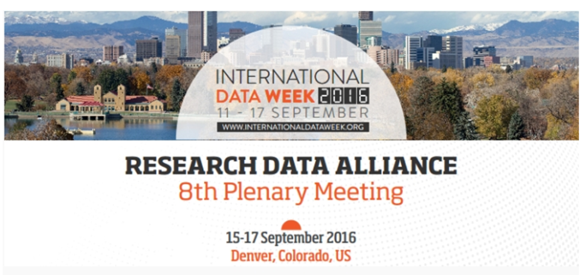
RDA deliverables presented:
RDA/CODATA Summer Schools in Data Science and Cloud Computing in the Developing World WG
Brokering Governance WG
Metadata Standards Catalog WG Recommendations
Biosharing Registry WG Recommendations
Scholix Franmework
+ 6 Adoption cases
69 Breakout session meetings:
12 BoF Meetings
31 Interest group meetings
10 Working group meetings
16 Joint group meetings
69 Breakout sessions
Newcomers Session, 2 RDA organisational members meeting, TAB and Chairs session
RDA/EU sponsored 8 European Early Career Researchers and Scientists & RDA/US sponsored 8 Fellowship
42 posters on display
549 participants from 33 countries
https://www.rd-alliance.org/plenaries/rda-eighth-plenary-meeting-denver-co

Slide 13
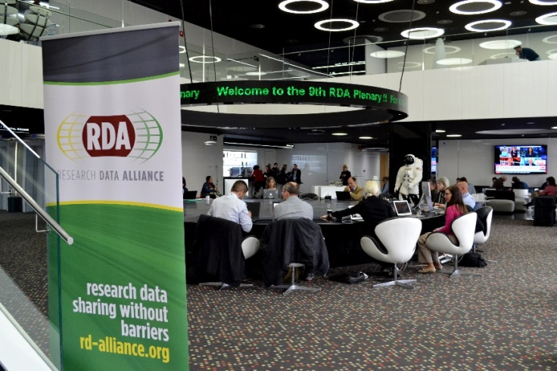
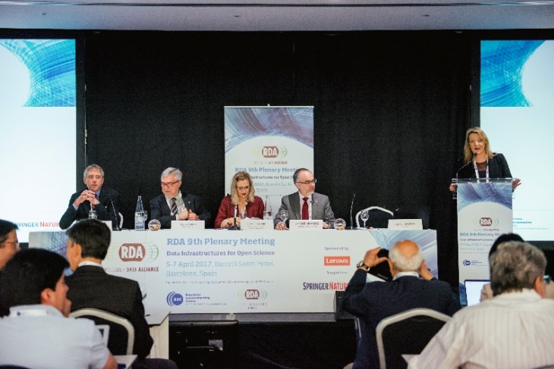
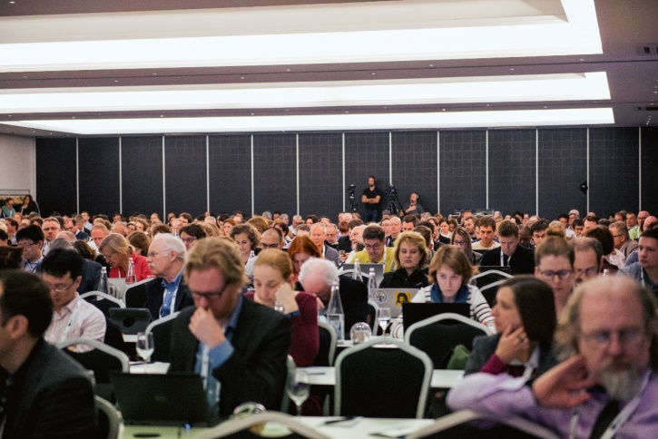
73 Breakout meetings
of which 15 Working Groups
of which 32 Interest Groups
of which 13 Joint Working & Interest Groups
of which 13 Birds of a Feather
3 Outputs presented
54 Posters
620 participants from 45 countries
https://www.rd-alliance.org/plenaries/rda-ninth-plenary-meeting-barcelona

Slide 14
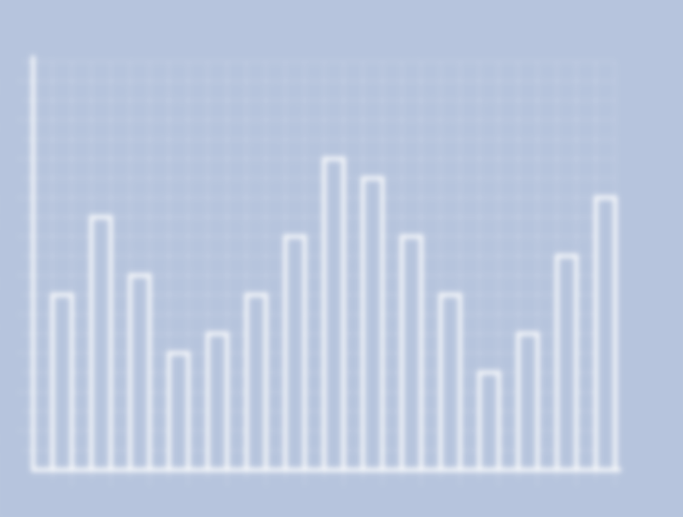
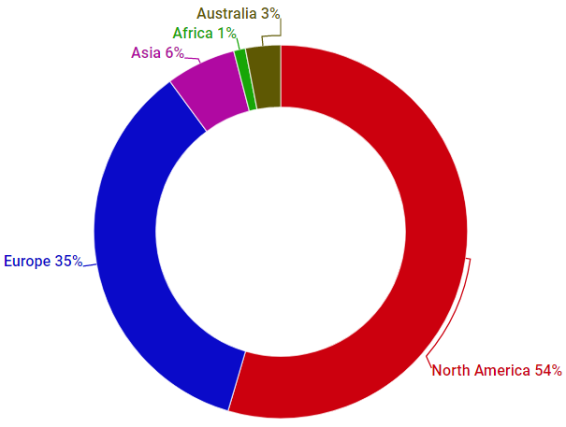
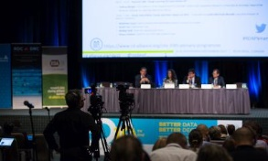
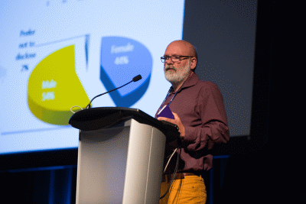
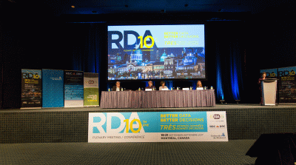
Over 430 participants from 30 countries
Increased female participation 44%
the highest sofar
73 Breakout meetings
of which 14 Working Groups
of which 37 Interest Groups
of which 6 Joint Working & Interest Groups
of which 16 Birds of a Feather
6 Outputs presented / 1 Final Release
60 Posters
https://www.rd-alliance.org/plenaries/rda-tenth-plenary-meeting-montr%C3%A9al-canada

Slide 15
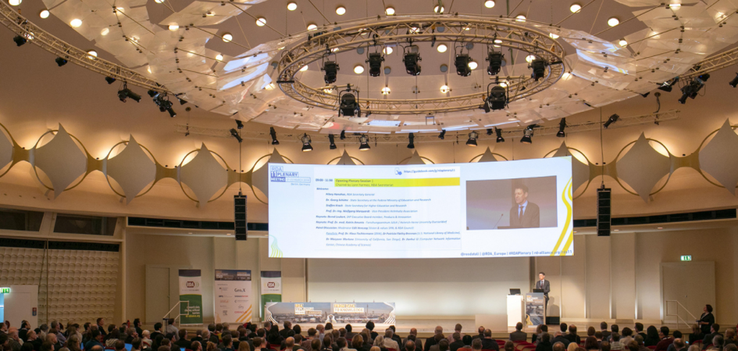
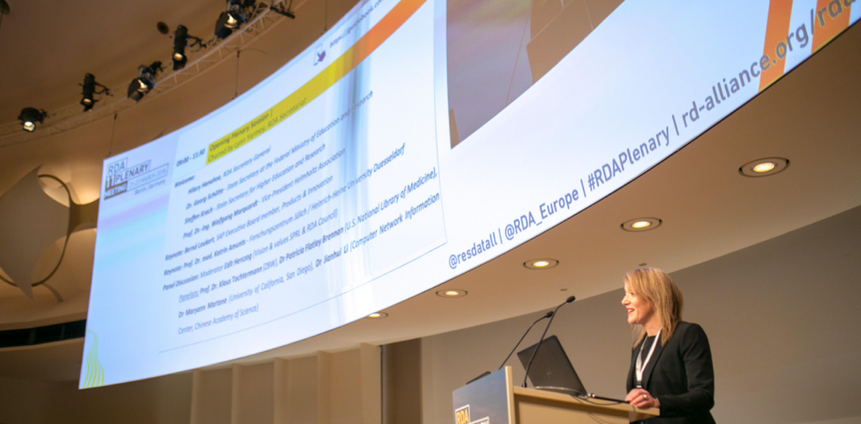
83 Breakout meetings
19 Working Groups
37 Interest Groups
12 Joint Working & Interest Groups
15 Birds of a Feather
4 Final Recommendations presented
3 New Recommendations
Collaboration projects with AGU and ISO on adoption and impact metrics
74 posters applications
661 participants from 41 countries
https://rd-alliance.org/plenaries/rda-eleventh-plenary-meeting-berlin-germany

Slide 16
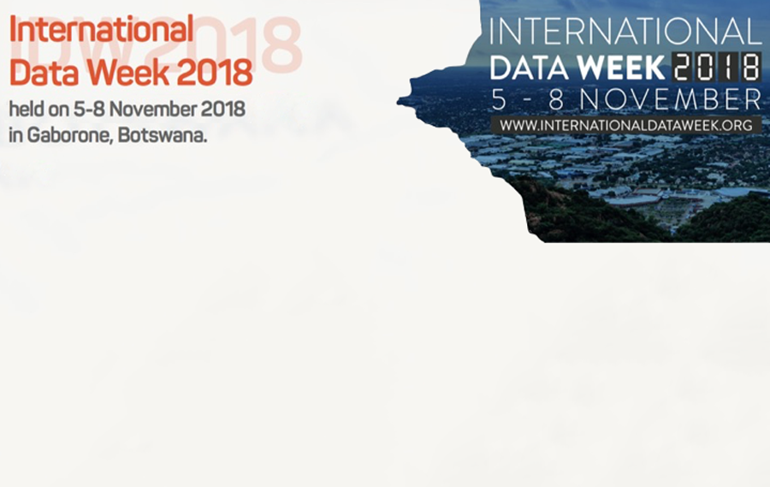
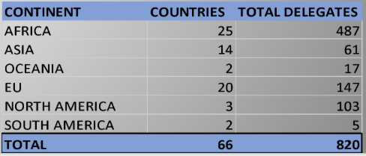
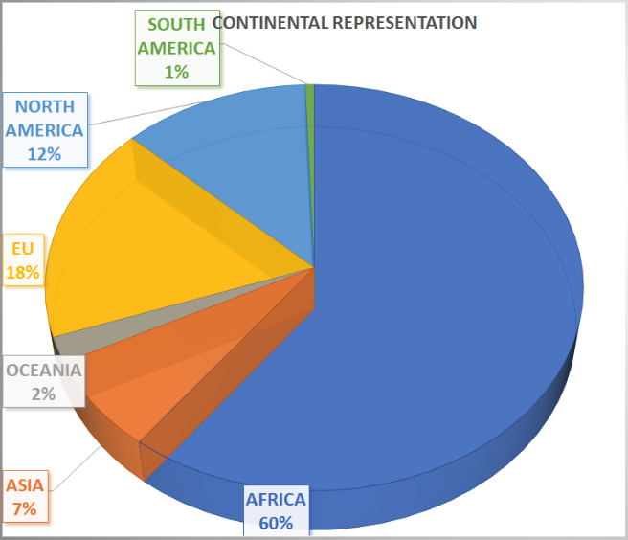
Attendees at P12
RDA 58 breakout meetings over the 7 allocated RDA sessions.
13 of those were Birds of a Feather (BoF),
11 working groups
28 Interest groups
11 joint group meetings to cross fertilise amongst groups with a common interest or activity focus.
https://www.rd-alliance.org/plenaries/rdas-12th-plenary-meeting-part-international-data-week-2018-gaborone-botswana

Slide 17
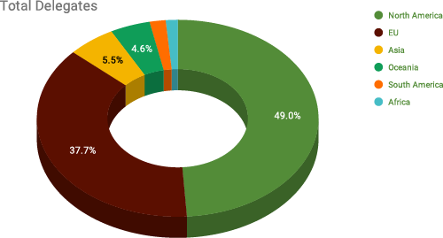
RDA Plenary 13, Philadelphia, PA 2 - 4 April 2019
Attendees at P13
Continent | Countries | Total Delegates
North America | 2 | 213
Europe | 17 | 164
Asia | 7 | 24
Oceania | 1 | 20
South America | 3 | 8
Africa | 4 | 6
62 breakout meetings over the 8 allocated RDA sessions.
13 of those were Birds of a Feather (BoF),
13 working groups
30 Interest groups
14 joint group meetings to cross fertilise amongst groups with a common interest or activity focus.
Organised by:
https://www.rd-alliance.org/plenaries/rdas-13th-plenary-meeting-philadelphia-us

Slide 18
RDA Plenary 14, Helsinki, Finland 23 – 25 October 2019
Data Makes the Difference
86 breakouts including
23 WGs, 42 IGs, 13 BoF and 8 joint Group meetings
94 poster presentations
https://www.rd-alliance.org/plenaries/rdas-14th-plenary-helsinki-finland

Slide 19
https://www.rd-alliance.org/plenaries/rda-15th-plenary-meeting-australia

Slide 20
RDA VP15 in numbers …
2 Keynote addresses
170 registered
90 registered
45 virtual sessions -> 34 unique
of which:
4 Joint meetings
13 Interest Group meetings
8 Working Group meetings
9 BoFs (Birds of a Feather)

Slide 21
RDA VP15 in numbers …
2,170 total registrants:
of which
270 for keynote webinars
1,900 for virtual breakout sessions
900 unique attendees at virtual sessions
3 Virtual coffee breaks – 9 April 2020

Slide 22
and RDC
https://www.rd-alliance.org/plenaries/rda-16th-plenary-meeting-costa-rica

Slide 23
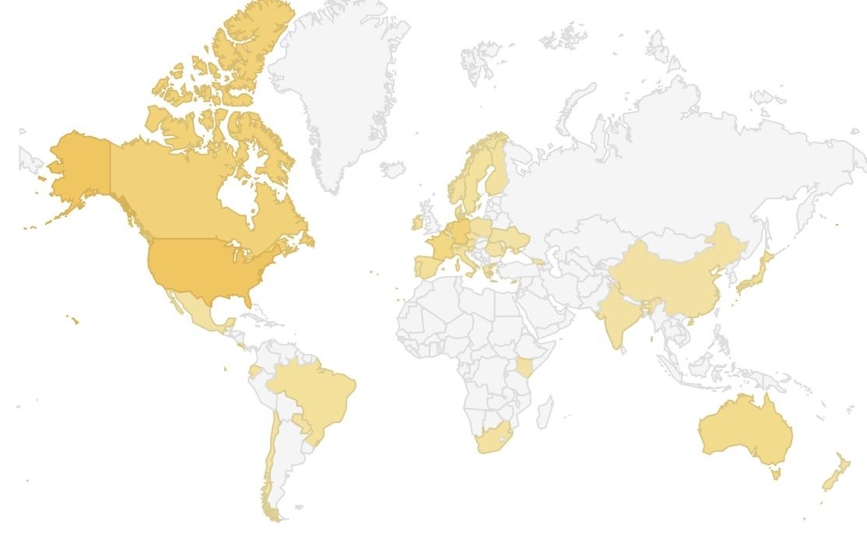
RDA Virtual Plenary 16 Snapshot
Americas | 297
Africa | 8
Asia | 21
Europe | 329
Oceania | 42
Total VP16 Participants | 697

Slide 25
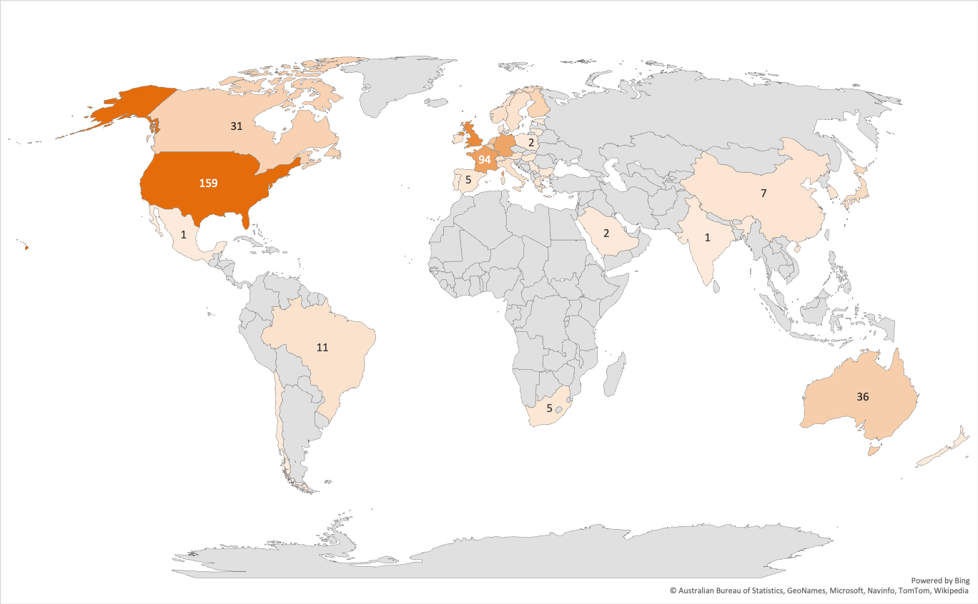
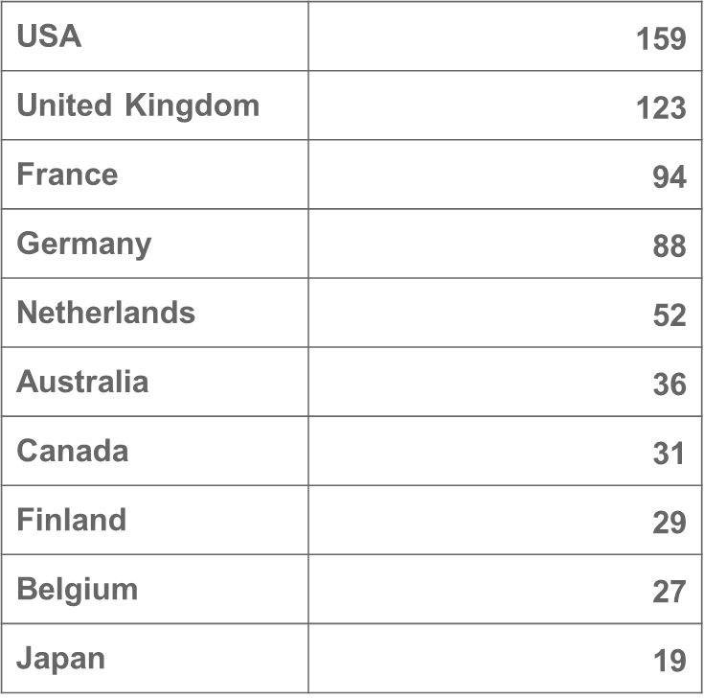
The RDA VP17 Participants
829 Participants from 35 Countries
Top 10 countries:

Slide 26
The RDA VP17 Meetings (Total: 123)

Slide 27
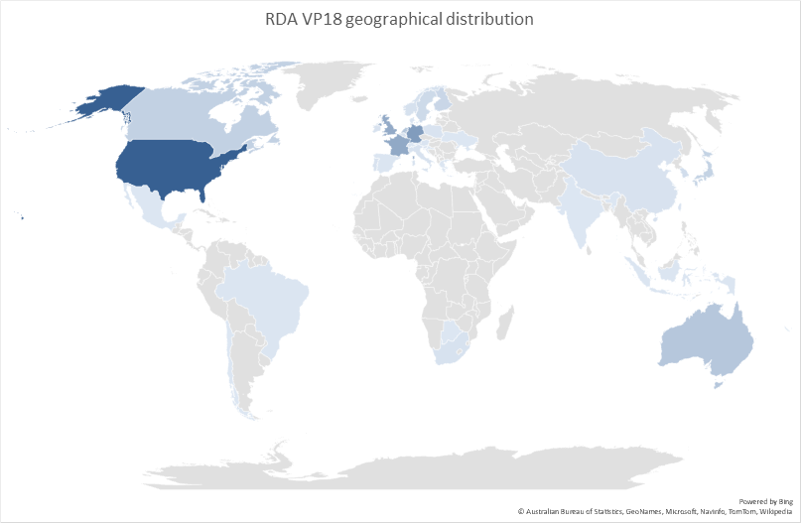
Top 10 countries:
USA | 154
Germany | 85
France | 71
UK | 69
Netherlands | 39
Australia | 36
Canada | 25
Japan | 23
Finland | 19
Sweden | 15
626 participants from 40 different countries

Slide 28
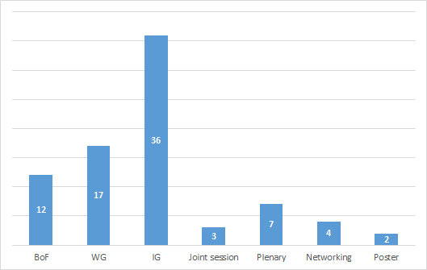
RDA Virtual Plenary 18 Sessions
Total working meetings / sessions: 81
Birds of a Feather: 12
Interest Groups: 36
Working Groups: 17
Joint meetings: 3
Networking sessions: 4
Plenary sessions: 7
Poster sessions: 2
https://www.rd-alliance.org/plenaries/rda-18th-plenary-meeting-virtual

Slide 29
19th Plenary Meeting at IDW2022
https://www.rd-alliance.org/plenaries/rda-19th-plenary-meeting-part-international-data-week-20%E2%80%9323-june-2022-seoul-south-korea

Slide 30
Rundown of IDW 2022
50 Countries, 827 Global Participants
Asia 13 countries, 298 participants
Europe 20 countries, 272 participants
Africa 5 countries, 35 participants
North America 2 countries, 140 participants
South America 4 countries, 13 participants
Oceania 2 countries, 64 participants
Middle East 4 countries, 5 participants

Slide 31
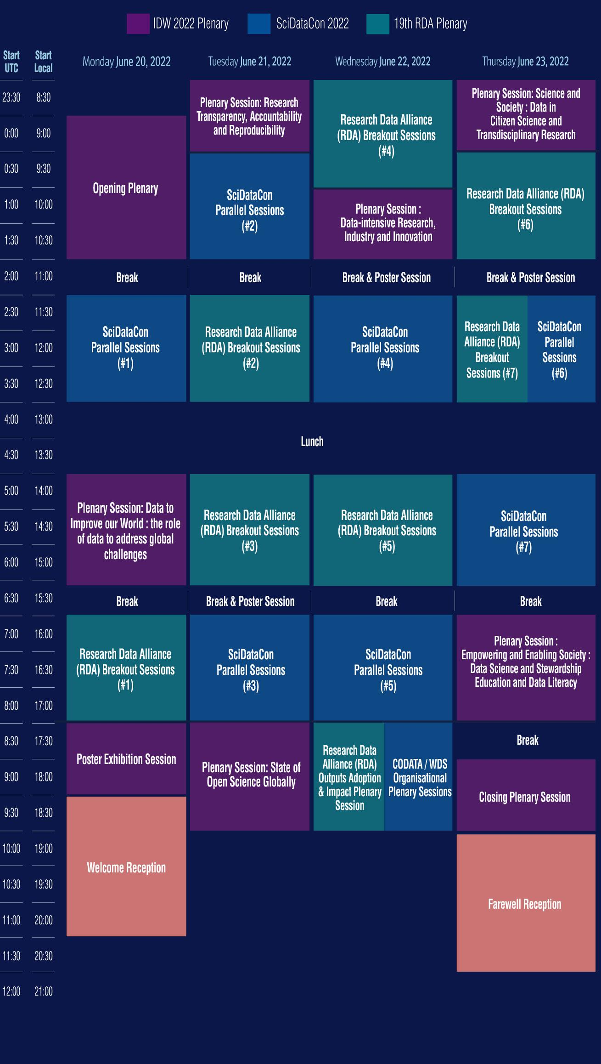
Run Down of IDW 2022
Number of Session Operated
Plenary (8)
RDA (73)
SDC (47)
Co-located Events (7)
Poster Exhibition (4)
Total 139
Fully Virtual Sessions (48)
Hybrid Sessions (91)

Slide 32
RDA Breakout session summary
73 RDA sessions of which:
1 Community of practice meeting (Fully virtual)
3 Joint group sessions (Fully virtual)
15 Working Group meetings (Hybrid-5, Virtual-10)
27 Interest Group meetings (Hybrid-12, Virtual-15)
11 BoF meetings (Hybrid-6, Virtual-5)
39 RDA posters (Hybrid-7, Virtual-32)
https://www.rd-alliance.org/rdas-19th-plenary-highlights
Presentation of RDA 19th Plenary meeting Breakout session key messages and next steps. Organised and presented by Technical Advisory Board (TAB) and clustered according to Plenary Pathways. Recordings available on RDA web site.
ALL RECORDINGS AVAILABLE ON RDA P19 PROGRAMME

Slide 33
Research Data Alliance 10th Anniversary Plenary meeting
Gothenburg, Sweden, March 21-23, 2023
Co-hosted by Chalmers University of Technology, Chalmers e-Commons and
University of Gothenburg, Swedish National Data Service (SND)
https://www.rd-alliance.org/plenaries/rda-20th-plenary-meeting-gothenburg-hybrid

Slide 35
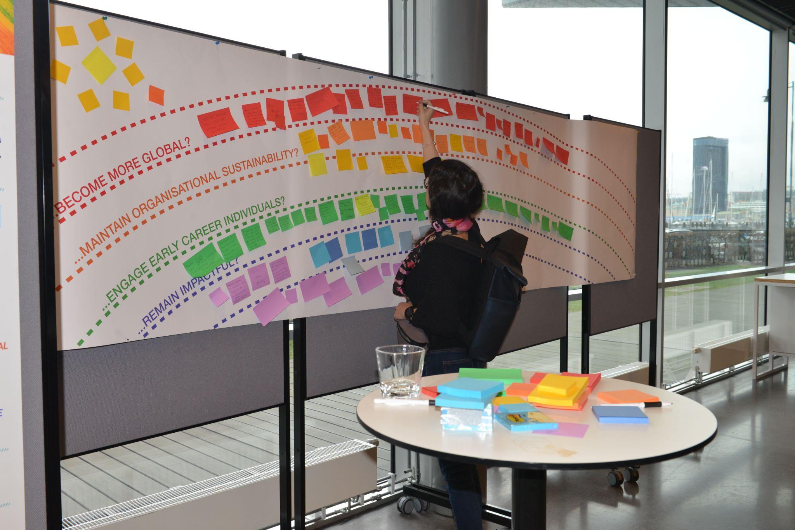
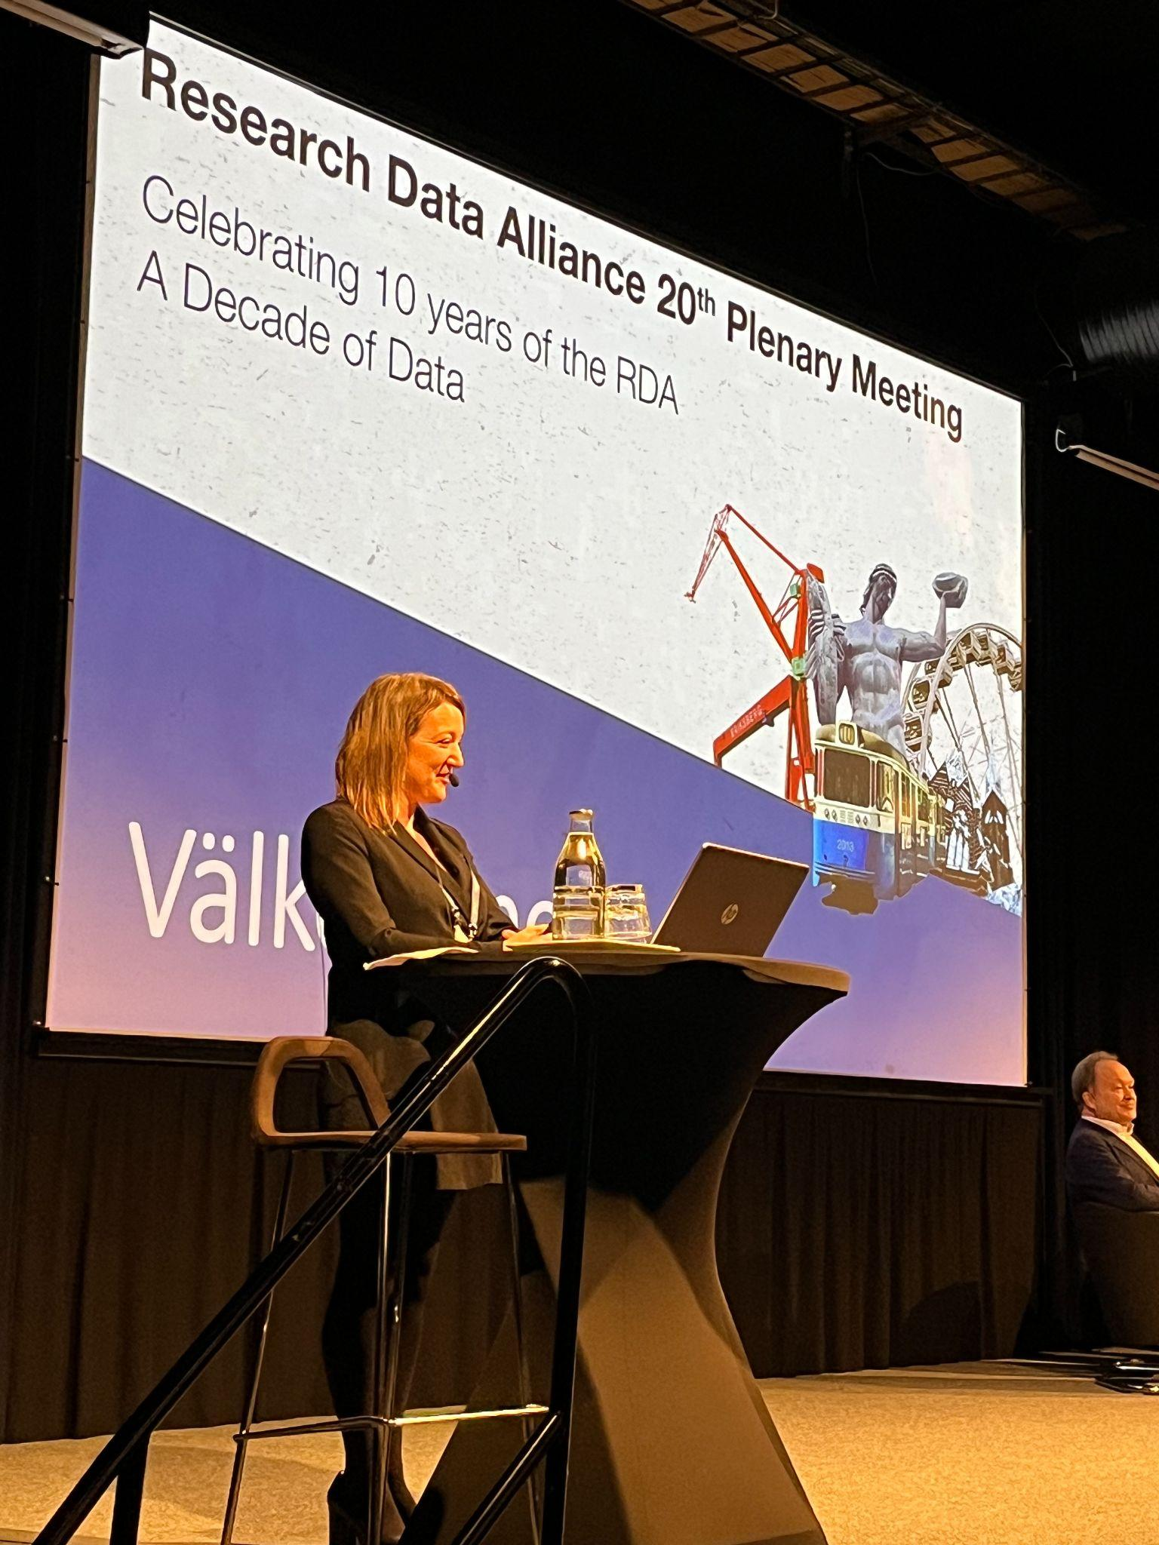
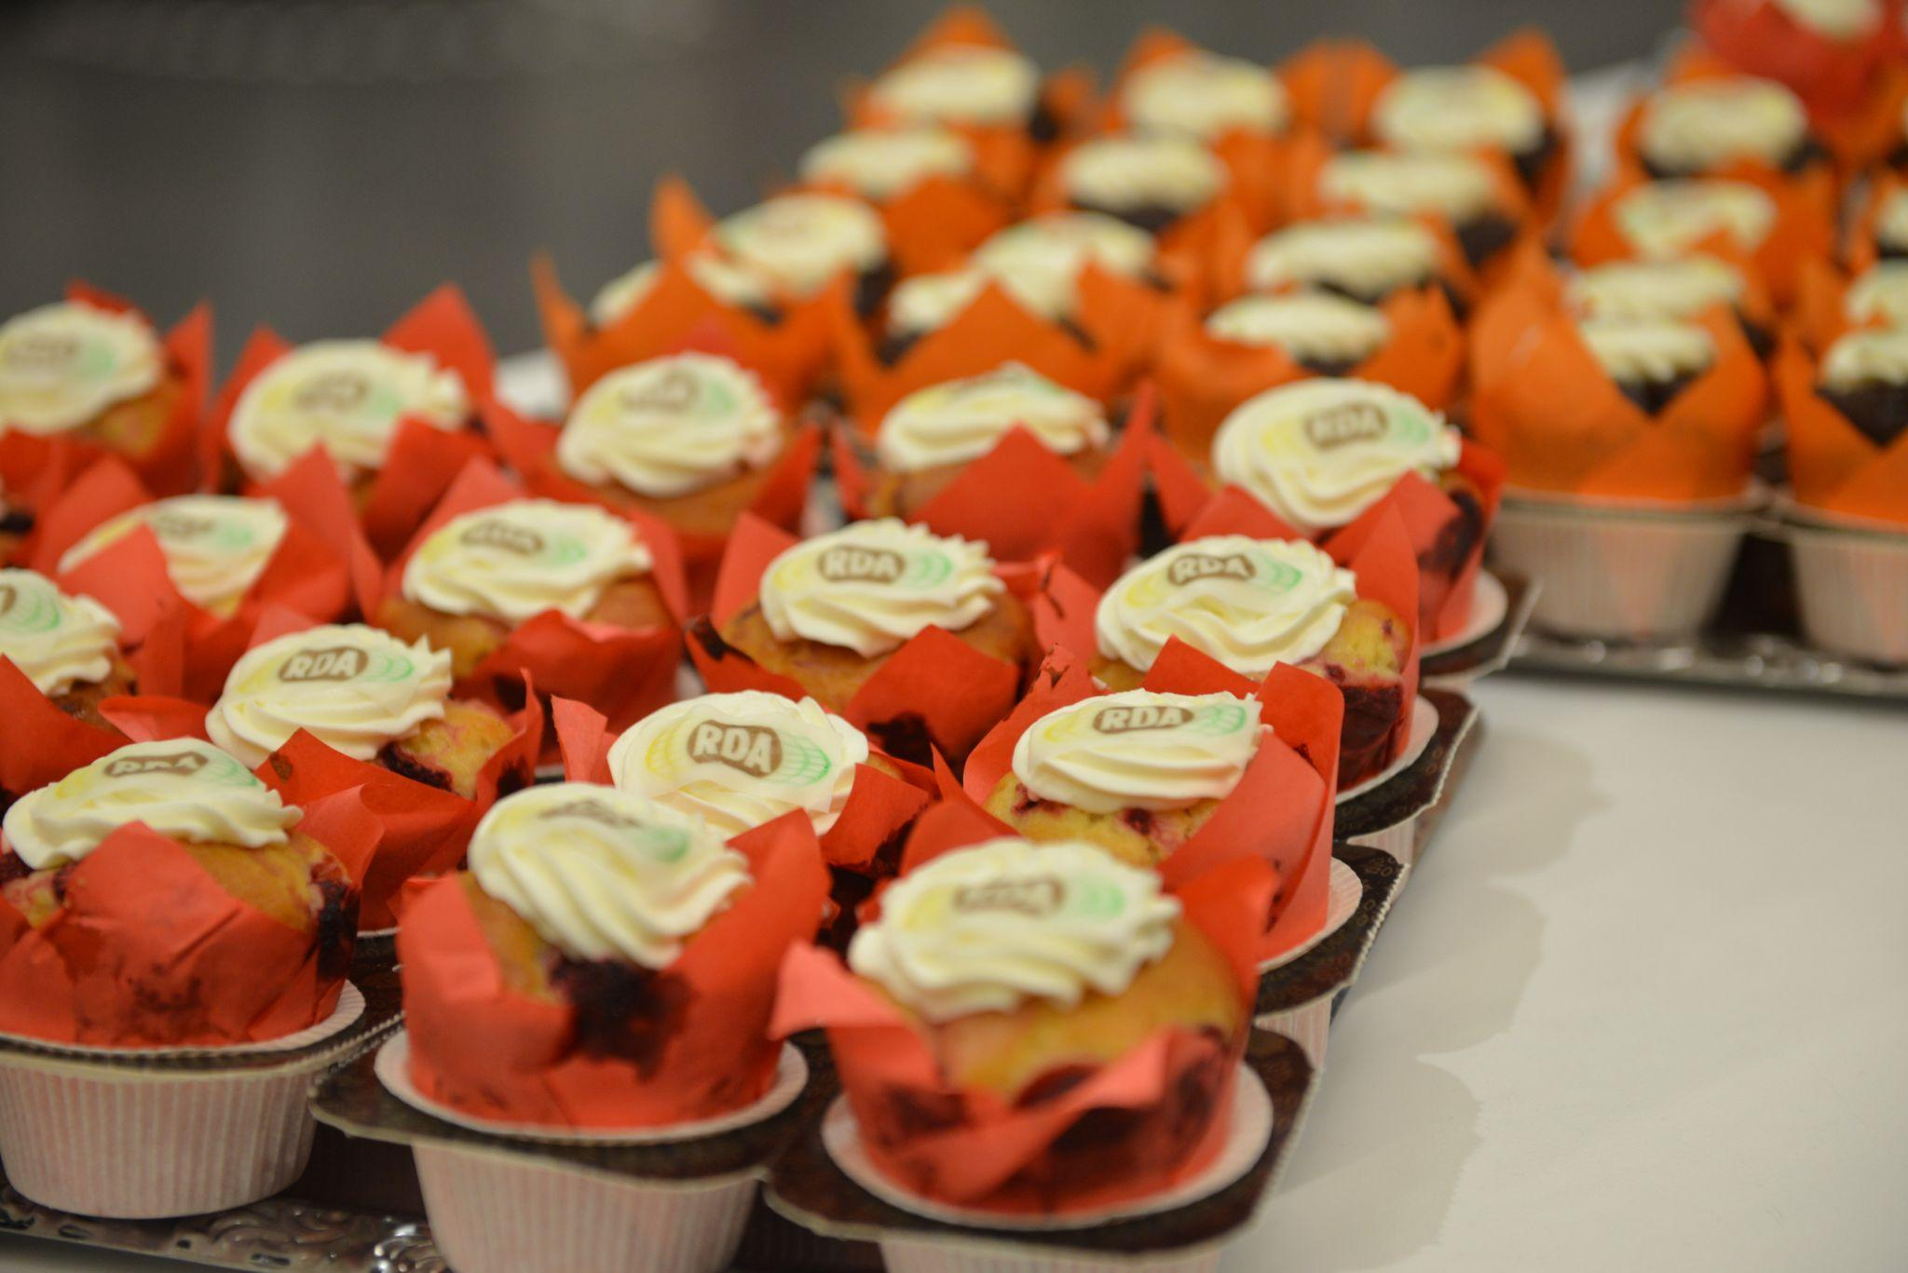
20th Plenary Meeting Breakout Sessions Summary & the RDA’s 10th Anniversary Celebration
13 Co-located events of which:
8 events were held on 20th March
5 events on 24th March
53 RDA sessions of which there were
7 Plenary meetings
46 Breakout sessions in total of which:
8 BoF meetings
20 Interest Group meetings
10 Working Group meetings
7 Joint group sessions
1 Community of practice meeting

Slide 36
RDA’s Plenary 21st [part of International Data Week 2023]

Slide 37
⇨View Plenary Takeaways⇦
https://www.rd-alliance.org/rdas-21st-plenary-programme

Slide 38
Learn More Here

Slide 39
RDA’s 23 Plenary, San Jose, Costa Rica
⇨Learn More About P23⇦

Slide 40
⇨Learn More About IDW 2025/RDA P25⇦
Including
Research Data Alliance 25th Plenary Meeting

Slide 41
⇨Learn More About IDW 2027/RDA Plenary⇦
Including Research Data Alliance Plenary Meeting

Slide 42
RDA Global Contact Details
Email - enquiries@rd-alliance.org
Web - www.rd-alliance.org
X [formerly Twitter] - @resdatall
LinkedIn - www.linkedin.com/in/ResearchDataAlliance
Contact for the RDA Plenaries
Irina Hope, RDA Global Events Manager
Email - irina.hope@rda-foundation.org

