Slide 1
DFIG Core Session - where are we, where to go - Alan Blatecky, Peter Wittenburg, Yunkiang Zhu

Slide 2
Agenda
Breakout 1: Discussion about Guidelines/Recommendations
Breakout 2: configuration building and Minimal PID Types
Breakout 4: DFIG Core Session
Breakout 5: Joint session with Brokering Group
Breakout 7: Joint meeting with Publishing Data Workflows
11.00 Welcome and overview (Peter)
11.15 Discussion about co-chairing (Zhu)
11.20 Guidelines/Recommendations (Peter)
11.30 Repository Registry Case Statement (Peter)
11.45 Components and configuration building (Larry)
12.20 How to go ahead and other issues (Alan)
12.30 End
DFIG is in phase of change – also wrt ch-chairs

Slide 3
Quick Look Back I
Data Foundation&
Terminology
and now?
are there links?
shouldn‘t it all come
together?
Data Fabric IG
bring people together
bring pieces together
look at the whole picture
identify gaps
focus on data creation/consumption
processes
Data Type
Registry
Metadata Standards
Directory
PID Information
Types
Practical Policy

Slide 4
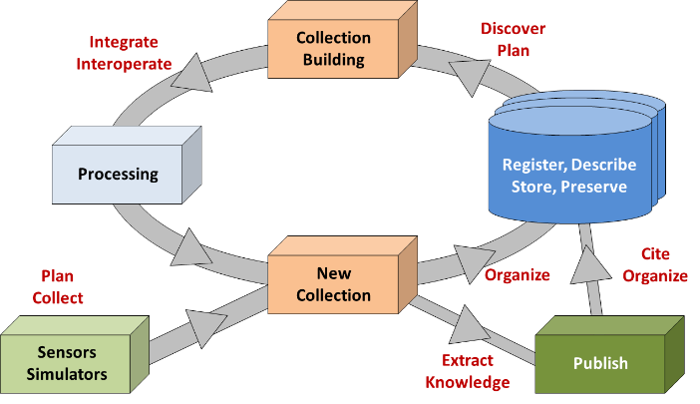
Quick Look Back II
Observations
Experiments
Simulations
etc.
This slides indicated the continuous cycle of creating data as raw or as derived data based on collections of existing data.

Slide 5
Quick Look Back III
configuration A
configuration B
Common
Components
& Services
Task to solve:
Identify and specify Common Components (CoCo)
Recommend CoCo
Put CoCo in place
Task is not to identify ONE architecture, but to identify CoCos that could cooperate in specific configurations to solve a function (infra, VRE, etc.)
Specific
Components
& Services

Slide 6
DFIG Tracks - Current Focus
DFIG tracks of work
White Paper & Docs need an update!!
Use Cases not in focus
Identifying components shift to configuration work
Testing components pushed a lot
Repository Registry case statement to TAB
Guidelines Discussion in focus
GEDE group in EU
Configuration building in focus - need to deliver
Short term track fill the immediate gap
Global DO cloud next step

Slide 7
Co-Chairs
Alan, Peter and Zhu did it for some time
Alan and Zhu stopping now
Peter will stop in Barcelona
Need new co-chairs – also RDA rules
Have 2 excellent candidates
Bridget Almas (US)
Li, JianHui (China)
Anyone else?
One European candidate to start in Barcelona

Slide 8
Bridget and Jianhui
Bridget Almas
Tufts University, Software Architect, Perseus Project and Perseus Digital Library
Active In RDA since 2013, former member of TAB, currently also co-chair of Collections WG
Interested in DFIG for its impact contextualizing the outputs of RDA
Li Jianhui
Computer Network Information Center, CAS, research fellow
Develop advance Scientific data infrastructure for CAS
Active in CODATA as a member of executive committee
Interested in DFIG due to its relevant topics

Slide 9
Repository Registry – how to move ahead
repository registries such as re3data that collect much useful information about repositories for human consumption mainly
collection registries describe major collections also meant mainly for human consumption informing
federation repository registries (FRR) as they are required in the increasingly large federations that are meant mainly for machine consumption to enable efficient operation
for FRR WG Case Statement has been submitted
need to make a campaign still – no time yet

Slide 10
Guidelines – how to move ahead
Guidelines session in Breakout 1 - summary
Presented the approach
Define bundles & start with the PID bundle
Integrate relevant assertions from initiatives
Build short living charrettes to find common messages and areas of disagreements
Broad integration of practitioners is important
Have GEDE in Europe with 45 infras involved
What in other regions?
Does it all make sense?
Will it work?

Slide 11
Linking Up with Other Groups
Publishing Workflow Group
Need to build bridges
Talking about the same core issues from 2 views
Data practitioners view – from the lab
Data publication view – from the publishing
Do we need to respect each other?
Brokering Group
Brokering: use external services
Where in the cycle could brokering help?
Which components should be offered by external SP?
PID System, Authorisation records, etc.

Slide 12
Agenda
Breakout 1: Discussion about Guidelines/Recommendations
Breakout 2: configuration building and Minimal PID Types
Breakout 4: DFIG Core Session
Breakout 5: Joint session with Brokering Group
Breakout 7: Joint meeting with Publishing Data Workflows
11.00 Welcome and overview (Peter)
11.15 Discussion about co-chairing (Zhu)
11.20 Guidelines/Recommendations (Peter)
11.30 Repository Registry Case Statement (Peter)
11.45 Components and configuration building (Larry)
12.20 How to go ahead and other issues (Alan)
12.30 End
DFIG is in phase of change – also wrt ch-chairs

