Slide 1
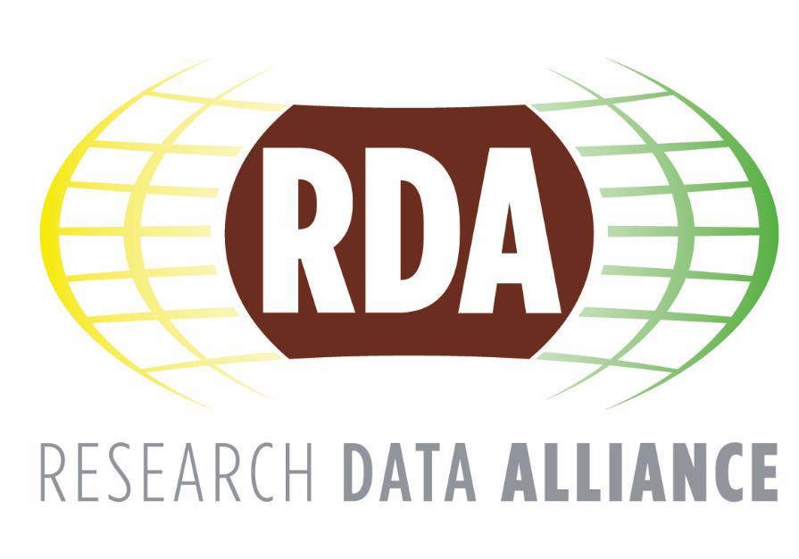
The Value of the RDA for Libraries
The research Data Alliance’s vision is researchers and innovators openly sharing data across technologies, disciplines, and countries to address the grand challenges of society

Slide 2
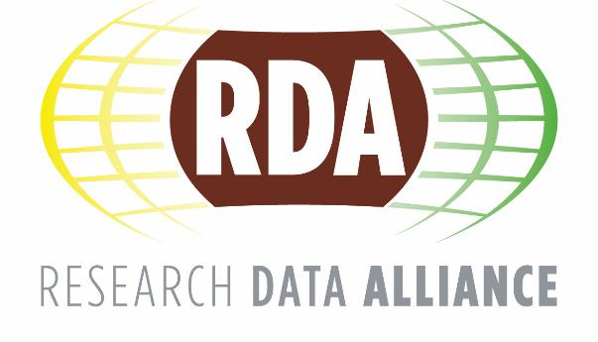
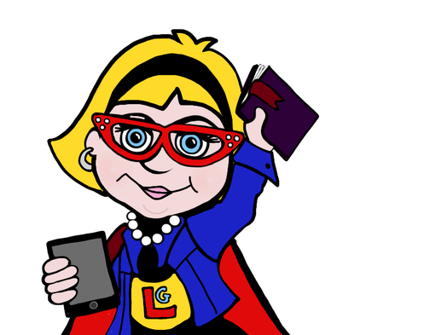
Why should libraries engage with RDA?
Interact with data professionals, researchers, ICT experts and academics;
Partner with experts to augment the library community and its interoperability solutions;
Develop strategic, collaborative relationships and partnerships with data producing stakeholders;
Engage in institution-wide advocacy processes;
Engage in an international forum;
Adopt RDA recommendations and outputs to support the strategic aims of libraries.

Slide 3
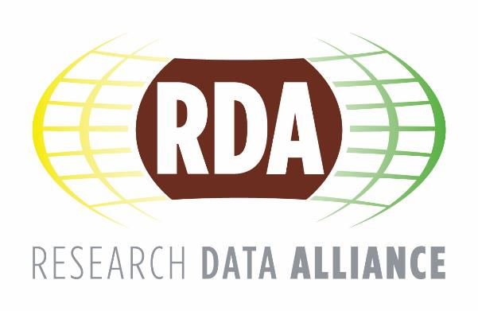
What’s in it for librarians and information management professionals?
Gain greater experience and expertise; ​
Enhance the quality and effectiveness of personal work and activities; ​
Improve your competitive advantage professionally;
Access an extraordinary network of international colleagues and organisations. ​

Slide 4
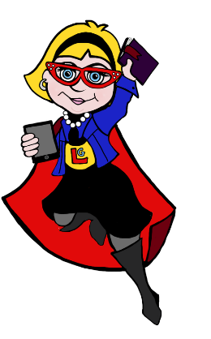
How can libraries engage?
Become part of a large, international data community; ​
Provide an organisational perspective of RDA - influence its direction, assist in the implementation and adoption of RDA’s Recommendations; ​
Join RDA as an organisational member and contribute an annual subscription fee;
As a library director, encourage your staff to become RDA community members.

Slide 5
Libraries offer significant contributions to the RDA by …
augmenting and enriching the worldwide network of data experts and information professionals;
contributing to the development and maintenance of high-quality, practical solutions for data interoperability in libraries across the globe;
acting as the bridge and communication hub for all activities surrounding the data creation and publication lifecycle;
acting as RDA adopters who amplify, direct, and promote RDA Recommendations for the greatest effect and utility in libraries.

Slide 6
Engaging with the RDA
Participate:
Nominate library staff to be involved in Working and Interest Groups;
Propose a new group to discuss and resolve a research data challenge
Follow and contribute to the RDA and Librarianship Archival Science and Information Service
Attend:
Send library representatives to the RDA biannual plenaries
Adopt:
An RDA Recommendation or Output
​

Slide 7
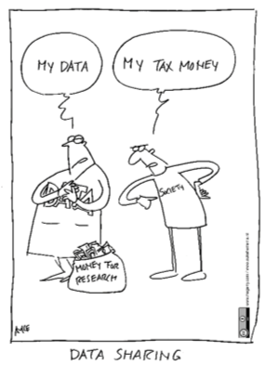
What does RDA do?
RDA is building the social and technical bridges that enable open sharing of data to achieve its vision of researchers and innovators openly sharing data across technologies, disciplines, and countries to address the grand challenges of society. ​
RDA members collaborate together across the globe to tackle numerous infrastructure & data sharing challenges related to:
Reproducibility
Data preservation
Best practices for domain repositories
Legal interoperability
Data citation
Data type registries
Metadata
So much more!

Slide 8
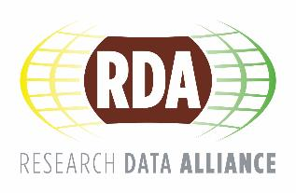
“At their core, libraries in the information age provide a public means of accessing knowledge” David Pescovitz, research director at the Institute for the Future.
“People will come to see libraries as places to create the future, not just learn about the present.”

Slide 9
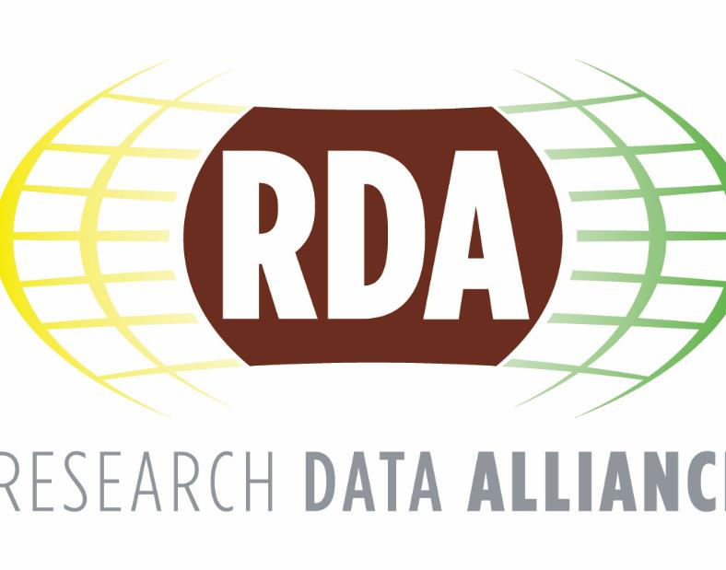
Libraries and RDA
Please use these slide sets for your own use.
To find out more about Libraries and RDA visit rd-alliance.org/get-involved/value-research-data-alliance-libraries
For the complete RDA Value statement for Libraries click here
Stay up to date with RDA:
Email - enquiries@rd-alliance.org​
Web - www.rd-alliance.org​
Twitter - @resdatall​
LinkedIn - www.linkedin.com/in/ResearchDataAlliance​
Hilary Hanahoe, Secretary General RDA – hilary.hanahoe@rda-foundation.org
Twitter - @hilaryhanahoe

Slide 10
