Slide 1
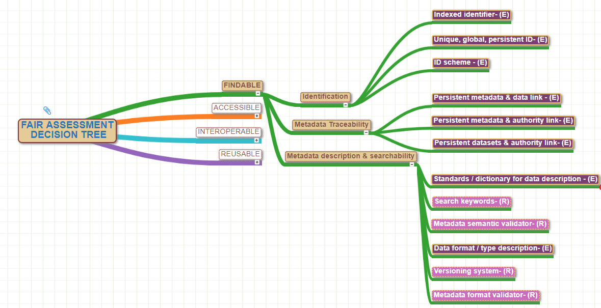
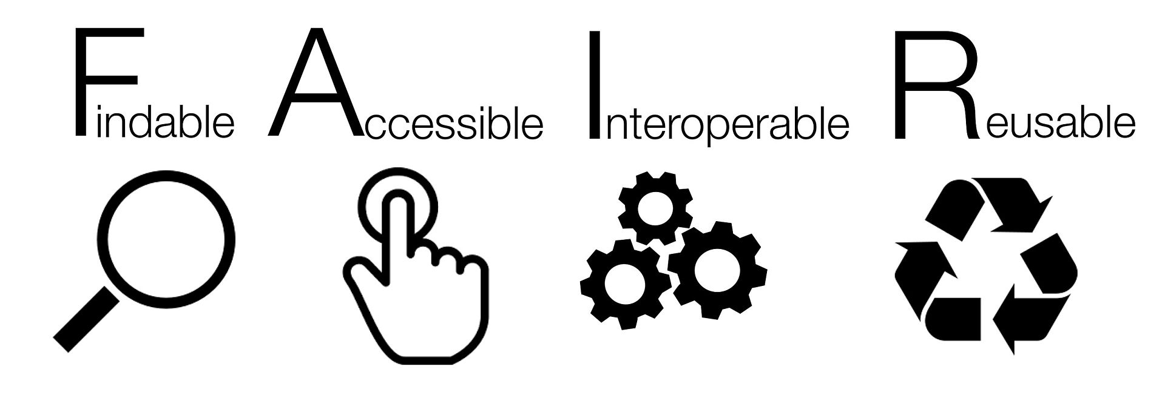
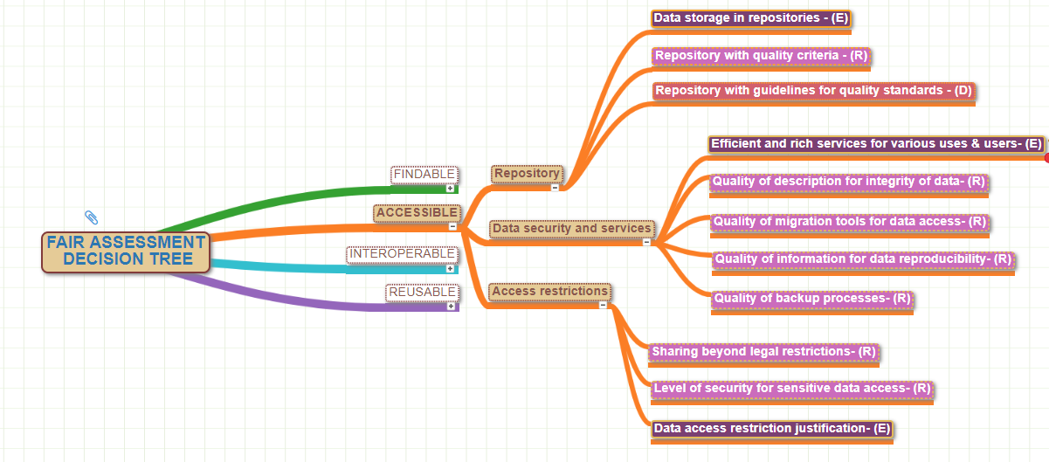
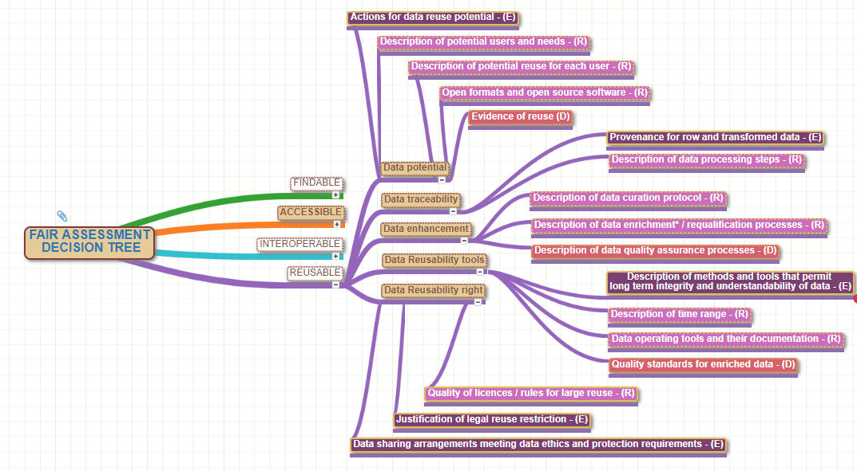
How to operationalize and to evaluate the FAIRness in the crediting and rewarding processes in data sharing: a step forward towards an extensive assessment grid.
Romain David, Laurence Mabile, Mohamed Yahia, Anne Cambon-Thomsen, Anne-Sophie Archambeau, Louise Bezuidenhout, Sofie Bekaert, Gabrielle Bertier, Elena Bravo, Jane Carpenter, Anna Cohen-Nabeiro, Aurélie Delavaud, Michele De Rosa, Laurent Dollé, Florencia Grattarola, Fiona Murphy, Sophie Pamerlon, Alison Specht, Anne-Marie Tassé, Mogens Thomsen, Martina Zilioli, and the RDA-SHARC Interest Group.
Contacts: Romain David romain.david@imbe.fr Laurence Mabile: laurence.mabile@univ-tlse3.fr Anne Cambon-Thomsen: anne.cambon-thomsen@univ-tlse3.fr
In order to foster data sharing, the RDA-SHARC (SHAring Rewards & Credit) interest group has been set up to unpack and improve crediting and rewarding mechanisms in the data/resources sharing process.
As part of the objectives, one extensive FAIRness external assessment grid is being developed using criteria to establish if data are compliant to the F.A.I.R. principles (Findable/Accessible/Interoperable/Reusable). The objective is to promote a FAIRness literacy to improve scientists sharing behaviours.
MIND MAPPING OF EXTENSIVE GRID. Synthetic criteria denominations.
BUILDING 1st DRAFT OF AN EXTENSIVE
FAIRNESS ASSESSMENT GRID
The grid displays a mind-mapped tree-graph structure based on previous works on FAIR data management (Reymonet et al., 2018; Wilkinson et al., 2016; Wilkinson et al., 2018; and E.U.Guidelines about FAIRness DMPs*). The criteria used are based on the work from FORCE 11*, and on the basis of the Open Science Career Assessment Matrix designed by the EC Working group on Rewards under Open science.
MAIN PROPERTIES to be generic and trans-disciplinary :
As simple as possible (understandable by non IT people)
Step by step processes
Easy to complete (due to FAIR skills availability in evaluation processes)
Based on informations given by researchers in careers activity reports
Creative Commons author license
12 Findable criteria
Par SangyaPundir — Travail personnel, CC BY-SA 4.0, https://commons.wikimedia.org/w/index.php?curid=53414062
11 Accessible criteria
ASSESMENT PROCESS
Designed as a decision tree in each FAIR Principle
3 Level of criterion importance : essential / recommended / desirable
4 possible answers/criteria: ࠡ Never/NA ࠡ If Mandatory ࠡ Sometimes ࠡ Always
Evaluation based on scoring each answer for each F.A.I.R. principle ex: for Findable 2/8 Never/NA; 3/8 If Mandatory; 1/8 Sometimes; 2/8 Always
Recommendations based on this scoring
5 Interoperable criteria
LESSONS LEARNT FROM FIRST TESTS
Essential criteria are not always understandable without training.
Implementation of some criteria can be time consuming and may need some technical advisor / operator support.
POSSIBLE OPEN ISSUES
Develop gradual assessment of the researcher FAIRness literacy
Help identify needs to build FAIRness guidelines for a better researcher sharing capacity (based on rewards and credits / How to do and Step by step tools)
Develop step by step curation processes for FAIRness compliance incrementation
17 Reusable criteria
NEXT STEPS
RDA P13 Sharc’s session: please attend!
A crowd sourced paper on F.A.I.R. criteria evaluation with open contribution from interested Working Groups in R.D.A. community
Tools experimentation in specific networks and in various scientific communities (IMI FAIRplus/Elixir community; BiodiFAIRse, Belmont -PARSEC, Citizen science networks, agronomy community…)
INPUT NEEDED FROM RESEARCH COMMUNITIES
To implement a highly fair appraisal of the sharing process, appropriate criteria must be selected in order to design optimal generic assessment grids. This process requires participation, time and input from volunteer data producers/users scientists in various fields. The aim is to get feedback from a larger community as to the validity of the criteria over different fields.
A survey has been launched in March 2019 to assess the usability and the validity of the grid. If you produce or use data, please participate in the development of the FAIRness assessment grids by completing the online questionnaire. It will help you get credit back for your efforts!
HOW? Join the SHARC RDA community and the SHARC interest group at www.rd-alliance.org/groups/sharing-rewards-and-credit-sharc-ig You will then be informed in real time.
* Reymonet N et al. Réaliser un plan de gestion de données « FAIR » : modèle, 2018. 〈sic_01690547v2〉 * Wilkinson MD et al. (2018). A design framework and exemplar metrics for FAIRness. Scientific data, 5, 180118. doi:10.1038/sdata.2018.118
* Wilkinson MD, The FAIR Guiding Principles for scientific data management and stewardship.Sci Data. 2016 Mar 15;3:160018. doi: 10.1038/sdata.2016.18.
* E.U. European Commission Directorate-General for Research and Innovation report: Evaluation of Research Careers fully acknowledging Open Science Practices; Rewards, incentives and/or recognition for researchers practicing Open Science. 2017
* E.U. European Commission Directorate-General for Research and Innovation report: H2020 Programme Guidelines on FAIR Data Management in Horizon 2020, Version 3.0, 26 July 2016
Author affiliations : Romain DAVID (Aix-Marseille Université, CNRS, IRD, UAPV, Institut Méditerranéen de Biodiversité et d'Ecologie Marine et Continentale), romain.david@imbe.fr; Laurence Mabile, INSERM-Université Paul Sabatier Toulouse III, FR; Mohamed Yahia, INIST-CNRS, Nancy, FR; Anne Cambon-Thomsen, INSERM-Université Paul Sabatier Toulouse III, FR; Anne-Sophie Archambeau, GBIF-UMS PatriNat, Paris, FR ; Louise Bezuidenhout, University of Oxford, UK; Sofie Bekaert, Gent University, BE; Gabrielle Bertier, McGill University, Montréal, CA - Université Paul Sabatier Toulouse III, FR; Elena Bravo, Istituto Superiore di Sanità, Roma, IT; Jane Carpenter, University of Sydney, AUS ; Anna Cohen-Nabeiro, Fondation pour la Recherche sur la Biodiversité, Paris FR ; Aurélie Delavaud, Fondation pour la Recherche sur la Biodiversité, Paris FR ; Michele De Rosa, BONSAI, DEN; Laurent Dollé, Biothèque Wallonie-Bruxelles, BE; Florencia Grattarola, University of Lincoln, UK;Fiona Murphy, Murphy Mitchell Consulting Ltd, UK; Sophie Pamerlon, GBIF-UMS PatriNat, Paris, FR ; Alison Specht, Fondation pour la Recherche sur la Biodiversité, Paris, FR; Anne-Marie Tassé, P3G, Montreal, CA; Mogens Thomsen, INSERM-Université Paul Sabatier Toulouse III, FR; Martina Zilioli, CNR-IREA, Milan, IT.

