Slide 1
Discussion of Larger Scope DFT Concepts & Terminological Issues
Prepared for RDA P4, Amsterdam, Sept 2014
Gary Berg-Cross: Co-Chair DFT WG

Slide 2
Topical Outline –is there more to define and richer ways to define it?
Broader View of Data Processes
Boarder WG and Data Concept View
Automated policy driven definitions – example goal
To identify typical application scenarios for policies such as replication, preservation etc.
Selective examples from metadata
Is Web view of data important to include?
Better Vocabulary Development
Recap from P2
Taxonomies, relations, attributes
Operational
Organizational
Procedural
Data curation
registration
Aggregations
Unclassified

Slide 3
Vocabulary can be Built out in Stages –adapted example from P2
RDA Scope….
WG Scope
Core
Starter Set
18 months +
9-12 months P4-P5?
6-9 months P3-P4?
On 3 months P2

Slide 4
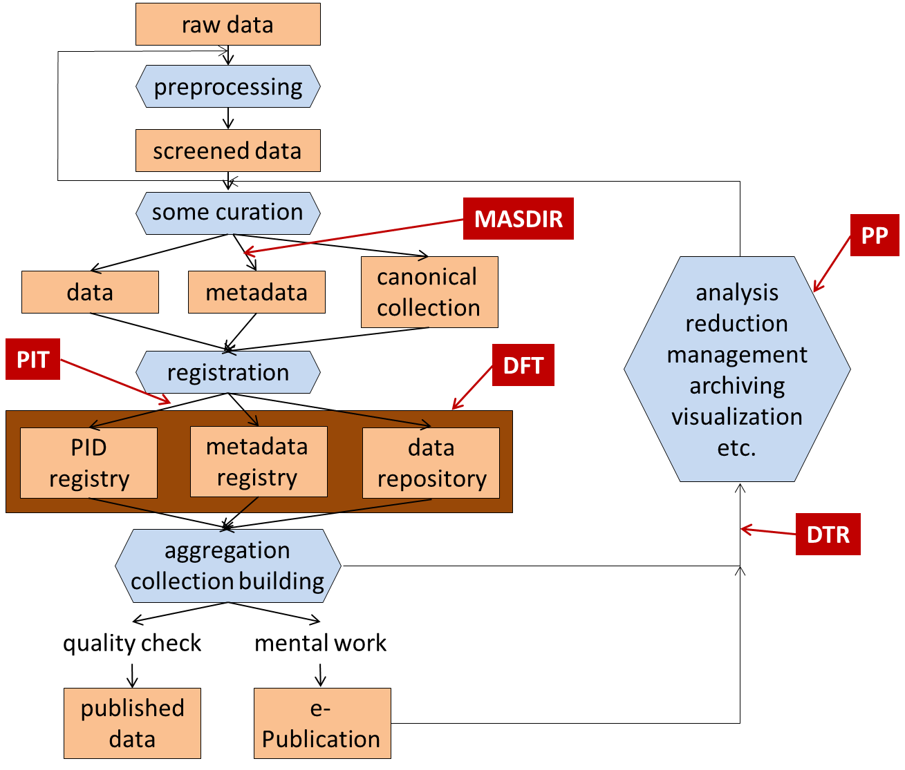
One View of DFT Scope from Process View
Policy defines this?
What elements are in a PID record
How to point to a metadata record
What is in a metadata record at registration
What is replication with identical vs. different bit-streams that may store additional attributes
We have policy for a minimum metadata record?
The rest of data management and the lifecycle?
Other WGs…..

Slide 5
Other Basic Terms -Data Citation as Example
Term Data Citation
Definition Data Citation is the practice of providing a citation to data in a similar way that researchers routinely include a bibliographic reference to published resources.
Examples References [[References::Australian National Data Service [ANDS], [2011], Van Leunen, [1992]
Other sources: quoted from http://www.force11.org/node/4770, cited there as 'adapted from https://www.jstage.jst.go.jp/article/dsj/12/0/12_OSOM13-043/_pdf']]
Related Term: Citable Data is a type of referable data that has undergone quality assessment and can be referred to as citations in publications and as part of Research Objects.
Data Citation
A citation is a formal structured reference to another scholarly published or unpublished work.
In traditional print publishing, a “bibliographic citation” refers to a formal structured reference to another scholarly published or unpublished work.
Typically, in-text citation pointers to these structured references are either marked off with parentheses or brackets, such as “(Author, Year),” or indicated by superscript or square-bracketed numerals although in some research domains footnotes are used. Such citations of a single work may occur several times throughout the text. The full bibliographic reference to the work appears in the bibliography or reference list, often following the end of the main text, and is called a “reference” or “bibliographic reference.” Traditional print citations include “pinpointing” information, typically in the form of a page range that identifies which part of the cited work is being referenced.

Slide 6
Practical Policy WG area examples
Contextual metadata extraction policies
This policy area focuses on metadata associated with files and collections.
The creation of provenance and descriptive metadata defines a context for interpreting the relevance of files in a collection. Depending upon the data source, there are multiple ways to provide metadata:
Extract metadata from an associated document. An example is the medical imaging format DICOM.
Extract metadata from a structured document which includes internal metadata.
Examples are FITS for astronomy, netCDF, and HDF.
Extract metadata by parsing patterns within the text within a document.
Identify a feature present within a file and label the file with the location of the feature that is present within the file.
Contextual metadata extraction
Data access control
Data backup
Data format control
Data retention
Disposition
Integrity (including replication)
Notification..
A start on minimal MD?
Key processes across the data lifecycle?
Extract metadata | Attribute_name
 | Attribute_value
 | Attribute_unit
 | Source_file
 | Source_collection

Slide 8
Data LifeCycle define all stages in the existence of digital data from creation to destruction and chained operations Workflows with LC
Core definitions then might include….
Curation : The activity of, managing and promoting the use of data from its point of creation, to ensure it is fit for contemporary purpose, and available for discovery and re-use.
For dynamic datasets this may mean continuous enrichment or updating to keep it fit for purpose.
Higher levels of Curation will also involve maintaining links with annotation and with other published materials.
Archiving : A curation activity which ensures that data is properly selected, stored, can be accessed and that its logical and physical integrity is maintained over time, including security and authenticity.
Preservation : An activity within archiving in which specific items of data/collections are maintained over time so that they can still be accessed and understood through changes in technology.
Interoperability: The ability of a system to accept and send services and to use the services so exchanged to enable them to operate useful. ISO TC204, document N271)

Slide 9
The Basic 4 Part Model (should also note Actors like User as needed)
Process
Infrastructure
Uses
Transformed
Data
Data
Process
Produces
Modifies
Standardized relations

Slide 10
Illustrating the Basic 4 Part Model
Registry
Uses
Registered
Data
Raw
Data
Registration
Process
Produces
Modifies

Slide 11
Data Transformed to Information (Note, for now our detailed Processes are what Practical Policy has identified)
Representation Object =
Process Infrastructure
Uses
Information
Object
Process
Data
Object
Produces
Modifies

Slide 12
Notional Core Diagram Reflecting Data Lifecycle and RDA WGs
Metadata Types
PIT
WG
PID Types
Curation Types?
Citation?
Provenance Types?
Uses
DTR
WG
Uses
Raw
Data
Initial Process & Registration
?
Type Registries
Archives…..
Modifies
Metadata Registries
MDSD
WG
Data Repositories
Referable Data…
Collection repositories
User/
manager
Data & Metadata Management
Practical Policies : Divided by Policy Types such as “Manage data sets in a repository”
PP WG
Curation/Provenance policies…..

Slide 13
Manage Data Sets within the Data Lifecycle
Any of these concepts might be defined as part of DFT
Data Types
Data Repositories
Digital Object/Data Management
DO Naming & descriptive metadata
DO representation & administrative metadata
replication of digital objects
DO retention, disposition, integrity
DO arrangement
DO provenance metadata
DO access controls
User/
manager
Practical Policies: Manage data sets in a repository

Slide 14
Metadata Catalogs within the Data Lifecycle
Metadata Registries/
Directories/Catalogs
Data Repositories
Metadata Types
Metadata Management
reserved
vocabularies
metadata organization in tables
metadata properties (creation date, access control, ownership).
metadata schema
User/
manager
Practical Policies: Manage Metadata Catalog

Slide 15
Building Data Collections
Data Repository
Data Citationetc…
Collection Repositories
Metadata Repository
Digital Object/Collection Management
Generate PID for digital collection object
Collection Naming & descriptive metadata including composition & arrangement
Collection representation & administrative metadata
Collection provenance metadata including data source for collection
Collection access controls
User/
manager
Practical Policies: Collection Building and Management

Slide 16
Terminological Issues
Community discussion and Better Definitions
5 steps vocabulary process from scope & requirements to tool building and population to:
Focused Vocabulary Design Process and Community Agreement (at and after 3rd Plenary)
Refinement & Maintenance (ongoing)
Draft Vocabulary Publication and Review (4th Plenary)

Slide 17
Still Relevant From P2 - Vocabulary Analysis Process
Identify concepts and concept relations implied by collected terms;
Analyze and model concept systems on the basis of identified concepts and concept relations that are used to understand a term and its referent;
Establishing representations of concept systems through concept diagrams;
Craft concept-oriented definitions as a concept base;
Test arrangement in taxonomical class hierarchy(s)
Add essential Properties/Attributes/slots to distinguish related concepts
Link concepts via Relations…..etc.
Associate a designated vocabulary term to each concept (in one or more languages); and,
Document the vocabulary in an agreed upon form,
perhaps starting as a structured glossary and support concept models
Adapted liberally from ISO TC 37 Standards Basic Principles of Terminology
Notes:
Arguing about ambiguities in the word 'context' is fruitless. But the general issues about the multiple senses of words -- or even better *microsenses* -- are fundamental.

Slide 18
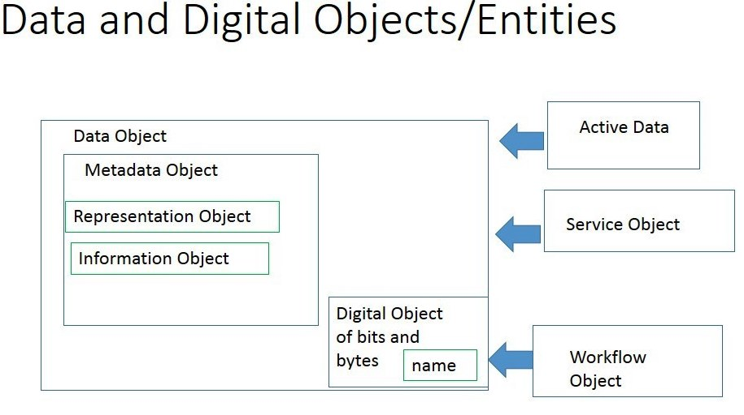
Simple Vocab Entry Example from P2 illustrates taxonomy & other relations, attributes etc.
Data Object
Type of: Abstract Object (Taxonomy)
Sub-types: digital object,……
Definition: n computer science, an object is any entity that can be manipulated by the commands of a programming language, such as a value, variable, function, or data structure. (With the later introduction of object oriented programming the same word, "object", refers to a particular instance of a class)
http://en.wikipedia.org/wiki/Data_object
Definition 2: a Data Object is a dataset
Equivalent terms (other languages) ...
Attributes….metadata record with data object name, local ID, PID, representation info, checksum…..
Relations a data element isPartof Data Object….
Examples/Instances include: repository metadata, data models, databases, tables, views, files, entities, columns, data elements, and attributes.
(Source http://www.indiana.edu/~dss/Services/Naming/nvgglossary.html)

Slide 19
Backup Slides

Slide 20
Vocabulary Design Process & Vocabulary Qualities
Both analysis and design may employ conceptual modeling to capture the essential meaning and structure of the descriptions of the vocabulary.
The product of this is some form of conceptual model.
Desired Qualities
Adequate capture of content intuitions, expressed by domain experts,
in an understandable forms
includes details on constraining descriptions
Uses well defined relations, taxonomic and others
Illustrate with examples
Rigorous – stands up to rational analysis
Minimally redundant - no unintended synonyms

Slide 21
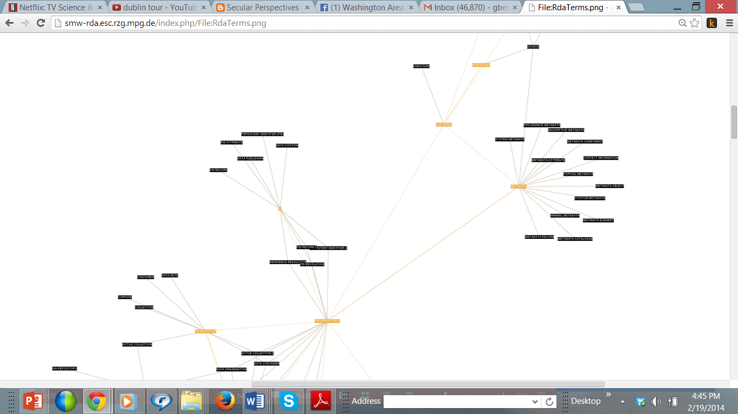
Overview of Term Development
Scope
Terms from
Model Papers
Placed In Tool
Getting Defs
organized for
review
Digital Object | A digital object is composed of structured sequence of bits/bytes. As an object it is named. This bit sequence can be identified & accessed by a unique and persistent identifier or by use of referencing attributes describing its properties.
Analysis and Revision Process
Term Definition Tool prototyped and developed at Rechenzentrum Garching (RZG) der Max-Planck-Gesellschaft
Defs & Refinement
Starter areas and items :
Persistent Identifiers (PIDs and types)
Digital Object - Data Object
Collection - Data Set - Aggregation
Repository (Registries and related Policies)

Slide 22
Conceptual Spaces
property
contains_a
attribute
data
stream
has_a
metadata
record
PID
record
is_equal
data
object
has_a
has_a
is_a
bit
stream
has_a
digital
object
service
object
has_many
is_a
instance
of a bit
stream
is_a
is_a
informational
object
is_part_of
Refinements
aggregation
is_a
is_equal
data
set
collection
is_equal
corpus
Peter’s Original

Slide 23
Digital Object (aka Digital Entity) is composed of structured sequence of bits/bytes. As an object it is named. This bit sequence can be identified & accessed by a unique and persistent identifier or by use of referencing attributes describing its properties.
Note Digital Entity definition from X.1255 ITU standard “machine-independent data structure consisting of one or more elements in digital form that can be parsed by different information systems; the structure helps to enable interoperability among diverse information systems in the Internet.”
Metadata is a type of data object that that contains attributes describing properties of an associated data or digital object. It may contain as key the persistent identifier of that associated object. The association between a data object and metadata is that the content of the metadata describes the data object. Metadata may serve different purposes, such as helping people to find data of relevance - discovery (Michener 2006) or to bring data together – federation.
A list of used include:
Discovery, Access, Selection, Licensing, authorization, Quality, suitability and Provenance, reproducibility.
Data properties, both internal and external, are types of metadata as is transactional information about data.
Ref; Michener, W.K. 2006
Data Object is a type of digital object that included the named bits of a digital object but also has representation object allowing processing of its information content.
Information that maps a Data Object into more meaningful concepts" (OAIS) — makes humanly-perceptible properties happen
Examples: file format, encoding scheme, data format, encoding scheme, data type

Slide 24
Representation Object provide some context for a data object. It contains provenance, description (e.g. format, encoding scheme, algorithm-Brown, 2008), structural, and administrative information about the object. This is a form of metadata.
Brown, A. (2008). White paper: Representation information registries. Retrieved June19, 2009, from http://www.planets-project.eu/docs/reports/Planets_PC3-D7_RepInformationRegistries.pdf
Service Object (Code Object) is a type of digital object containing executable code, considered as a unit.
Note: Under specific circumstances a service object can be viewed as a data object.
Information Object is a type of Data Object which includes the object’s metadata in the Object.
OAIS example, a digital image in TIFF format can only be rendered as an image using software which has been designed to interpret the bitstream in accordance with the TIFF format specification. In other words, the logical Information Object (the image) can only be derived from the physical Data Object (the bitstream) via a process of interpretation. OAIS uses the term Representation Information to describe the knowledge base required for this interpretation.
Active Data denotes virtual units of data objects that are created dynamically by executable code.
Active data may be viewed as a product from executing the workflow. It may thus also be called a "dynamic data object"
Workflow object A Text file listing the chained operations. (too specific to RENCI)

Slide 25
9. Aggregations
Digital Object Aggregation (aka aggregation) is a structured bundle of distinct data/digital objects.
Digital Collection is a type of aggregation. It is also a Digital Object with a PID to be referable and metadata describing at a minimum its aggregation properties.
Gappy Data is an attribute of data collections or sets indicates that it is incomplete at its time of registration and which is completed at unpredictable moments.
Note: Eudat has a definition that might be used.
Active Collection is a type of collection that is being generated dynamically by executable code and results in what some call a dynamic data object.
Data/Digital Sets is a type of managed data collection. It is the basic unit of managed data and has a persistent identifier and metadata.
Alternative Dataset: A collection of data, published or curated by a single agent, and available for access or download in one or more formats.
Compound Data Object/digital objects are bounded aggregations of resources and their relationships
Data Catalog is a curated collection of metadata about datasets.

Slide 26
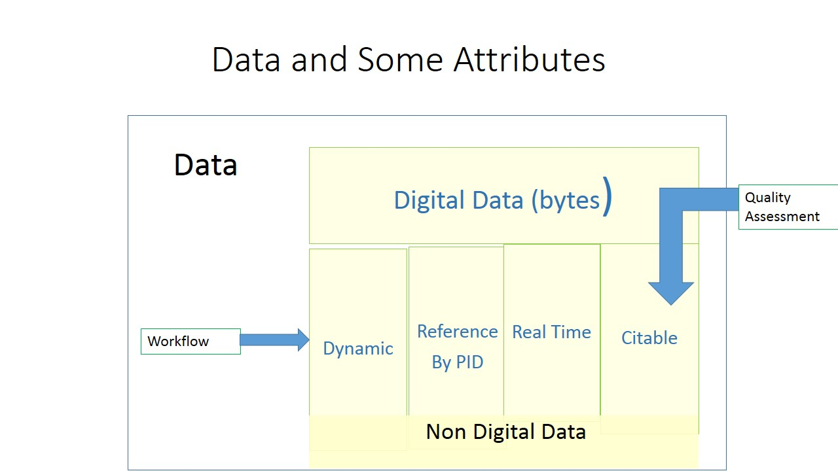
1 Basic Digital & Data Concepts data is inherently collective so one could be saying data collection as well as data
Digital Data refers to a structured sequence of bits/bytes that represents information content. In many contexts digital data and data are used interchangeably implying both the bits and the content.
Real-Time Data is data/data collection which is produced in its own schedule & has a tight time relation to the processes that create it and that require immediate actions. Timeliness such as real time is an attribute of data.
Dynamic Data is a type of data which is changing frequently and asynchronously.
Note1: EUDAT has defined DD since it occurs in many data creation situations and needs special treatment.
Note2: Dynamic data has also been used in the context of Workflow- workflow that is executed a "dynamic data object", or you can call the results from executing the workflow a "dynamic data object"
Referable Data is a type of data (digital or not) that is persistently stored and which is referred to by a persistent identifier. Digital data may be accesses by the identifier. Some data objects references may access a service on the object (OAI-ORE).
Citable Data is a type of referable data that has undergone quality assessment and can be referred to as citations in publications.

Slide 27
More Aggregation Types
Data Container is a type of data structure used to store data collections for particular uses.
File is a named and ordered sequence of bytes that is known by an operating system. A file can be zero or more bytes and has one file format, access permissions, and usually file system statistics such as size and last modification date.
Corpuse (Corpus)is a type of collection that has a meaningful value to a researcher. It may or may not be digitally represented.
Data Container is a type of data structure used to store data collections for particular uses.

Slide 28
Data Replication In Repository
Associated Metadata Repositories
Data Repository
Data Sources
Data Sources
Data Sources
Original MetaData
Metadata Management
reserved
vocabularies
metadata organization in tables
metadata properties (creation date, access control, ownership).
metadata schema
User/
manager
Practical Policies: Manage Data Replication in Repository

Slide 29
Query of Local Data & Metadata Repositories
User/
manager
MD
Query Processing
Metadata Repositories
MD Query
Data Query Processing
User/
manager
Local Data Repositories
Data Query
Practical Policies: Local Query Operations

Slide 30
Query of Remote Data Repositories vis PID
PID
Query Processing
PID Registry
Data Query
Data Repository
User/ manager
Practical Policies: Remote (Repository) PID Query

