Slide 1
TeD-T: Term Definition Tool http://dft-tool.rd-alliance.org
Raphael Ritz, MPCDF
DFT IG
P11, Berlin, March 2018

Slide 2
At P8: What’s next? - PIDs??
Should we assign PIDs?
If so, to what?
  HTML export
Granularity (Collections ⬄ Part Ids)
  The whole document?
  Each term?
  Each definition?
Versioning

Slide 3
At P9: First Approach
http://dx.doi.org/20.500.11946/tedt-barcelona
One PID for a static HTML Snapshot of the tool’s content.

Slide 4
At P10: Second Release
https://smw-rda.esc.rzg.mpg.de/dft-1.0.html
A static HTML Snapshot of the tool’s content with PIDs assigned to each term.
Example: 21.11109/dft/1.0/Collection

Slide 5
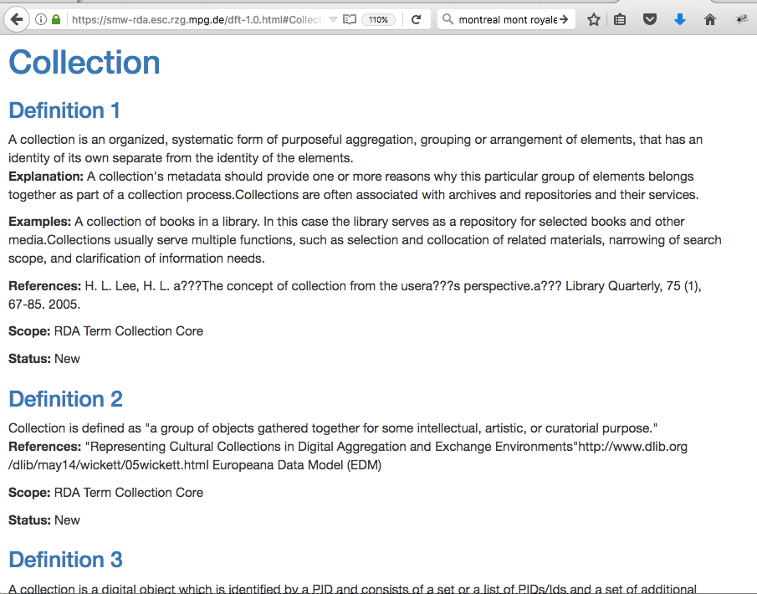
https://smw-rda.esc.rzg.mpg.de/dft-1.0.html#Collection

Slide 6
Now at P11: First Approach again
https://hdl.handle.net/21.11109/dft-2.0
One PID for a static HTML Snapshot of the tool’s content as part identifiers can be made to work, e.g.:
https://hdl.handle.net/21.11109/dft-2.0@#Active_Collection

Slide 7
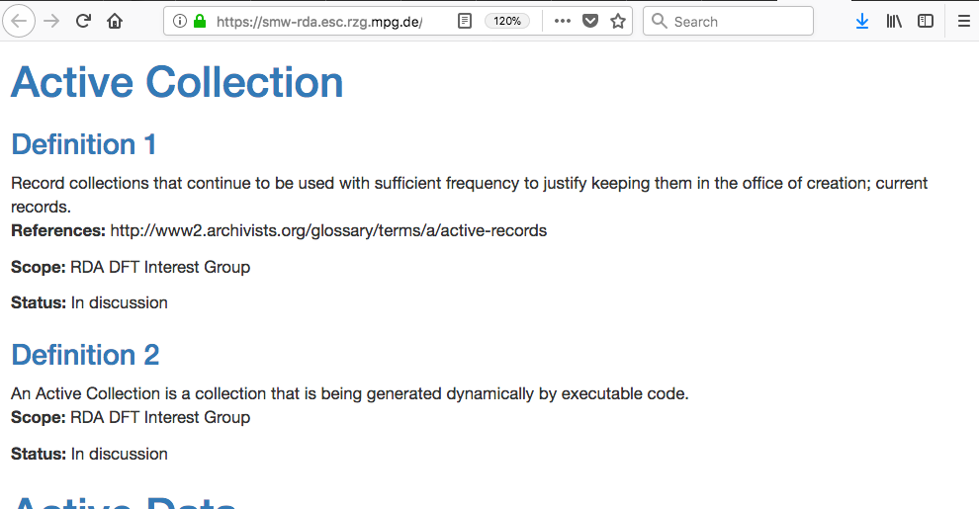

Slide 8
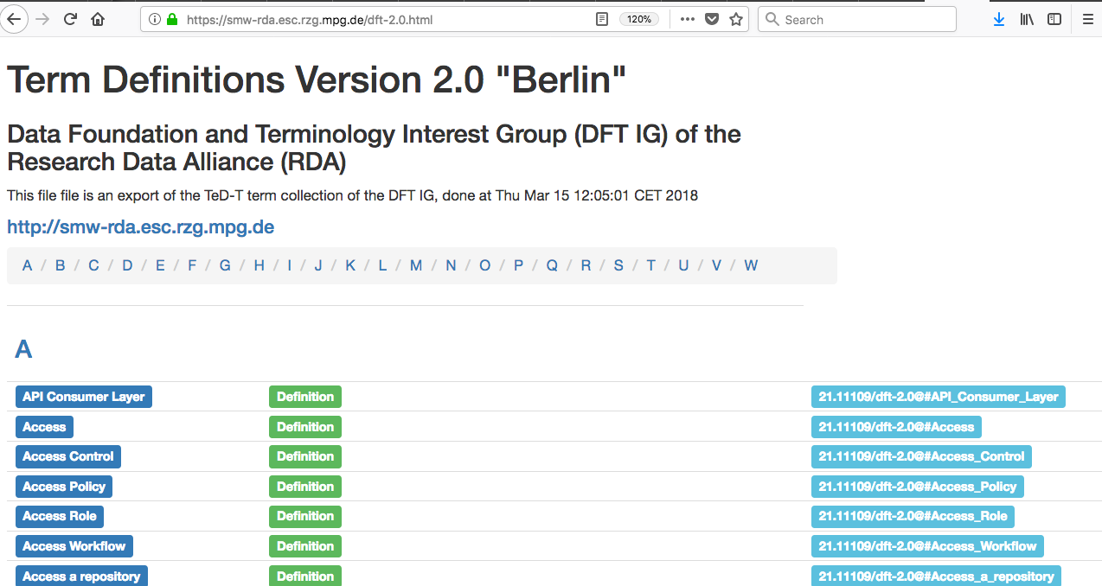

Slide 9
Proposed Conventions
“Speaking PIDs”
  human readable
Structure inspired by URLs
  familiar
Includes version number
  implicit “time stamp”
  allows for evolution
  plan: new release for every plenary
Points to terms, not definitions, but …

Slide 10
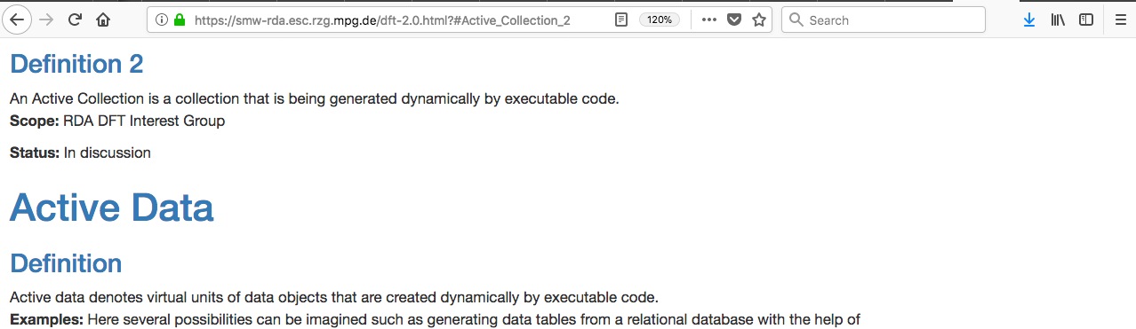
Point to Definitions
… Definitions can be referred to by appending a number, e.g
https://hdl.handle.net/21.11109/dft-2.0@#Active_Collection_2

Slide 11
Open Issues at P10
PIDs for definitions or terms?
Why not part identifiers?
  Can’t be resolved globally (???)
How to establish relationships across releases?
  Collections?
  PID-Versioning?
Naming conventions OK?
… your questions ...

Slide 12
SKOS Export
Work started at P8 in Denver
Stefan Zednick provided a basic script to transform RDF to SKOS
Remaining Issue: cast from terms to concepts …
No progress since

Slide 13
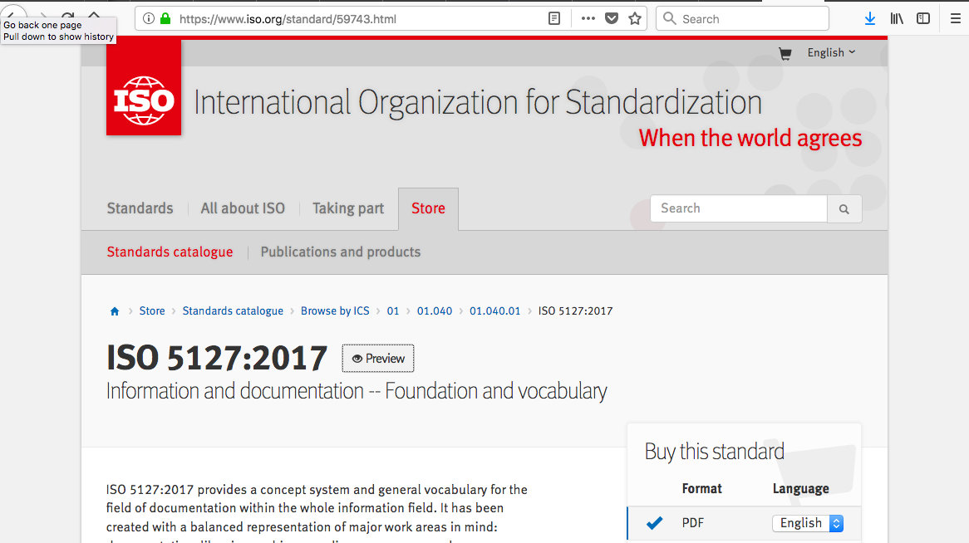
Adoption Case: ISO 5127
https://www.iso.org/standard/59743.html

Slide 14
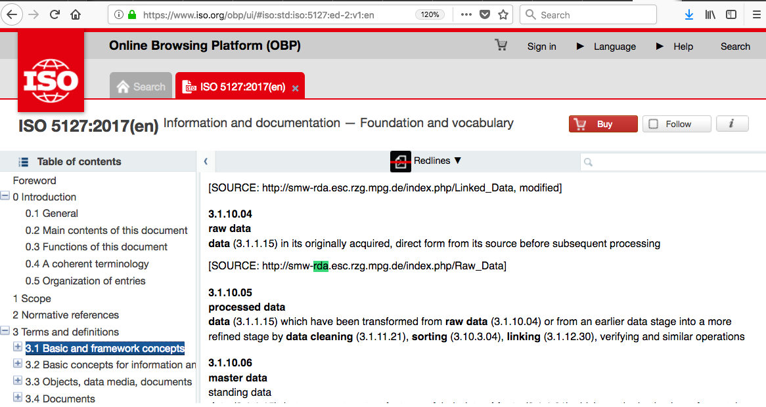
ISO 5127 - Preview
https://www.iso.org/obp/ui/#iso:std:iso:5127:ed-2:v1:en

Slide 15
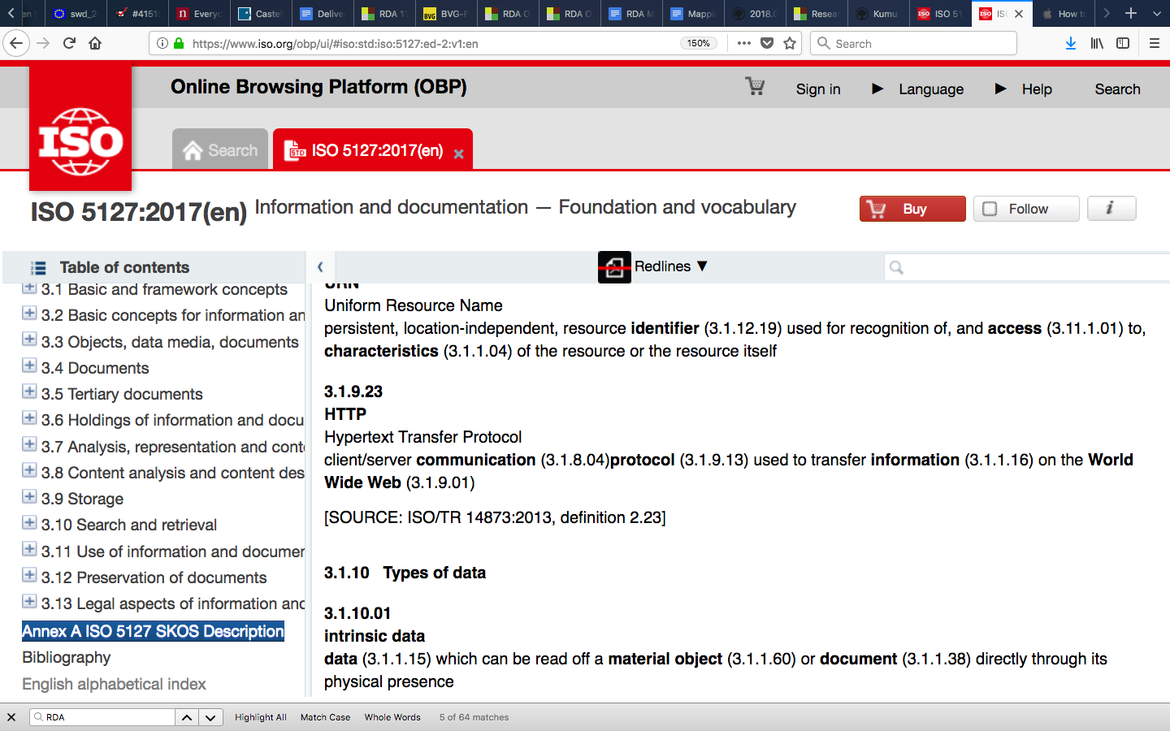
ISO 5127 – SKOS?
https://www.iso.org/obp/ui/#iso:std:iso:5127:ed-2:v1:en

Slide 16
Contacts
Websites
  DFT IG: https://rd-alliance.org/groups/data-foundations-and-terminology-ig.html
  TeDT: http://dft-tool.rd-alliance.org
People:
  Gary Berg-Cross: gbergcross@gmail.com
  thomas.zastrow@mpcdf.mpg.de
  raphael.ritz@mpcdf.mpg.de

Slide 17
Backup slides

Slide 18
Background
Provide an online tool to coordinate and document community contributions
Run by MPCDF
Software stack: Semantic Media Wiki plus Semantic Forms
Customizations:
  Pages have a substructure
  Various overviews
  Simple categorization
New: Download content in multiple formats

Slide 19
Structure of a page
Definition
Explanation
Examples
References
Scope
Status
Possibly multiple times
Plus categorization

Slide 20
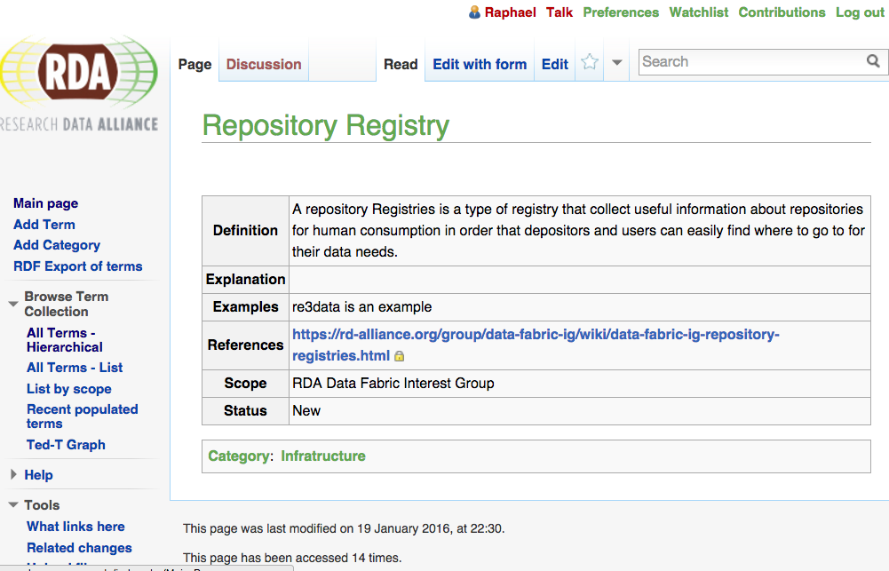

Slide 21
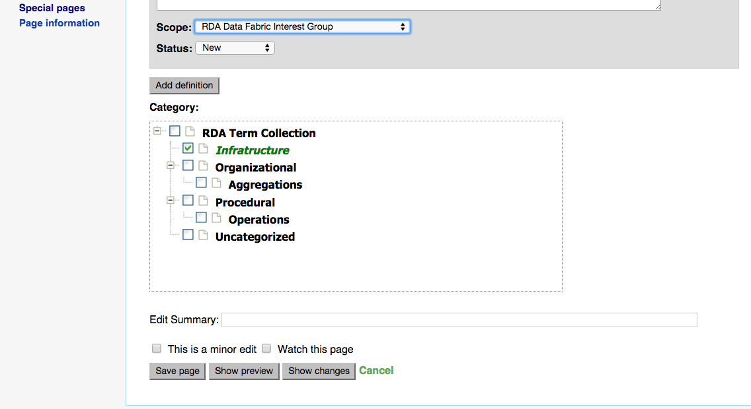
Simple categorization

Slide 22
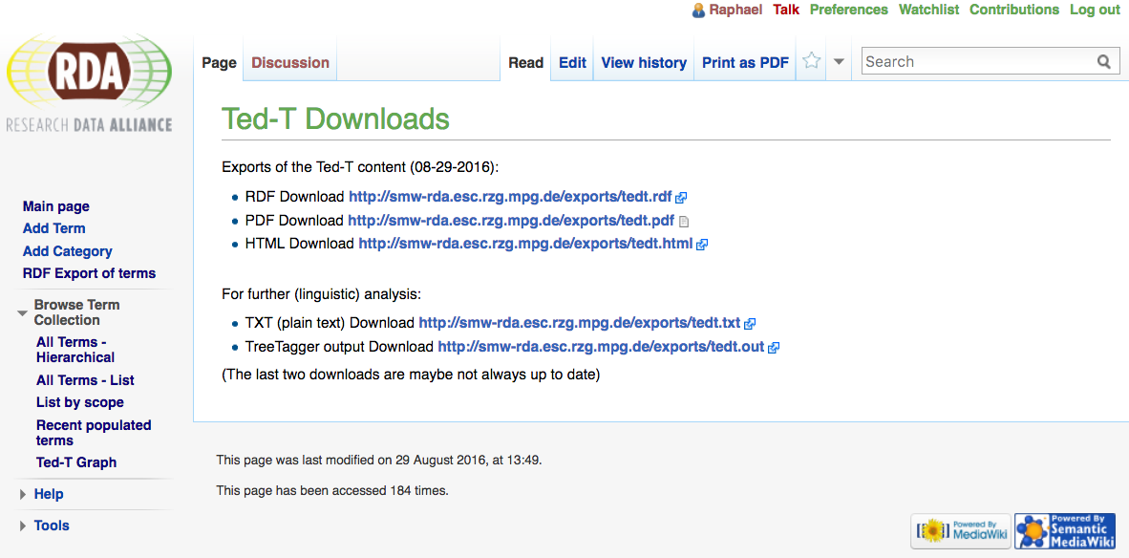
Downloads – work in progress
http://dft-tool.rd-alliance.org/index.php/Ted-T_Downloads

Slide 23
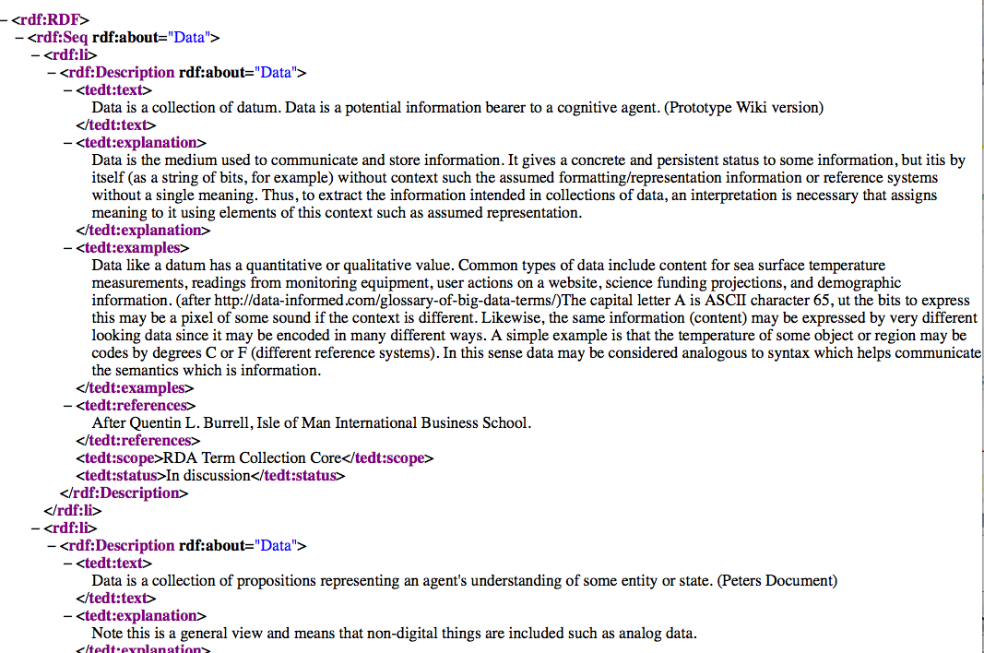
Machine readable: RDF

Slide 24
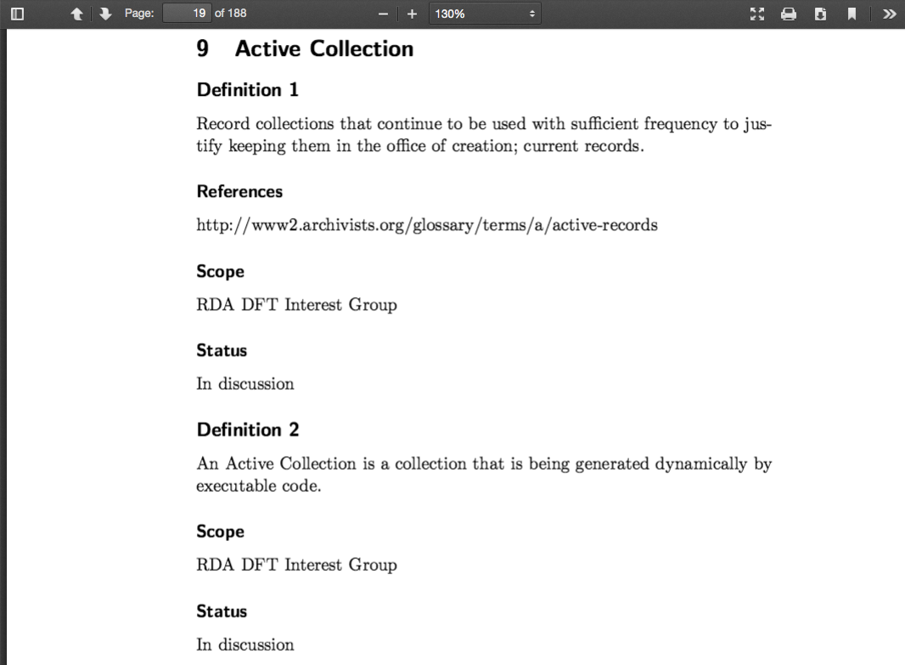
Human readable (1): PDF
Notes:
190 pages

Slide 25
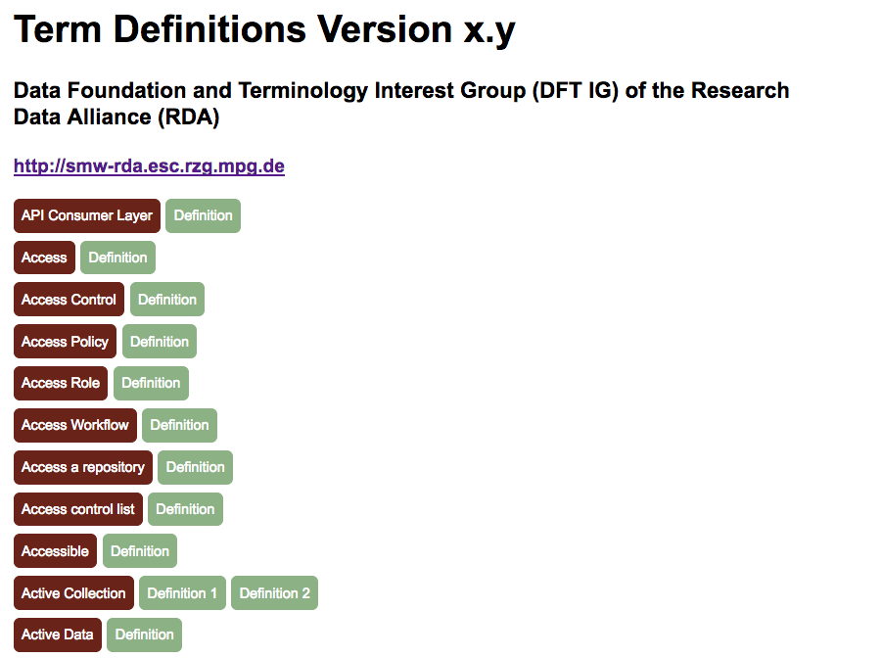
Human readable (2): HTML
http://smw-rda.esc.rzg.mpg.de/exports/tedt.html
Notes:
190 pages

Slide 26
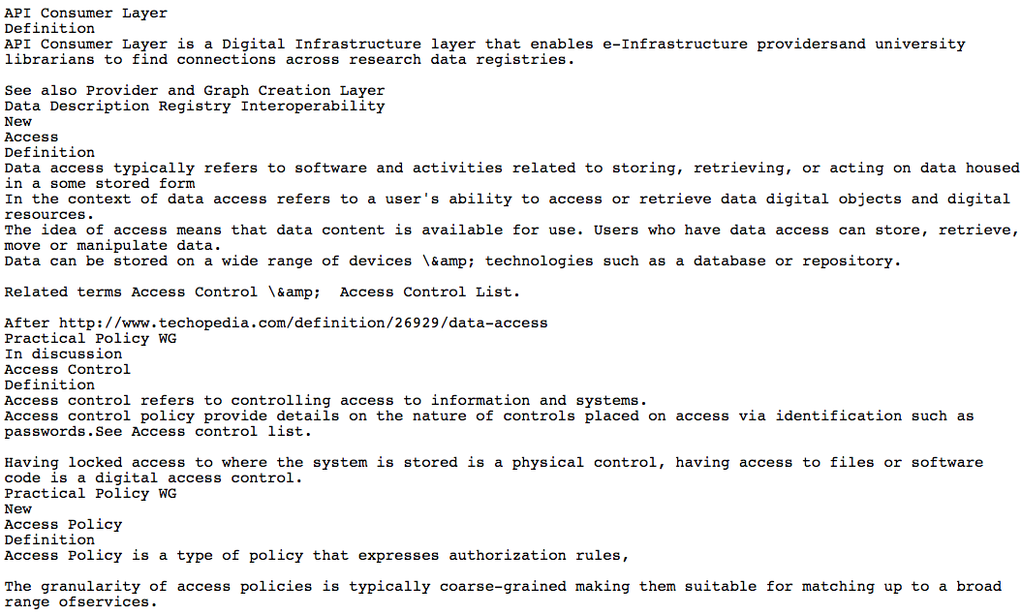
Human readable (3): Plain Text
http://smw-rda.esc.rzg.mpg.de/exports/tedt.txt
Notes:
190 pages

Slide 27
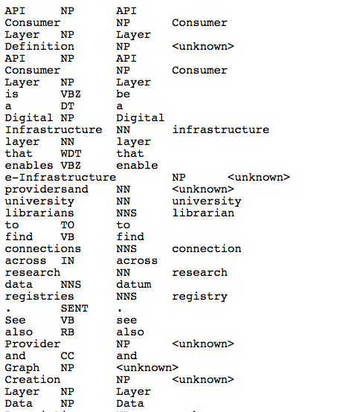
NLP Specific: Tree Tagged
http://smw-rda.esc.rzg.mpg.de/exports/tedt.out
Notes:
190 pages

Slide 28
Connection Points
DTR/PID Information Types (linking versions)
Collections (grouping terms/definitions)
Dynamic Data (tracking changes/additions)
What are your expectations, experiences, use cases?

