Slide 1
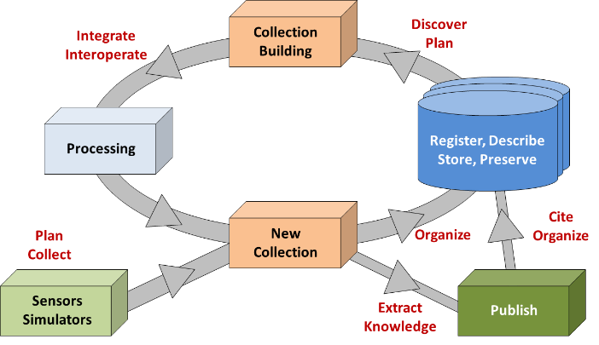
Data Fabric Cycle
Observations
Experiments
Simulations
etc.
This slide indicated the continuous cycle of creating raw data or derived data based on collections of existing data.
Identify components that could improve (stepwise).

Slide 2
Dimensions of Testing: getting to Data Fabrics
RDA produces RDA Recommendations (i.e., outputs)
Some technically-oriented RDA Recommendations have reference software with it, these are starting point
Many technically oriented RDA recommendations do not have reference software, yet are machine actionable (a schema for instance). These also are of immediate interest to data fabric composition.
Other recommendations play important but background roles in early composition
RDA recommend-ation: Reference software
RDA recommendation: Purely human consumption and action
Machine actionable reference
Human consumption needed before being actionable reference

Slide 3
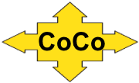
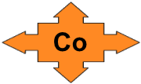
Compositions of components
Composition (or Fabric) A
Composition B
Core
Components
& Services
Specific
Components
& Services

Slide 4
Compositions of components
Given nature of data (can’t do much without understanding it), successful data fabric will likely:
Run on possibly distributed e-infrastructure (EUDAT, NDS, …)
Serve scholarly domain as domain infrastructure
Support multiple projects within that domain
And eventually result in cross-domain research
For 3 and 4 to be realized, composition of 2 must be shared across projects
Composition (Fabric) B

Slide 5
Testbed* (US) to facilitate community evaluation of DTR and PIT service, and to test complex types
* Funding proposal under review

Slide 6
WCRP CMIP6 data scenario
WCRP: World Climate Research Program
CMIP6: Coupled Model Intercomparison Project, phase 6
Ultimately inform IPCC assessment reports
Big community effort: Earth system simulations, run internationally at multiple sites
Estimated ca. 50 PB data volume over next 5 years
PID for every file – 250 Mio. Handles

Slide 7
The publishing process is elaborate and takes a lot of real time
Requirement: Put a Handle in every file header, but not allowed to change files after production phase
CMOR
ESGF publication
ESGF replication
IPCC DDC archive →
CMIP
project storage
Step
LTA
DOI
Phase
Production Phase
Project / Community Phase
Bibliometric Phase
MD Check
M1
M2
M3
M4
Data Check
D1
D2
D3

Slide 8
More details on the registration workflow
Requirement: Put a Handle in every file header, but not allowed to change files after production phase
tracking_id = hdl:21.14100/<UUID>
Lot of time spent on agreements that ensure sanity of PID record
Each object gets a PID and no object outside our control with embedded PID
PID not citable – required metadata not ready
Still: some file headers are extracted and put in the PID record
PIDs are a new development – Handle registration not allowed to interrupt publication process

Slide 9
Make it scalable: Deal with burst events, provide high availability
Notes:
Tobias, What is this PID assembler? How does this fit into the simple workflow that we used yesterday?

Slide 10
Does the idea of common components work in this case?
Yes.

Slide 11
What are the common components in this case?
Object registration
Object management (copy, move, delete)
Collection builder
Classifier (DTR)
register specific community PID profile
register file data types (netcdf, variables)
Object information (end-user)
Landing page – link to further information, enable browsing
Information tool
External addendum (processing; feedback)
Policy provider and enforcer (preliminary objects, LTA)

Slide 12
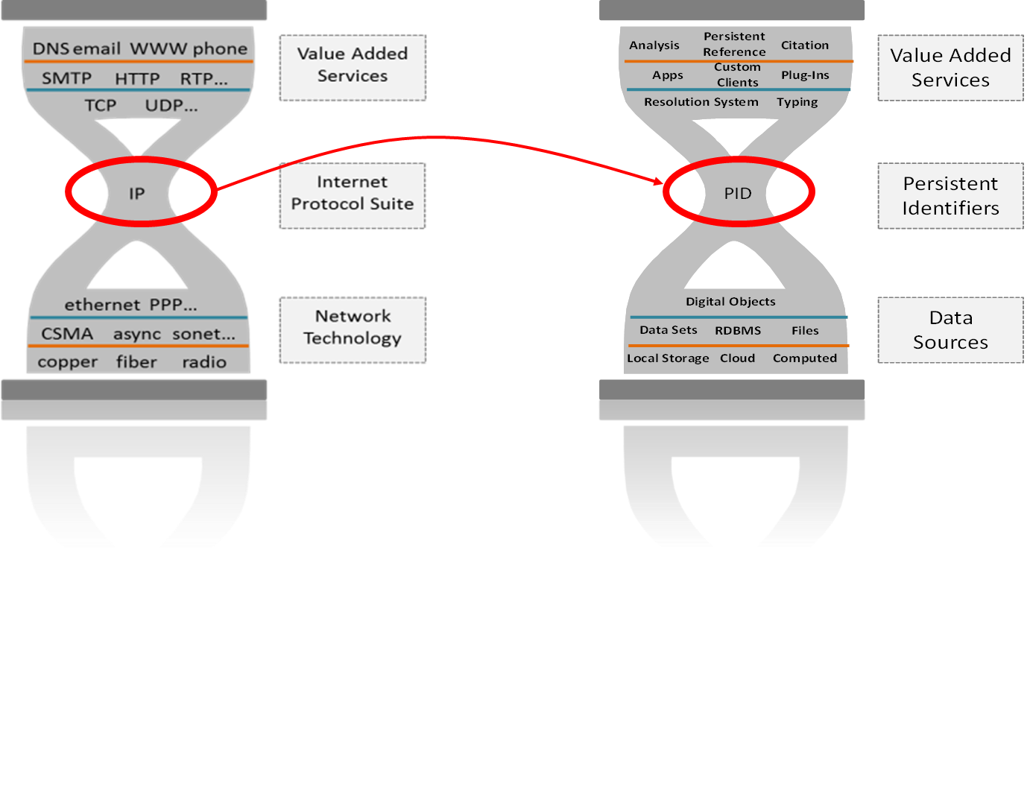
Address Every Object on the Net
Two documents in prep: Report from Workshop, Digital Object Cloud

Slide 13
The DO Cloud
ID: 123…
A
Identifier Service
Identifier Service
ID: 987/…
Repository
Repository
Repository
F
Repository
Identifier Service
Repository
ID: 843…
G
End users, developers, and automated processes
deal with persistently identified,consistently structured digital
objects
which are securely & redundantly managed & stored in the Internet
which is an overlay on
existing or future infor-mation storage systems.

Slide 14
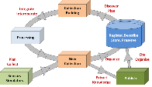
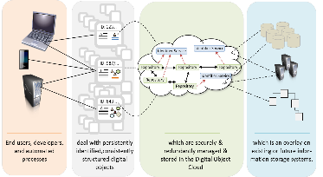
From abstract fabrics to solutions
Common
Components
& Services
Specific
Components
& Services
t-repositories
PID system
MD schemas
MD editors
vocabularies
etc.
Closing
urgent gaps
Global Digital Object Cloud

